Slide 2

Unit 16: Migrating Application Development
Between Environments

Slide 3
Lesson Objectives
After completing this lesson, you should be able to:
Describe the steps involved in migrating an application between environments
Export the application definition, underlying database objects, and data from your development environment
Import the application definition, underlying database objects, and data in the target development environment
Notes:
In this lesson, you learn how to migrate your application between environments. First, you export the application definition and the underlying database objects and data from your current development environment. Then, you import this application definition, database objects and data in to the target development environment. Finally, you test your application in the new environment.

Slide 4



Migrating your Application Development Between Environments: Overview
Notes:
An application written with Application Express can readily be moved from one environment to another. It is normal development practice to move an application from development to test to production. This generally involves exporting the application from development and importing it into the test or production environment. If the latest development also requires changes to database object structures, such as creating a new table or adding a new column, then a separate Database Definition Language (DDL) script should be written for updating the other environments. Similarly, if data needs to be manipulated, such as inserting or updating records, then a Data Manipulation Language (DML) script should be written.
Migrating where you do your application development, for example from on-premise to the cloud, is much the same as the steps required for rolling out a new version of your application to test or production. However, rather than just providing scripts for the deltas between the current production and development environments, you need to create scripts for all of the database objects (DDL) and you need to move all of the data from development into the new environment. This section covers the steps required to move your development environment from one Oracle Application Express installation to another.
To learn about Oracle Database Cloud, navigate to https://cloud.oracle.com. Then, click Database under Platform > Data Management.
Note: You cannot import an application into an earlier release of Application Express. For example, if you are exporting an application from a cloud instance that has Application Express 5.1, you can not import that application into an on-pemise instance that is only running Application Express 4.2. You will need to update the target Application Express environment prior to importing the application.
Check the version of Application Express in both your current development environment and the environment you are migrating to. In any release of Application Express, check the bottom right corner for the version information.

Slide 5
Migrating your Application Development Between Environments: Steps
Exporting the application from the current environment, and importing it into the new environment
Recreating all of the database objects, and then populating the tables with the data from the current environment
Testing the application in the new environment
Notes:
The slide shows steps involved in migrating your application development between environments.

Slide 6
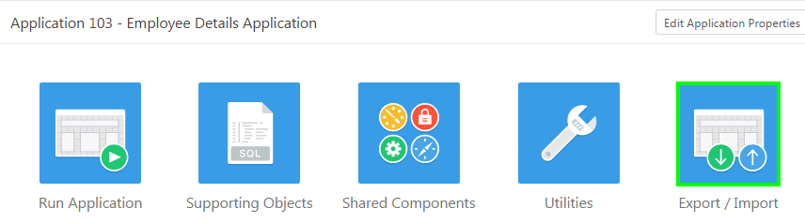
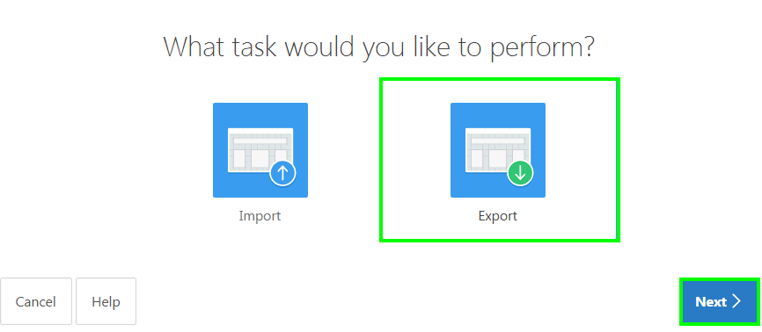
Exporting the Application
1
2
Notes:
An application written in Application Express is stored as meta-data in the Oracle Database. As you define applications, pages, regions, items, and so forth, the definitions are saved in various tables defined within the Application Express Engine schema. When you export an application a single SQL file is created by extracting the application definitions from the meta-data tables. When importing the application, records are inserted (or updated if overwriting an existing application) into the Application Express meta-data tables, of the environment being imported into. Therefore, once an application is imported, all of the application definitions can be reviewed from the Application Builder, and the application can be run immediately. However, running the application will produce errors if the required database objects are not available in the workspace.
Note: The export only captures the application definition, and does not export any of the underlying database objects or data that may be associated with the application. Application Express does include the ability to define installation and update scripts within Supporting Objects. However, developers must manually define these scripts.
To export the application definition from your current development environment, perform the following steps:
Navigate to the Home Page for your current application. Click Export / Import.
Click Export.

Slide 7
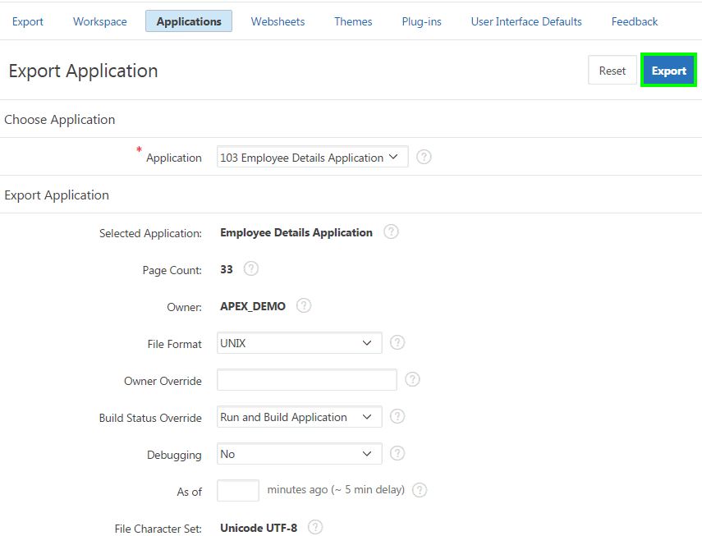
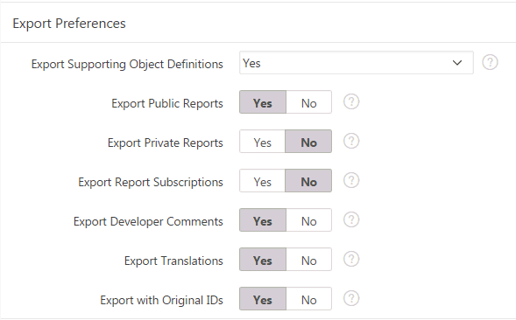
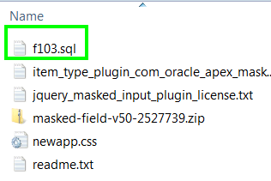
Exporting the Application
3
4
Notes:
Review the application details. The slide shows default selections for export preferences. You may want to set Yes for Export Private Interactive Reports and for Export with Original IDs. Exporting with the Original IDs will allow an export from the target environment to be re-imported back into this current environment, if necessary at some later date. Click Export.
Save the exported file. Your application definition is saved as a .sql file. It is good practice to rename the export file and include a version or date so that subsequent exports do not overwrite previous exports. Creating a subdirectory, specifically for all of the files required for the migration, makes it easier to locate the files when using them within the target environment.

Slide 8
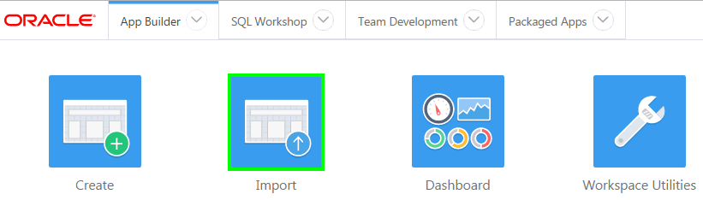
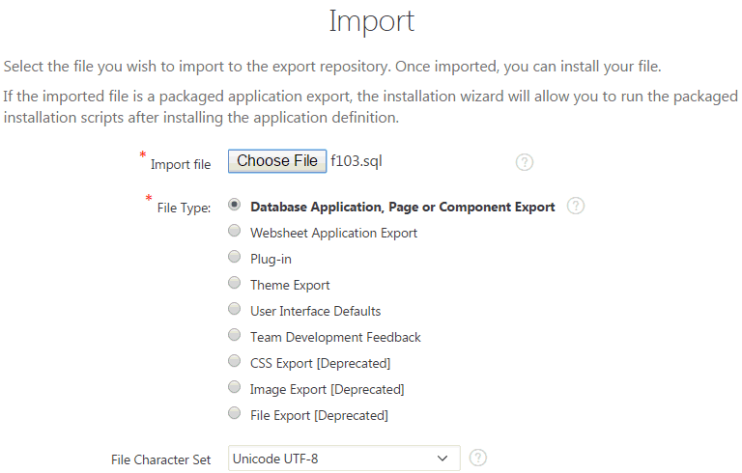
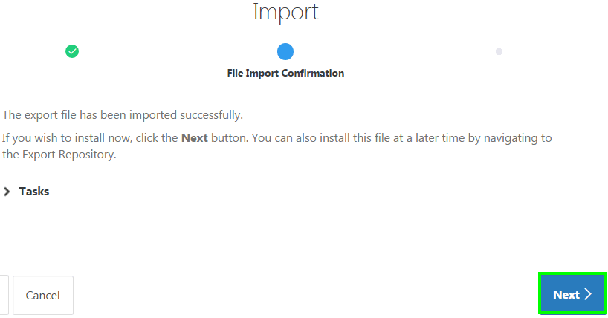
Importing the Application into the Target Environment
1
2
3
Notes:
After exporting the application definition from the current development environment, now you need to import the same into your target APEX environment. Perform the following steps:
Log into your target Application Express environment. Navigate to the Application Builder Home Page. Click Import.
For Import File, click Choose File. In the operating system File Browser, navigate to the subdirectory where you saved the export file. Locate the export file, and double-click the file or click the file and then click Open. Note: Some of the labels outlined in the steps may be different based on the browser you are using. Verify that the File Type is Database Application, Page or Component Export. Click Next.
For the File Import Confirmation step, click Next.

Slide 9
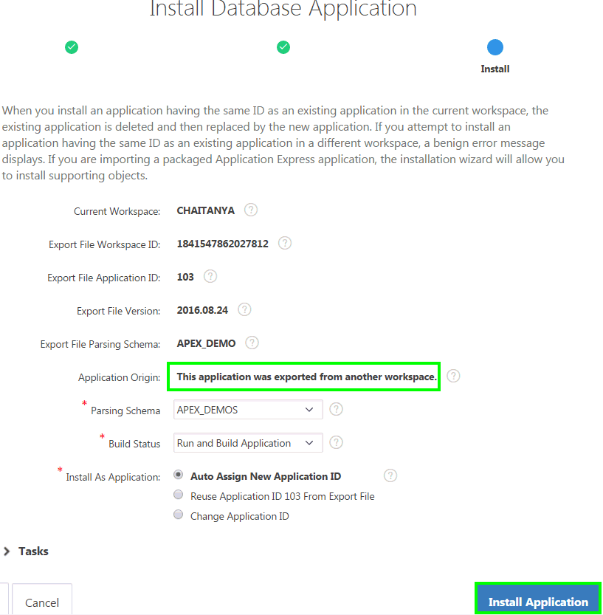
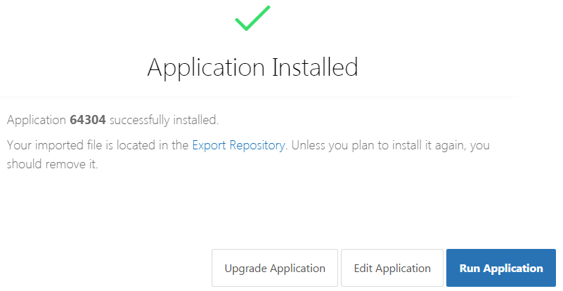
Importing the Application into the Target Environment
4
5
Notes:
The slide shows the default selection in the wizard. For ease of reference it is preferable to keep the same Application Id in the target development environment. However, this may not be viable, in which case assigning a new application Id will need to be used. For the Install step, verify the Parsing Schema is correct, and verify the Build Status is Run and Build Application. Click Install Application. Note: The majority of Application Express workspaces are only associated with a single schema. As such the Parsing Schema will not need to be updated as it will default to the only associated schema.
You have installed the application in your target environment. However, until you have imported the database objects (tables) and data, you will get errors when you try and run the application. To view the application pages, click Edit Application.

Slide 10
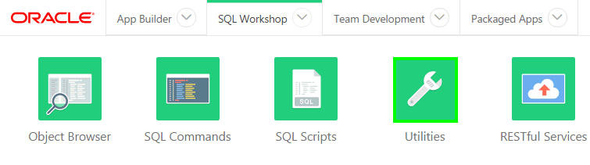
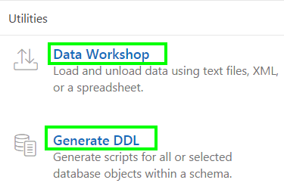
Migrating the Database Objects and Data
Notes:
The two primary ways to move the database objects and data from one environment to another, for a single application, is using either Oracle SQL Developer, or Application Express > SQL Workshop.
Oracle SQL Developer is a free integrated development environment that simplifies the development and management of Oracle Database in both traditional and Cloud deployments. SQL Developer is familiar to most professional Oracle developers and DBAs, but perhaps not to business developers.
Oracle Application Express includes SQL Workshop which also provides capabilities for managing database objects. SQL Workshop is designed for application developers who do not have direct access to the underlying Oracle Database, such as in hosted environments such as http://apex.oracle.com.
This lesson covers how to migrate the database objects and data using Application Express.
Note: Other techniques are available if moving complete development environments, or whole workspaces. For example, if using Oracle Database 12c Multitenant Option, you may be able to simply move the Pluggable Database (PDB) from one environment to another using Oracle Enterprise Manager 12c. In addition, there are a number of techniques available to move tables with large data volumes between environments.
The slide shows SQL Workshop. To migrate database objects, you first create scripts that include their DDL. SQL Workshop > Utilities > Generate DDL provides you the wizard to generate scripts for all or selected database objects within a schema.
To migrate data, you first unload data from your current development environment. SQL Workshop > Utilities > Data Workshop provides you the wizards to unload data using text tiles, XML, or a spreadsheet. This lesson covers unloading data into XML.

Slide 11
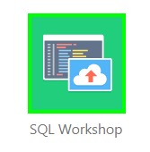
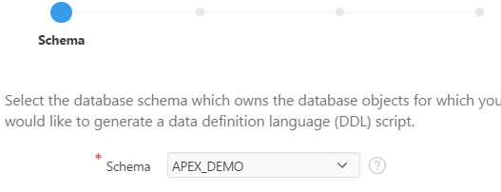

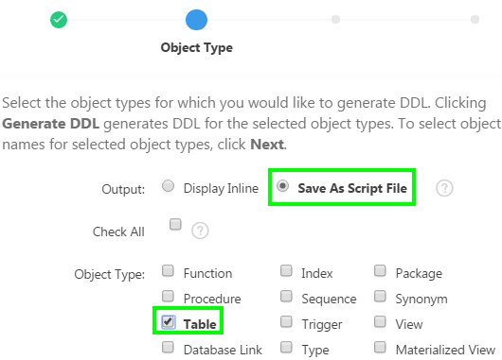
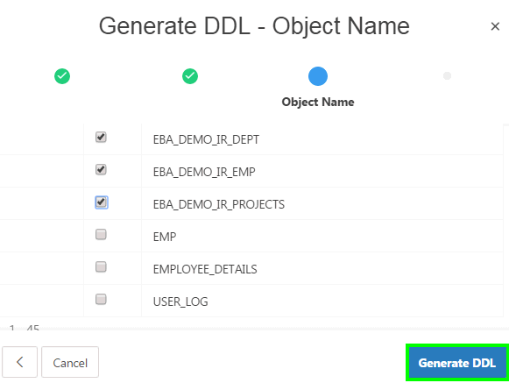
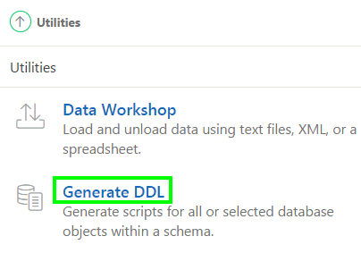
Migrating the Database Objects: Tables
4
5
1
6
7
2
3
Notes:
The SQL Workshop within Application Express provides all of the tools required for migrating database objects and data. In the slide, you generate DDL for the database tables. You use SQL Workshop to create a script file, for creating the table definitions. Perform the following steps:
Log into your current Application Express development environment. Click SQL Workshop.
Click Utilities.
Locate Generate DDL. Click Generate DDL.
Click Create Script.
Verify the Schema name is correct, and click Next.
For Output select Save As Script File, and for Object Type check Table. Click Next.
Select the underlying database tables for your application. Click Generate DDL.

Slide 12
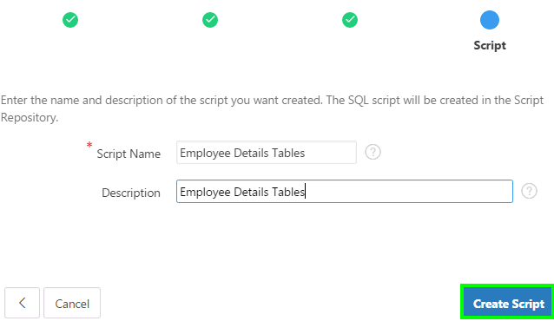
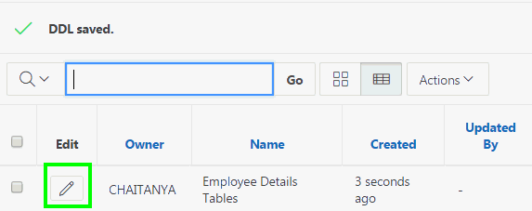
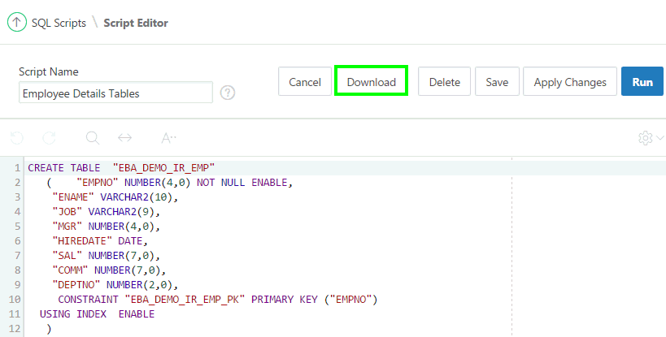
Migrating the Database Objects: Tables
9
8
10
Notes:
For Script Name, enter a meaningful name. Optionally enter a description. Click Create Script.
After a short wait, generally less than a minute, you will be returned to SQL Scripts. The page shows the new script just created. Click the Edit icon (pencil) on the recently created script.
Click Download and save the DDL file to your directory.

Slide 13
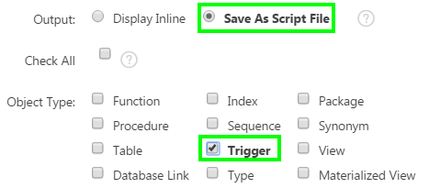
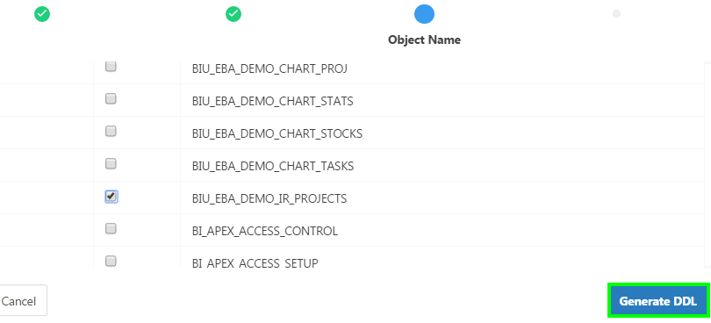
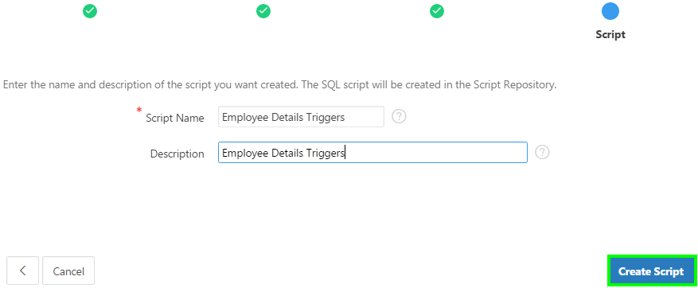
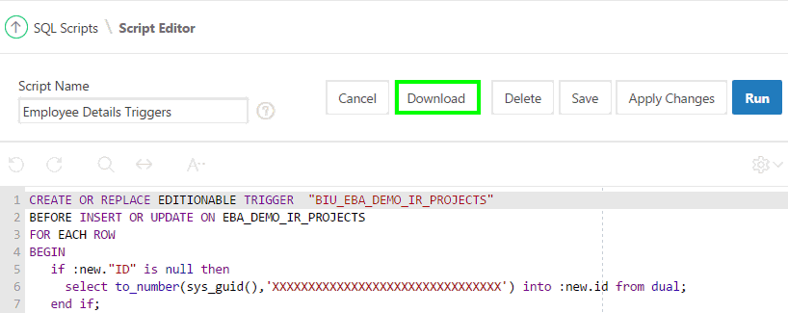
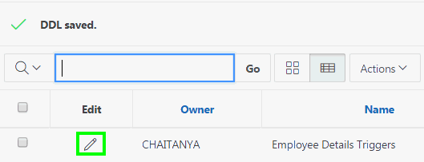
Migrating the Database Objects: Triggers
1
2
3
5
4
Notes:
Now, you use SQL Workshop to create a script file, for creating the trigger definitions. Navigate to SQL Workshop > Utilities > Generate DDL and click Create Script. Verify the Schema name is correct, and click Next. Then, perform the following steps:
For Output select Save As Script File, and for Object Type check Table. Click Next.
Select the underlying database triggers for your application. Click Generate DDL.
For Script Name, enter a meaningful name. Optionally enter a description. Click Create Script.
After a short wait, generally less than a minute, you will be returned to SQL Scripts. The page shows the new script just created. Click the Edit icon (pencil) on the recently created script.
Click Download and save the DDL file to your directory.

Slide 14
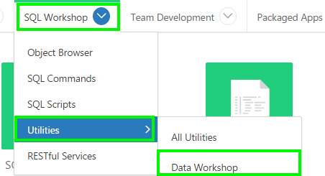
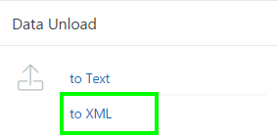
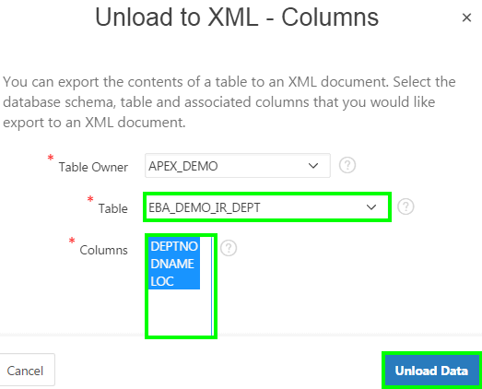
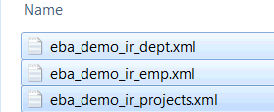
Migrating the Data
2
1
3
Exported XML documents
Notes:
You exported and saved the underlying database objects of your application. Now, you export the data from your current development environment. In the slide, you use SQL Workshop to create XML files for your data. Perform the following steps:
In the Application Express main toolbar, click the SQL Workshop down arrow, select Utilities and then select Data Workshop.
Under Data Unload locate to XML. Click to XML.
Verify the value for Table Owner is the correct schema. For Table select the underlying database table from which you want to unload the data. Select all of the columns. Click Unload Data. Save the XML file.
Repeat steps 2 and 3 until you unload data from all of the application tables.

Slide 15
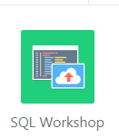
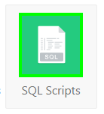

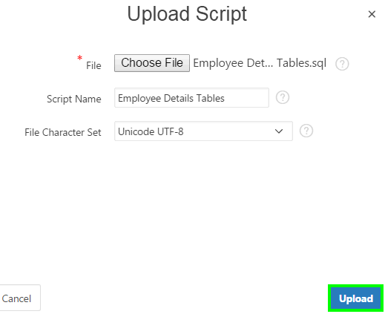
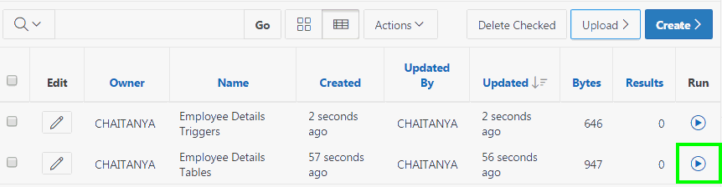
Recreating the Database Objects in the Target Environment
3
1
2
5
4
Notes:
Now that you have exported the database objects and data from your current development environment, you are ready to load and create them in to the target APEX environment. You use SQL Workshop to load and run the script file, for creating the table and trigger definitions. The slide shows steps to recreate the database tables in the target environment. Perform the following steps:
Log into your target Application Express development environment. Click SQL Workshop.
Click SQL Scripts.
Upload the script to create the tables first. Click Upload.
For File, click Choose File. In the operating system File Browser, navigate to the subdirectory where you saved the table script file. Locate the table script file, and double-click the file or click the file and then click Open. Click Upload.
Click the Run icon to the right of the script you uploaded. Click Run Now. Click the View Results icon for the script you just ran. Make sure there are no errors.
Repeat these steps to upload the script to create the triggers. Run the script and make sure the triggers are created in the target environment.

Slide 16
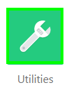
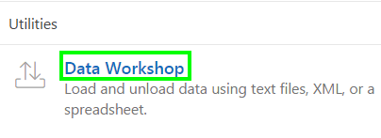
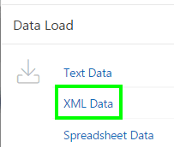
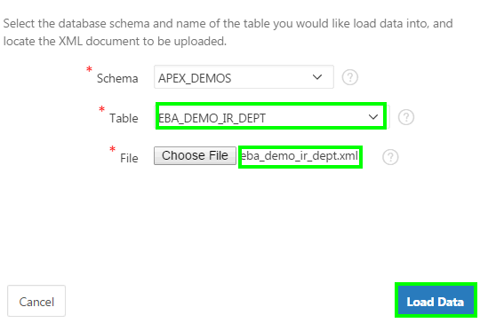
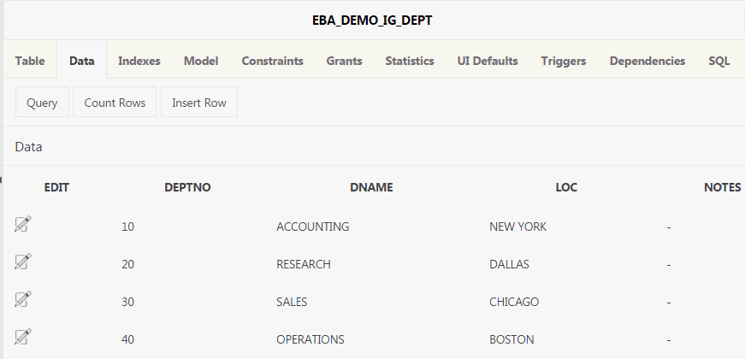
Migrating Data to the Target Environment
4
1
2
3
6
5
Notes:
Currently the tables you created do not have any data. Use the XML files you created to populate the tables. The order in which the tables are populated is crucial, to ensure referential integrity does not prevent records loading.
Perform the following steps:
On your Workspace home page, click SQL Workshop
Click Utilities
Click Data Workshop
Under Data Load, locate XML Data. Click XML Data
Verify the value for Schema is correct. For Table, select the table name for which you want to populate the data first in order. For File, click Choose File, locate the XML file for the corresponding table that you selected, and double-click the file or click the file and then click Open. Click Load Data.
Repeat steps above to load data in to all of the underlying tables of the application. Review the tables in SQL Workshop > Object Browser to ensure the data has loaded successfully in all the tables.

Slide 17
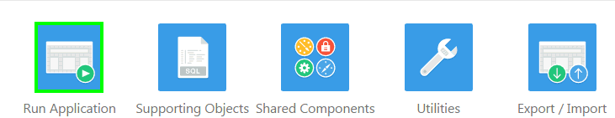
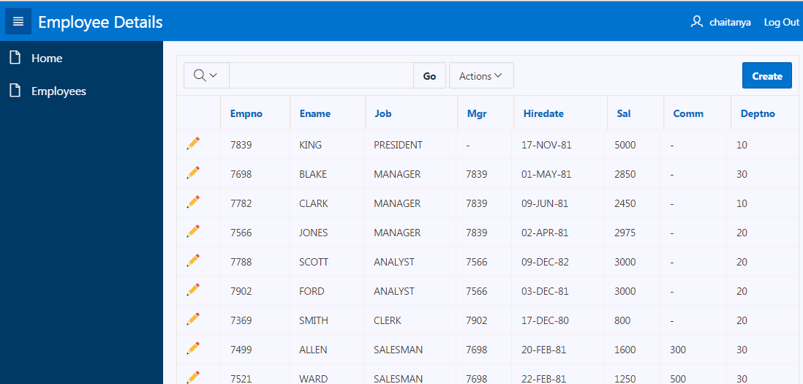
Testing the Migrated Application
Notes:
The target development environment should now have everything you need to continue developing the application. In the target APEX instance, navigate to the App Builder Home Page, click the Run icon for the application you migrated.

Slide 18
Summary
In this lesson, you learned how to:
Export an application from your development environment and import it in to the target APEX environment
Migrate database objects and data between environments

Slide 19


Slide 20
Hands-On Lab

