Slide 2

Unit 14: Adding Additional Pages to
your Application

Slide 3
Lesson Objectives
After completing this lesson, you should be able to create, customize, and use the following in your application:
  Oracle JET Charts
  Calendars
  Trees
Notes:
In this lesson, you learn to create Oracle JET Charts, Calendars, and Trees in your application. You also learn how to edit these pages in page designer.

Slide 4
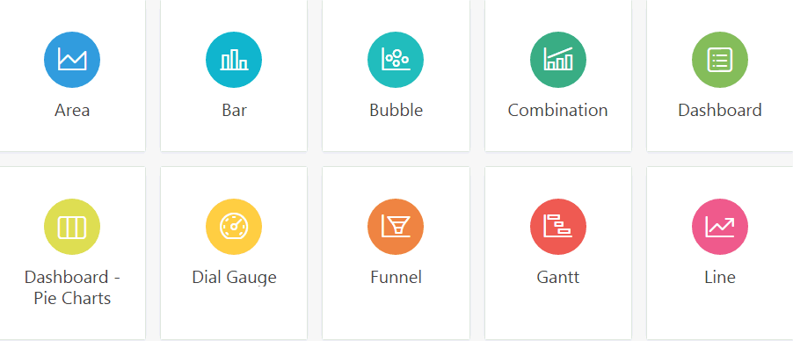
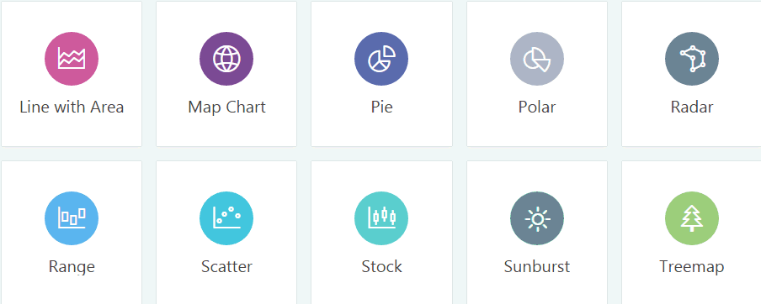
Creating Charts
Notes:
App Builder includes built-in wizards for generating charts. App Builder supports two types of charts:
Chart - Chart support in Oracle Application Express is based on the Oracle JavaScript Extension Toolkit (Oracle JET) Data Visualizations. Oracle JET empowers developers by providing a modular open source toolkit based on modern JavaScript, CSS3, and HTML5 design and development principles. The Oracle JET data visualization components include customizable charts, gauges, and other components that you can use to present flat or hierarchical data in a graphical display for data analysis. Each Oracle JET visualization supports animation, accessibility, responsive layout, internationalization, test automation, and a range of inter activity features. The charts provide dozens of different ways to visualize a data set, including bar, line, area, range, combination, scatter, bubble, polar, radar, pie, donut, funnel, and stock charts.
AnyChart Chart - AnyChart chart support is based on a third party charting solution provided by AnyChart. This is a flexible Flash and JavaScript (HTML5) based solution that enables developers to create animated and compact interactive charts. AnyChart charts have been categorized as a legacy component and may be deprecated in the future release.
For more information on Oracle JET and the Data Visualizations components, please refer to the Oracle JET Get Started documentation and ojChart API guide.
This lesson covers a few examples of native charts in Oracle Application Express that you build using Oracle JET Visualizations.
Note: In Page Designer, you can add a chart region to an existing page by using either of the following ways:
Drag the chart from the Gallery in the central pane and then drop it in the desired location
Right-click a chart in the Gallery to view a context menu and then select Add To and then select the desired location

Slide 5
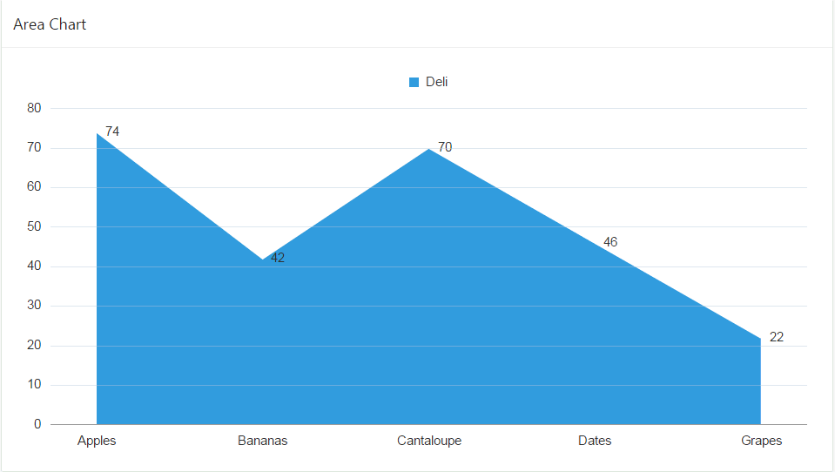

Creating Charts: Area Chart
SQL query used for the chart series
Notes:
The slide shows an example of an area chart and the SQL query used to generate the chart series. Once you build a native chart, you then use the chart attributes to format and customize the style of your charts. You learn how to create a chart in the next slide.

Slide 6
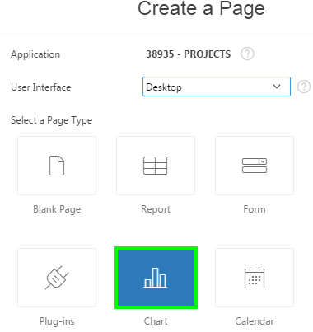
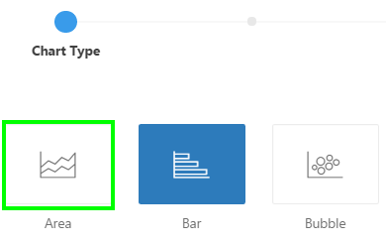
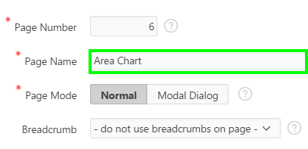
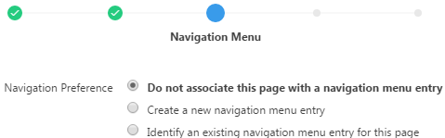
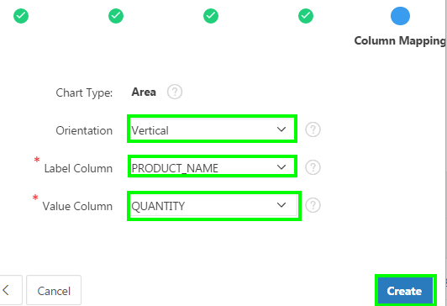
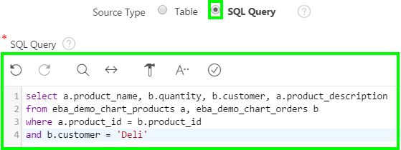
Creating an Area Chart: Steps
2
3
1
4
6
5
Notes:
To create a chart as a page in your application, first navigate to your application home page. Then click Create Page and perform the following steps:
Select Chart and click Next.
Select a chart type and click Next. In this example, select Area.
For Page and Region Attributes, specify a page name, accept the remaining defaults and click Next.
Specify your navigation preference and click Next.
For Source Type, select either Table or SQL Query. In the slide example, select SQL Query. Then, enter the SQL required to generate the chart and click Next.
For Column Mapping, the options that display will vary depending upon the chart type selected. For an Area chart:
Orientation: Select the orientation of this chart. Selecting Vertical displays the data items of the chart vertically. For example, the bars on a Bar chart will display vertically. Selecting Horizontal displays the data items of the chart horizontally. In the slide example, select Vertical.
Label Column: Select the column name to be used for defining the label(s) of the x-axis on the chart. In the example, select PRODUCT_NAME.
Value Column: Select the column name to be used for defining the value on this chart. In the example, select VALUE.
Then, click Create. Your area chart is now created. You can click Save and then click Save and Run Page.
This example shows creating a single series. To create multiple series, navigate to page designer. Under Rendering > Regions > Your chart
region, right-click Series and select Create Series. Follow the on-screen instructions.

Slide 7
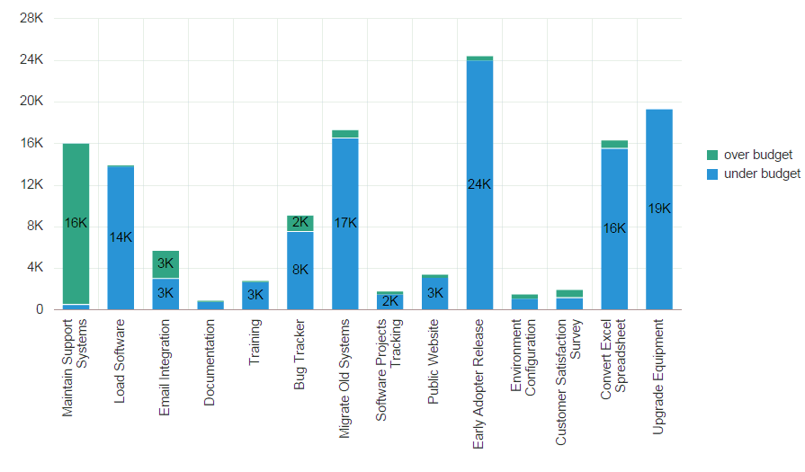
Creating Charts: Bar Chart
Notes:
The slide shows an example of a Bar chart. You learn how to create this type of chart in the next slide.

Slide 8
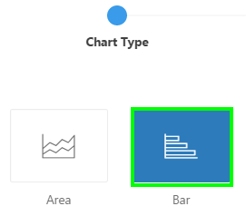
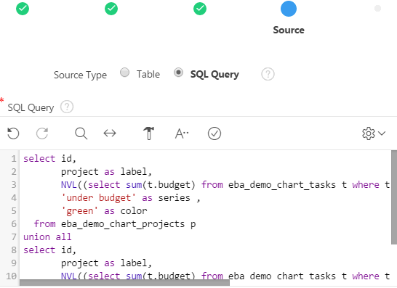
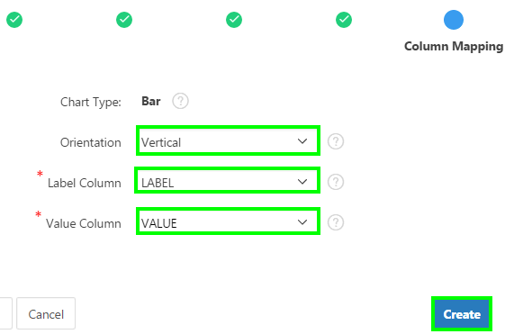
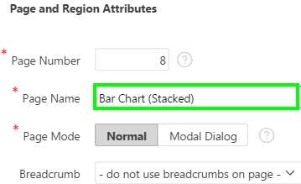
Creating a Bar Chart: Steps
1
2
5
6
3
4
6
Notes:
To create a Bar chart as a page in your application, first navigate to your application home page. Then click Create Page and perform the following steps:
Select Chart and click Next.
Select a chart type and click Next. In this example, select Bar.
For Page and Region Attributes, specify a page name, accept the remaining defaults and click Next.
Specify your navigation preference and click Next.
For Source Type, select either Table or SQL Query. In the slide example, select SQL Query. Then, enter the SQL required to generate the chart series and click Next.
For Column Mapping, the options that display will vary depending upon the chart type selected. For a pie chart:
Orientation: Select Vertical
Label Column: Select the column name to be used for defining the label(s) of the x-axis on the chart. In the example, select LABEL.
Value Column: Select the column name to be used for defining the value on this chart. In the example, select VALUE.
Then, click Create. Your Bar chart is now created. You can click Save and then click Save and Run Page. If you want to make your Bar chart as
stacked, then, navigate to page designer. Under Rendering > Regions, select your chart attributes. The attributes are displayed in the Property
Editor. In the Property Editor, under Appearance, select Yes for Stack.

Slide 9
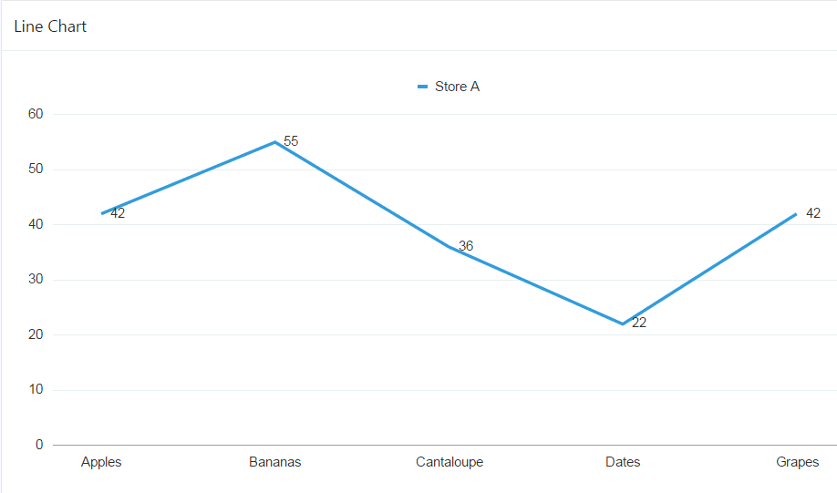
Creating Charts: Line Chart
Notes:
The slide shows an example of a Line chart. You learn how to create this type of chart in the next slide.

Slide 10
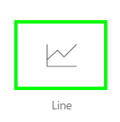
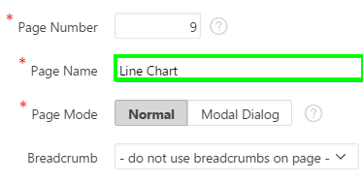
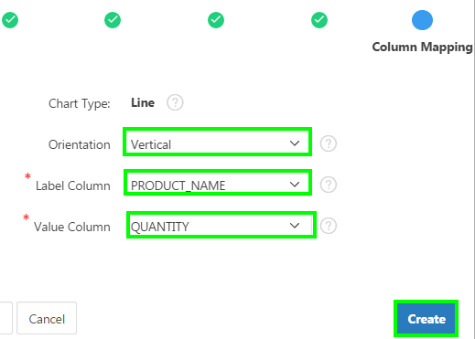
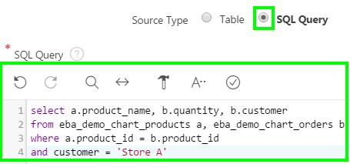
Creating a Line Chart: Steps
2
3
1
4
6
5
Notes:
To create a Line chart as a page in your application, first navigate to your application home page. Then click Create Page and perform the following steps:
Select Chart and click Next.
Select a chart type and click Next. In this example, select Line.
For Page and Region Attributes, specify a page name, accept the remaining defaults and click Next.
Specify your navigation preference and click Next.
For Source Type, select either Table or SQL Query. In the slide example, select SQL Query. Then, enter the SQL required to generate the chart series and click Next.
For Column Mapping, the options that display will vary depending upon the chart type selected. For a pie chart:
Orientation: Select Vertical
Label Column: Select the column name to be used for defining the label(s) of the x-axis on the chart. In the example, select LABEL.
Value Column: Select the column name to be used for defining the value on this chart. In the example, select VALUE.
Then, click Create. Your Line chart is now created. You can click Save and then click Save and Run Page.

Slide 11
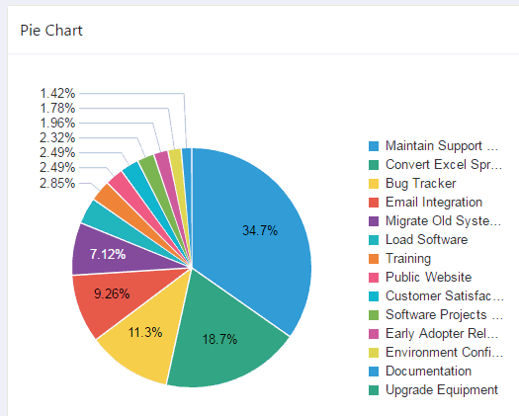
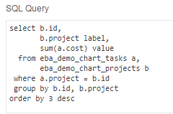
Creating Charts: Pie Chart
SQL query used for the chart series
Notes:
The slide shows an example of a pie chart and the SQL query used to generate the chart. Pie charts are useful for visualizing parts of a whole, but do not display zero or negative values, and are therefore not recommended for data sets that may have negative or null data.

Slide 12
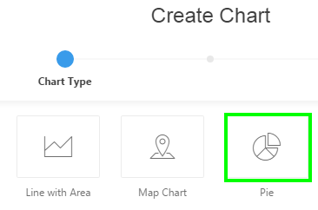
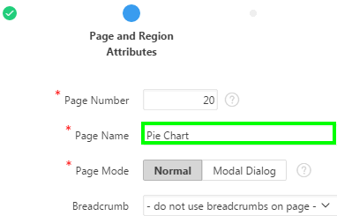
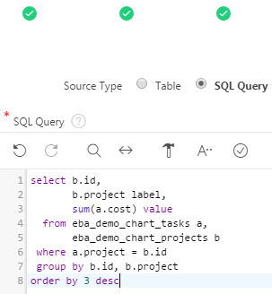
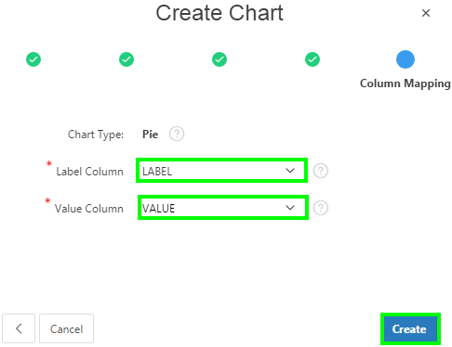
Creating a Pie Chart: Steps
1
2
3
6
4
5
Notes:
To create a chart as a page in your application, first navigate to your application home page. Then click Create Page and perform the following steps:
Select Chart and click Next.
Select a chart type and click Next. In this example, select Pie.
For Page and Region Attributes, specify a page name, accept the remaining defaults and click Next.
Specify your navigation preference and click Next.
For Source Type, select either Table or SQL Query. In the slide example, select SQL Query. Then, enter the SQL required to generate the chart and click Next.
For Column Mapping, the options that display will vary depending upon the chart type selected. For a pie chart:
Label Column: Select the column name to be used for defining the label(s) of the x-axis on the chart. In the example, select LABEL.
Value Column: Select the column name to be used for defining the value on this chart. In the example, select VALUE.
Then, click Create. Your pie chart is now created. You can click Save and then click Save and Run Page.

Slide 13
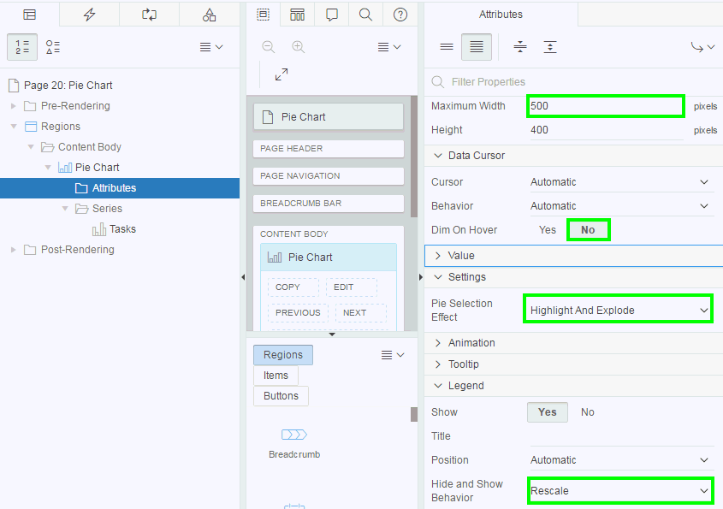
Altering the Display of a Pie Chart
Specify the maximum width of the chart in pixels
Select the behavior to be applied when hovering over data items on the chart.
Specify the effect applied when a pie is selected in the chart
Select the hide and show behavior that is performed when clicking on a legend item
Notes:
Once you create a chart, you can alter the display of the chart by declaratively editing the chart attributes in page designer. The slide shows a few changes made to the pie chart attributes.
To edit the chart attributes, navigate to the page designer and then locate the chart under the Rendering tab. Under Chart, select the Attributes node. The property editor now displays chart attributes. Once you save these changes and run the chart, you see the change in the display of the chart.
Maximum Width: Maximum Width is set to size the chart within its region. If you wish to default to using 100% width and height of the given region, simply remove the Maximum Width and Height values, and utilize the Template Options of the region to control the height as you wish.
Dim on Hover: Select the behavior to be applied when hovering over data items on the chart. Select Yes to dim all data items when not currently hovered over, and highlight only the current data item hovered over. In the example, you select No.
Pie Selection Effect: If you specify Highlight and Explode, selecting a slice of the pie will highlight and explode the slice. Available options include: Explode, Highlight and Explode, Highlight
Hide and Show Behavior: Select the hide and show behavior that is performed when clicking on a legend item. For example, deselecting a legend item will hide its associated data series on the chart. If you select Rescale as in the slide example, the chart axes will rescale as the minimum and maximum values of the visible data increase or decrease. This is useful for series with largely varying values. The other options include None and No Rescaling. If you select No Rescaling, the chart axes will not rescale. This is useful to keep the user in context.
For more information on the Pie chart settings, refer to the Oracle JET Cookbook Pie Chart: Hide & Show and Pie Chart: Animations examples.

Slide 14
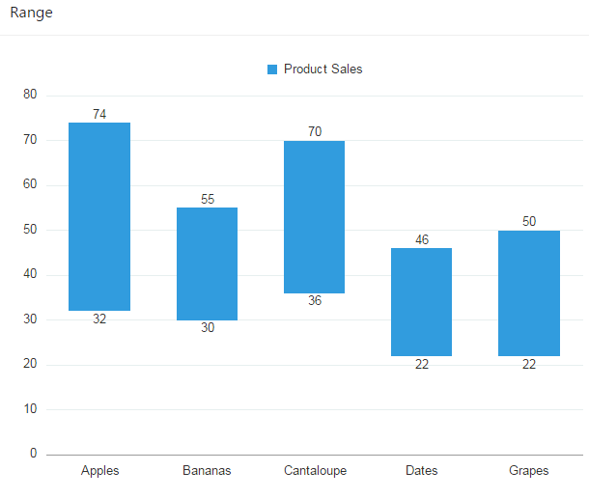
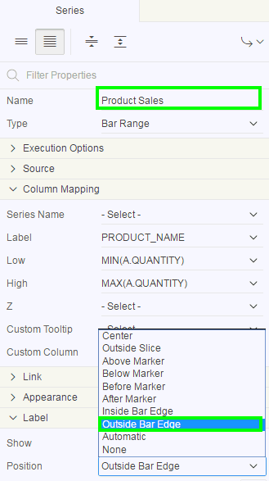
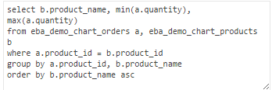
Creating a Range Chart: Example
SQL query used for the chart
Notes:
The slide shows an example of the native Range chart in Application Express. Range charts support two types of series: Bar Range, or Area Range. The slide example shows Bar Range. For range charts, each data point may have up to two labels, one for the low value and one for the high value. The slide also shows the SQL query used to generate the chart.
The next slide shows steps to create a native Range chart. Once the chart is created, you edit the series-level attributes to customize the display. Use the Label > Position series-level attribute to define the position of the labels. Valid label positions for a Bar Range series are 'Automatic', 'Center', 'Inside Bar Edge', and 'Outside Bar Edge'. The default is 'Inside Bar Edge'. The slide example uses Outside Bar Edge.
Note: Use the Series Type attribute to change the series to Area Range. Valid label positions for an Area Range chart are 'Automatic', 'Center', 'Above Marker', 'Below Marker', 'Before Marker', and 'After Marker'. The default is 'Below Marker' for the low label and 'Above Marker‘ for the high label.
In the slide example, after the chart is created, the chart attributes have been modified to specify the maximum width as 600 and height as 450 pixels respectively.

Slide 15
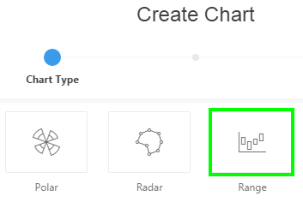
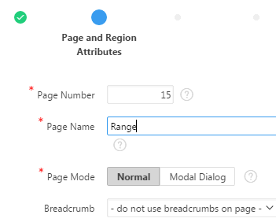
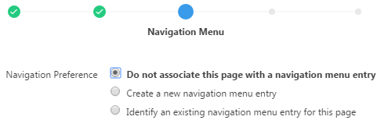
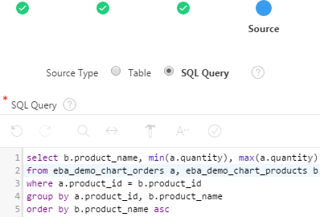
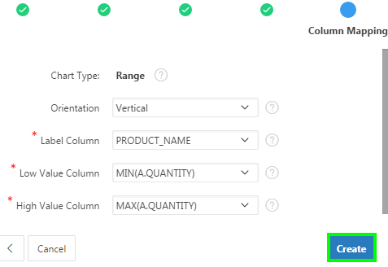
Creating a Range Chart: Steps
1
2
3
4
5
Notes:
To create a native Range chart, navigate to your application home page and click Create Page. Then, select Chart and perform the following steps:
Select Range for chart type and click Next
Specify the page name, accept the remaining defaults and click Next.
Specify your preference for navigation and click Next
Select either Table or SQL Query for Source Type. In the slide example, select SQL Query and then enter the SQL required to generate the chart. Then, click Next.
For Column Mapping:
Orientation: Select the orientation of this chart. Vertical displays the data items of the chart vertically. Horizontal displays the data items of the chart horizontally. In the example, select Vertical.
Label Column: Select the column name to be used for defining the label(s) of the x-axis on the chart. In the example, select PRODUCT_NAME.
Low Value Column: Select the column name to be used for defining the low value on this chart. In the example, select MIN(A.QUANTITY).
High Value Column: Select the column name to be used for defining the high value on this chart. In the example, select MAX(A.QUANTITY).
Click Create. The chart is now created. Click Save and then click Save and Run Page.

Slide 16
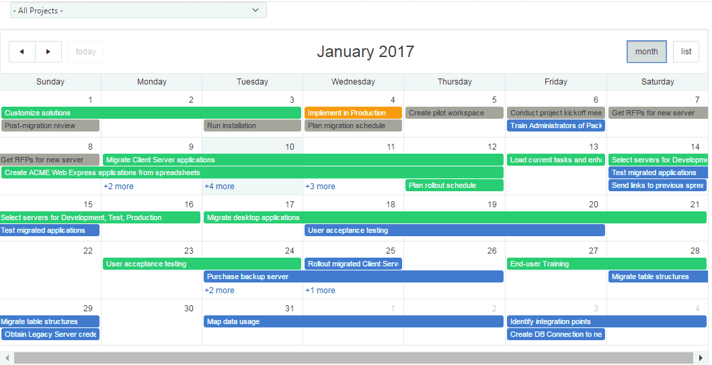
Creating Calendars
  Oracle Application Express has an integrated calendaring component
  Calendars in APEX are based on data obtained from SQL
Notes:
App Builder includes a built-in wizards for generating a calendar with monthly, weekly, daily, and list views. Once you specify the table on which the calendar is based, you can create drill-down links to information stored in specific columns and enable drag and drop capability.
App Builder supports two types of calendars:
Calendar - Calendar is based on the FullCalendar jQuery library and can only be customized through CSS.
Legacy Calendar - Legacy Calendar is template-based and may be deprecated in the future release.
Both calendar options enable you to create a calendar based on a table or SQL query you provide. During the creation process, you are prompted to select a date column and display column. Because it offers a better user interface and numerous additional features, Oracle recommends converting all legacy calendars to the latest calendar.
Note: In previous releases Legacy Calendar was referred to as Calendar (Template), Classic calendar, Easy calendar, and SQL calendar).
In the slide, features of the calendar include:
Previous - Navigates to the previous month.
Next - Navigates to the next month.
Month - Displays a monthly view of all orders.
List - Displays a list of all orders.
Note: For more calendar examples, install the Sample Calendar packaged application.

Slide 17
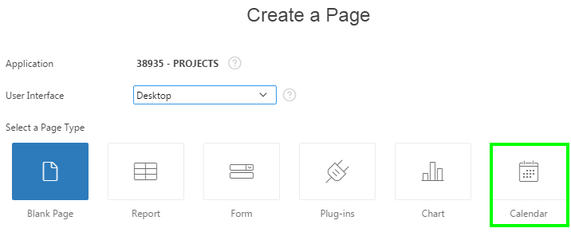
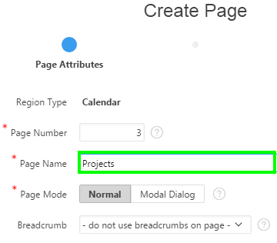
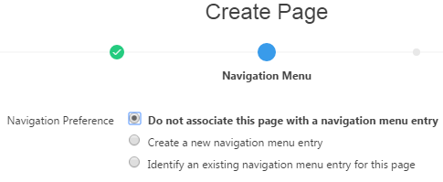
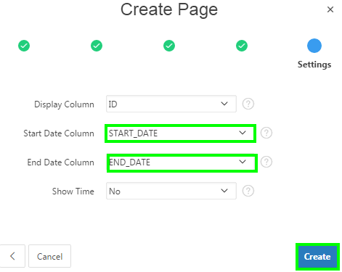
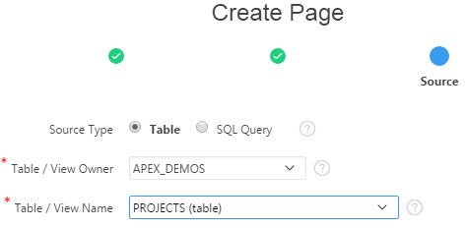
Creating a Calendar
1
2
5
3
4
Notes:
You can create a calendar as a new page in your application or as a region on an existing page. To create a calendar in Page Designer, you must provide a SQL Query. To create a calendar by selecting a table, use the Create Page Wizard. The slide shows steps to create a calendar as a page in your application using the Create Page wizard. First, navigate to your application home page, click Create Page and then perform the following steps:
Select Calendar and click Next.
Specify a name and click Next.
For Navigation Menu, specify the type of navigation to include on this page and click Next. The navigation options that display depend upon the current application theme.
For Source Type, select either Table or SQL Query. In the slide, you select Table. Then, select a table with the DATE column, and click Next.
Note: If the calendar source is SQL Query, then enter the SQL SELECT statement to be used for the calendar. The SQL SELECT statement must include at least two columns, of which one must be a DATE column.
For Settings:
Display Column - Select the column which holds the text displayed for events on this calendar
Start Date Column - Select the column which holds the start date for events displayed on this calendar
End Date Column - Select the column which holds the end date for events displayed on this calendar. If this attribute is specified, then the calendar displays duration-based events.
Show Time - Select whether the time portion of the date display.
Click Create. Now you can run the page to see how the calendar is displayed.

Slide 18
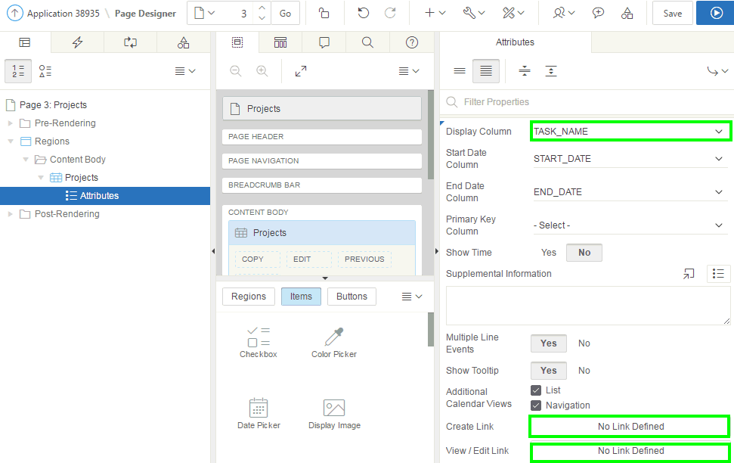
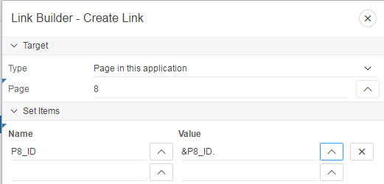
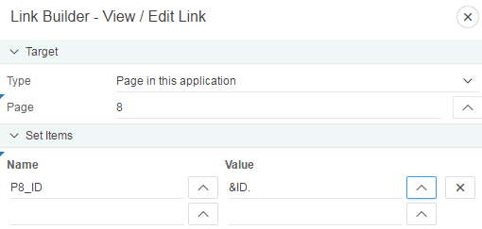
Editing Calendar Attributes in Property Editor
Notes:
Once you create a calendar, you can alter the display by editing attributes in the Properties Editor. Each calendar has two sets of editable attributes: region attributes and calendar attributes. Region attributes define the area of the page which functions as a container for the calendar. Calendar attributes specify the template, date columns, and general calendar formatting.
To edit calendar attributes, perform the following steps:
Navigate to the appropriate page in Page Designer. Page Designer appears.
In the Rendering tab, locate and select the calendar. The Property Editor displays the region attributes.
In the Rendering tab, locate the calendar and select the Attributes node. The Property Editor displays the calendar Attributes.
To view all attributes in the Property Editor, click Show All . To search for a group or an attribute, enter a keyword in the Filter Properties field.
Edit the calendar attributes. Click Save.
In the slide, you edit calendar attributes and select TASK_NAME for Display Column.

Slide 19
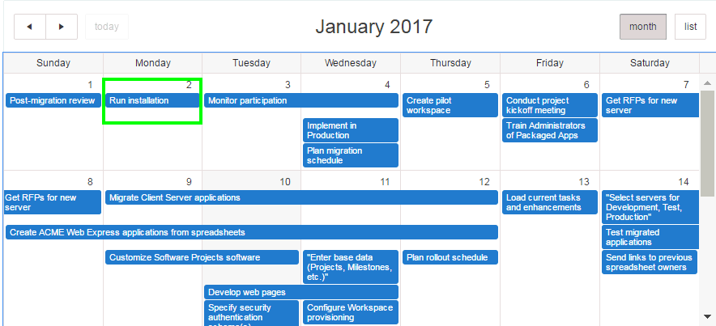
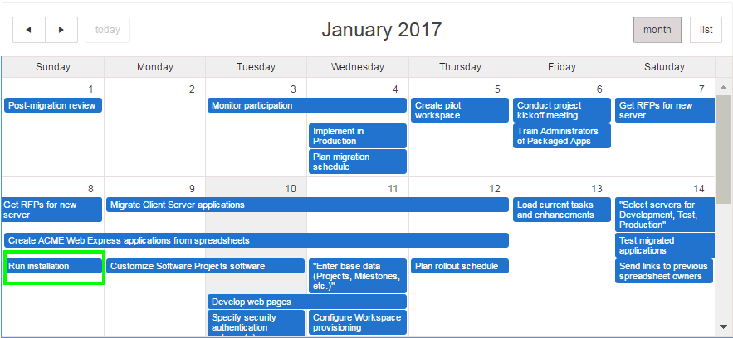
Enabling the Dragging and Dropping of Data: Example
Drag and drop
Notes:
The Calendar Region supports moving or changing calendar events with drag and drop. The slide shows dragging “Run Installation” task from Jan 2 and dropping in Jan 8. You learn how to enable dragging and dropping events in the next slide.

Slide 20
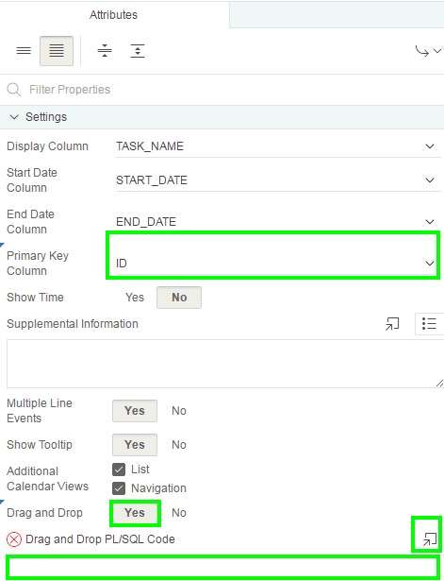
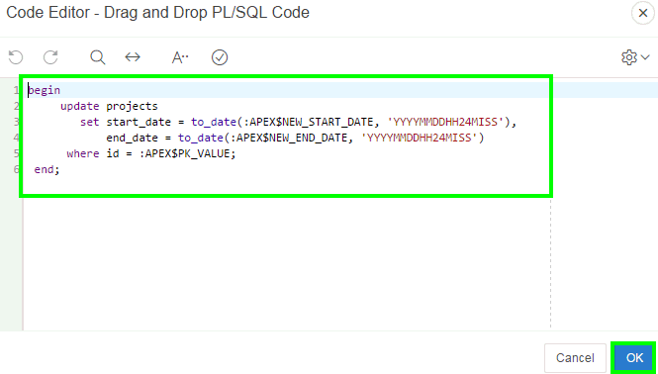
Enabling the Dragging and Dropping of Data: Steps
Notes:
To enable support for drag and drop for a calendar region, perform the following steps:
Navigate to the appropriate page in Page Designer. In the Rendering tab under the calendar title, select the Attributes node. The Property Editor displays the Attributes for the calendar.
Locate and expand Settings and edit the following attributes:
Primary Key Column - Select a table or SQL Query column. Drag and Drop appears under Settings.
Drag and Drop - Select Yes. Drag and Drop PL/SQL Code appears.
Drag and Drop PL/SQL Co de - Enter the PL/SQL code to execute when the end user finishes a drag and drop for an event. Within the PL/SQL code, you can reference the ID of the dragged event, the new start and end dates as:
:APEX$PK_VALUE, :APEX$NEW_START_DATE amd :APEX$_NEW_END_DATE
For example, the following code changes the event row in the PROJECTS table after the end user has dragged the event to a new date.
begin
update projects
set start_date = to_date(:APEX$NEW_START_DATE, 'YYYYMMDDHH24MISS'),
end_date = to_date(:APEX$NEW_END_DATE, 'YYYYMMDDHH24MISS')
where id = :APEX$PK_VALUE;
end;
Click Save.

Slide 21
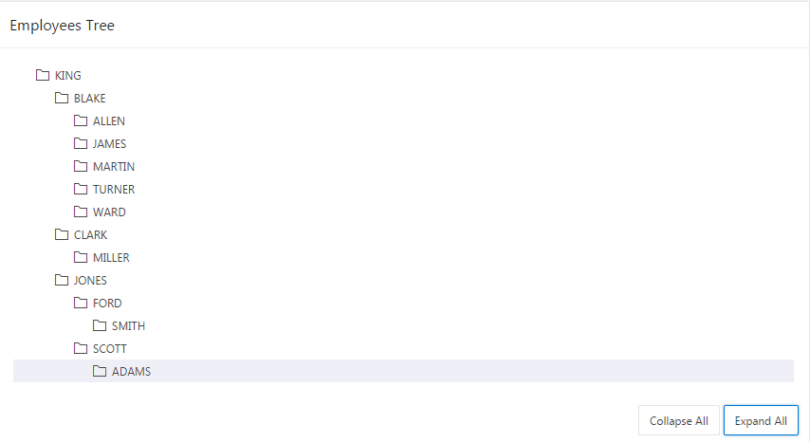
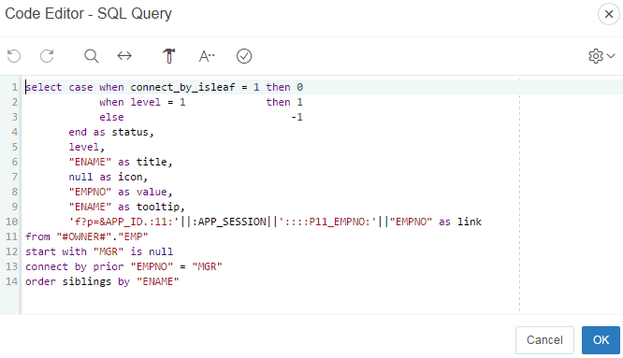
Creating Trees
  A tree is a hierarchical navigation mechanism
  Trees are implemented using a single hierarchical query that identifies the row to be used as the start of your query, and the relationship between parent rows and child rows of the hierarchy
SQL used for the Employees Tree
Notes:
App Builder includes a built-in wizard for generating a tree that displays a hierarchical view. The tree implementation in APEX is a JavaScript-based, cross browser tree component that features optional keyboard navigation, and optional state saving.
The slide shows employees hierarchy and also the SQL used to create the tree. The tree displays a list of managers and the employees who work for them. You can create a Tree from a query that specifies a hierarchical relationship by identifying an ID and parent ID column in a table or view. The tree query utilizes a START WITH .. CONNECT BY clause to generate the hierarchical query.
Note: The creation of APEX Tree regions is only supported on pages using a Desktop user interface.

Slide 22
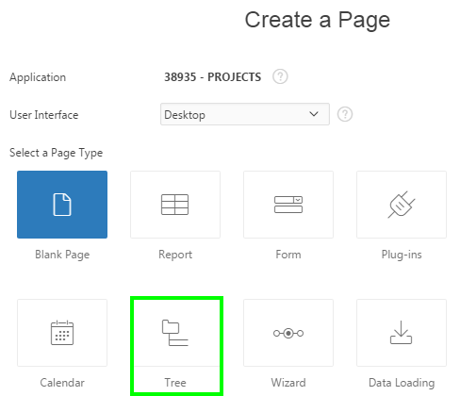



Creating a Tree: Example
1
2
3
4
Notes:
A tree is based on a query and returns data that can be represented in a hierarchy. When you create a tree using the Create Page Wizard, the wizards generates this hierarchical query for you based on the options you select.
The slide shows steps to create a tree using the create page wizard. Navigate to your application home page and click Create Page. Then, perform the following steps:
Select Tree and click Next
Specify the page attributes and click Next
Specify your preference for navigation menu and click Next
Select the owner of the table or view from which you want to draw the tree query.

Slide 23


Creating a Tree: Example
5
6
Notes:
A tree is based on a query and returns data that can be represented in a hierarchy. A start with .. connect by clause will be used to generate the hierarchical query for your tree. Use this page to identify the column you want to use as the ID, the Parent ID, and text that should appear on the nodes. The Start With column will be used to specify the root of the hierarchical query, and its value can be based on an existing item, static value or SQL query returning a single value. Notice that the values are pre-populated. You can however modify them. Click Next. In the example:
ID: Select the column to base the tree on, EMPNO
Parent ID: Select the column to use as the parent ID, MGR
Node Text: Select the text to appear on the tree nodes, ENAME
Start With: Select the column to be used to specify the root of the hierarchical tree query, MGR
Start Tree: Select how to start your query, Value is NULL
Identify an optional WHERE clause and order siblings by column for your query. Click the expand icon for Current Query to see the SQL query that is generated. Click Next.

Slide 24


Creating a Tree: Example
7
8
Notes:
In this step, you identify the button, tooltip, and link attributes you want to define on your tree. Select the page or application item to hold the selected node value. This item can be used to save the tree state, by holding the value of the last selected node. The value of the selected node can be saved to the selected item using the node link attribute or a page process. When the tree is reloaded, the tree opens to the last selected tree node. After specifying the tree attributes, click Next.
Click Create. Now, click Save and then Save and Run Page.

Slide 25




Modifying a Tree
BLAKE
CLARK
Notes:
The slide shows an example of manipulating a tree. In the Employees Tree, JAMES’s manager is BLAKE. Upon clicking the JAMES link you see the
Employee Details form. Now, you replace the value for Mgr with 7782 which is CLARK’s EMPNO. Click Apply Changes and the tree now shows the modified
hierarchy. That is, JAMES is now displayed under CLARK.

Slide 26
Summary
In this lesson, you learned how to create and customize:
  Oracle JET Charts
  Calendars
  Trees

Slide 27


Slide 28
Hands-On Lab

