Slide 2

Unit 13: Implementing Security
in your Application

Slide 3
Lesson Objectives
After completing this lesson, you should be able to:
  Explain how to secure your application
  Describe authentication and authorization
  Create and use an authentication scheme for your application
  Create and attach an authorization scheme to your application, page, or components
Notes:
While administrators are primarily responsible for ensuring the security of the Oracle Application Express installation, developers are responsible for building secure applications. In this lesson, you learn how to utilize the built-in features available in Application Express to build a secure Web application.

Slide 4



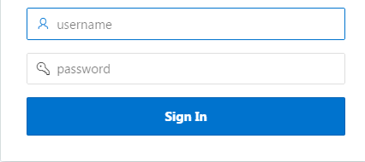


How to Secure an APEX Application?
Access Allowed
Authentication
Restricted
Who are you?
Authorization
What are you allowed to do after logging in?
Notes:
Once you create an application, you generally need to ensure that only authorized users can access the application, unless it is an open (public) application. That is, you want to implement security into your application. To ensure developers build a secure application, Application Express provides two different mechanisms: Authentication and Authorization.
The primary thing in building a secure web application is to understand who the accessing user is. You use a log in page with username and password as an access entry to an application. Only if the log in succeeds, the user is allowed access to the application. Confirming user's identity before allowing access to the application, is known as authentication.
After successfully logging in to the application, the next question is, what is that logged in user allowed to do? Can the user get access to a page, or a page component? Authorization covers this aspect of implementing security in an application. Authorization refers to restricting access to specific pages and components based on user privileges.

Slide 5


Establishing User Identity through Authentication
  Authentication is the process of establishing each user’s identity before they can access your application
  Many authentication processes requires users to provide credentials such as username and password
  APEX engine uses APP_USER to track each user’s session state
Valid credentials
Access to the application
Invalid credentials
User provides log in credentials
No access to the application
APEX engine validates the credentials
Notes:
Authentication is the process of establishing each user's identify before they can access your application. It may require a user to enter a user name and password or could involve the use of digital certificates or a secure key.
You determine how your application interacts with users. If all users have the same rights and privileges, they are referred to as public users. However, if your application must track each user individually, you must specify an authentication method. Authentication establishes the identity of each user who accesses your application. Many authentication processes require that a user provide some type of credentials such as a user name and password. These credentials are then evaluated and they either pass or fail. If the credentials pass, the user has access to the application. Otherwise, access is denied.
Once a user has been identified, the Application Express engine keeps track of each user by setting the value of the built-in substitution string APP_USER. As a user navigates from page to page, the Application Express engine sets the value of APP_USER to identify the user. The Application Express engine uses APP_USER as one component of a key for tracking each user's session state.
Note: Built-in Authentication schemes are provided for Single Sign-On (SSO), LDAP, and HTTP Header Variable authentication (used by Oracle Identity Manager).

Slide 6
How to Implement Authentication?
In Application Express, you can create authentication by:
  Selecting a built-in authentication scheme
  Creating a custom authentication scheme
Notes:
As you create your application, you must determine whether to include authentication. If you choose not to use authentication, Oracle Application Express does not check any user credentials. All pages of your application are accessible to all users.
You can:
Select a built-in authentication scheme. Create an authentication method based on available preconfigured authentication schemes. Depending on which scheme you choose, you may also have to configure the corresponding components of Oracle 11giAS, Oracle Internet Directory, or other external services.
Create custom authentication scheme. Create a custom authentication method to have complete control over the authentication interface. To implement this approach, you must provide a PL/SQL function the Application Express engine executes before processing each page request. This function's Boolean return value determines whether the Application Express engine processes the page normally or displays a failure page.
When you create a new authentication scheme, you have several options. Most let you reuse implementations that already exist in your application or in other applications within your workspace. There are even some pretested schemes you can copy to get you up and running immediately.

Slide 7
Understanding Preconfigured Authentication Schemes
Oracle Application Express supports the following preconfigured authentication schemes:
  Open Door Credentials
  Application Express Accounts
  Database Accounts
  LDAP Directory
  No Authentication (Using DAD)
  Oracle Application Server Single Sign-On
  Custom
  HTTP Header Variable
Notes:
The following preconfigured schemes ship with Oracle Application Express:
Open Door Credentials: Enables anyone to access your application using a login page that captures a user name.
Application Express Accounts: Application Express Account Credentials are internal user accounts (also known as "cookie user" accounts) that are created within and managed in the Application Express user repository. When you use this method, your application is authenticated against these accounts.
Database Accounts: This authentication scheme requires that a database user (schema) exists in the local database. When using this method, the user name and password of the database account is used to authenticate the user.
LDAP Directory: Authentication of user/password with an authentication request to a LDAP server.
No Authentication (Using DAD): Adopts the current database user. This can be used in combination with a mod_plsql DAD configuration that uses basic authentication to set the database session user.
Oracle Application Server Single Sign-On: This delegates authentication to the Oracle AS Single Sign-On (SSO) Server. To use this authentication scheme, your site must have been registered as a partner application with the SSO server.
Custom: Enables you to create a custom authentication scheme from scratch, giving you complete control over your authentication interface.
HTTP Header Variable: Authenticate externally, where the username is stored in a HTTP Header variable set by the web server.

Slide 8
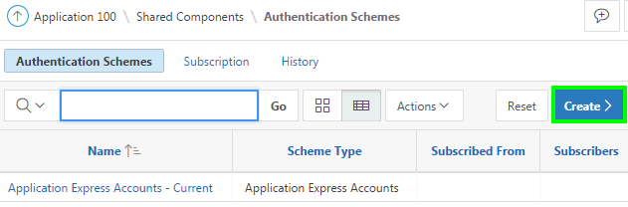
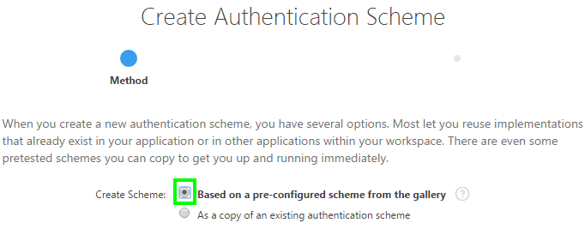
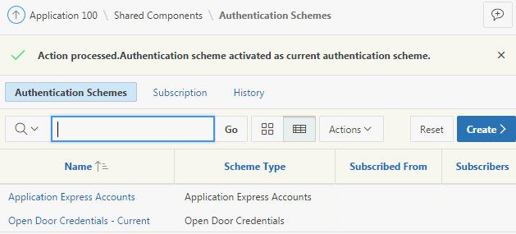
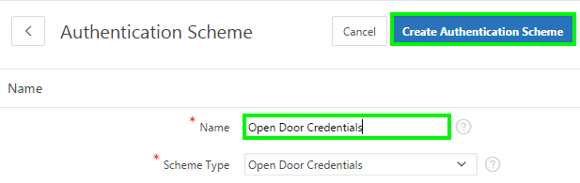
Creating an Authentication Scheme Based on a
Pre-configured Scheme
1
2
4
3
Notes:
To create an authentication scheme based on a pre-configured scheme, first navigate to your application home page. Then, click Shared Components > Security and then select Authentication Schemes. Perform the following steps:
On the Authentication Schemes page, click Create.
Select the Based on a pre-configured scheme from the gallery radio button and click Next.
Specify a name for your authentication scheme. Then, select a scheme of your choice from the Scheme Type list. Click Create Authentication Scheme.
Notice that the new authentication scheme is activated as current authentication scheme.

Slide 9
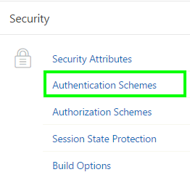
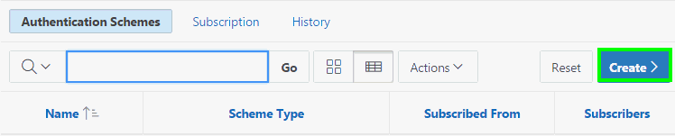

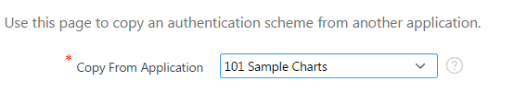
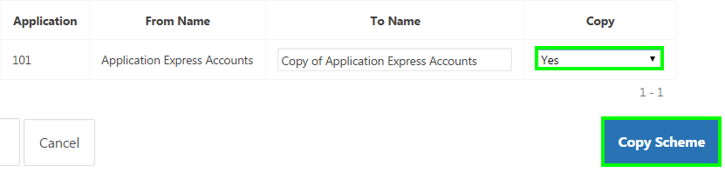
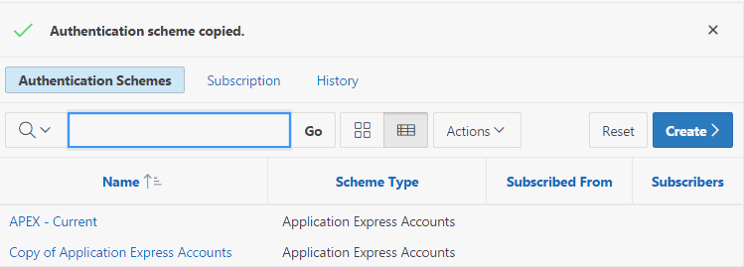
Creating a Copy of an Existing Authentication Scheme
1
2
3
4
5
6
Notes:
You may create a new authentication scheme by making a copy of a scheme in your application or in any another application in your Workspace. Then you can edit the new scheme, changing the name to what you prefer and changing any of the settings to meet your requirements.
To copy an authentication scheme, perform the following steps:
On your application home page, navigate to Shared Components. Under Security, click Authentication Schemes.
On the Authentication Schemes page, click Create.
Select As a copy of an existing authentication scheme and click Next.
Select the application from which you want to copy the scheme and click Next.
The schemes existing in the selected application are now listed on the page. Select Yes for the scheme that you want to copy. You can choose to copy or copy and subscribe to an authentication scheme in the application you select as the copy source. Subscribing to an authentication scheme puts a copy of it in your application but allows you to refresh it periodically to get the latest changes. Click Copy Scheme.
The Authentication Schemes page now shows the copied application. On this page, you can also see the scheme current to this application.

Slide 10

Providing Security Through Authorization
  Authorization involves controlling access to resources based on user privileges
  Use authorization schemes to implement authorization in an application
  You can apply an authorization scheme for:
      An entire application
      A page
      Specific control such as a region, item, or button
Notes:
Authorization is a broad term for controlling access to resources based on user privileges. While conditions control the rendering and processing of specific page controls or components, authorization schemes control user access to specific controls or components.
An authorization scheme extends the security of your application's authentication scheme. You can specify an authorization scheme for an entire application, page, or specific control such as a region, item, or button. For example, you could use an authorization scheme to selectively determine which tabs, regions, or navigation bars a user sees.
Before you associate an authorization scheme with an application, application component or control, you must first create it.
An authorization scheme either succeeds or fails. Common authorization scheme types include Exists, Not Exists SQL Queries, and PL/SQL Function Returning Boolean. If a component or control level authorization scheme succeeds, the user can view the component or control. If it fails, the user cannot view the component or control. If an application or page-level authorization scheme fails, then Oracle Application Express displays a previously defined message.
When you define an authorization scheme, you give it a unique name. Once defined, you can attach it to any component or control in your application. To attach an authorization scheme to a component or control in your application, simply navigate to the appropriate attributes page and select an authorization scheme from the Authorization Scheme list.

Slide 11
How to Implement Authorization?
Oracle Application Express allows you to implement authorization to an application or its components in two different ways:
  By navigating to Shared Components and then either creating an authorization scheme from scratch or copying an existing authorization scheme
  By creating an Access Control Page and then performing the following steps:
      Configuring the Access Control Page:
            Setting the application mode
            Adding users to the Access Control List
      Applying the authorization scheme to application components
Notes:
You can create and apply an authorization scheme to an application and its components using two different ways:
Navigate to Shared Components > Authorization and then create an authorization scheme from scratch or by copying an existing authorization scheme
Create an Access Control page, set the application mode and then add users to the Access Control List. Then, you apply the authorization scheme to application components

Slide 12
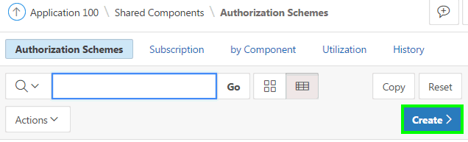
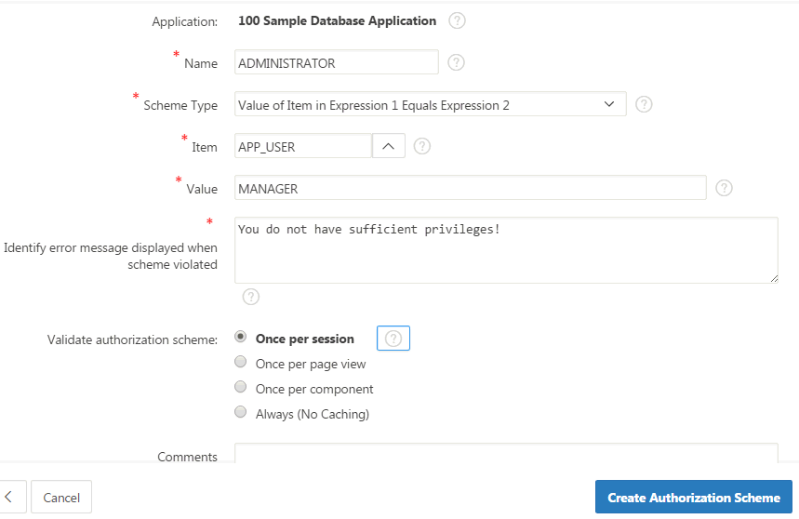
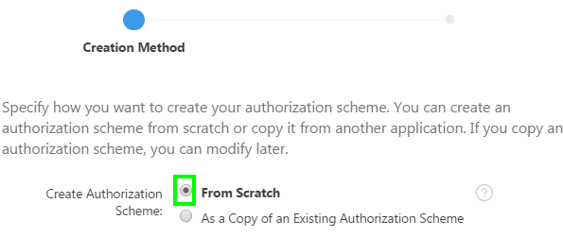
Creating an Authorization Scheme from Scratch
1
2
3
Notes:
When you create an authorization scheme, you select an authorization scheme type. The authorization scheme type determines how an authorization scheme is applied. Developers can create new authorization type plug-ins to extend this list.
To create an authorization scheme, navigate to your application home page, click Shared Components. Under Security, select Authorization Schemes and then perform the following steps:
On the Authorization Schemes page, click Create.
For Create Authorization Scheme, select From Scratch and click Next.
On Create Authorization Scheme:
Name - Enter an unique name that identifies this authorization scheme. In the slide example, enter ADMINISTRATOR.
Scheme Type - Select how this authorization scheme will be applied. In the slide example, select Value of Item in Expression 1 Equals Expression 2. The authorization succeeds if the item's value equals the authorization value. In the slide example, select APP_USER for Item, and enter MANAGER for Value. That is, in the example, the value in Expression 1 (APP_USER) is compared to the value specified in Expression 2 (MANAGER).
Identify error message displayed when scheme violated - Enter error text that displays if the authorization scheme fails (that is, the current user fails the security check).
Validate Authorization Scheme - Authorization schemes are evaluated on first use in a session. Use this option to controls if future uses cause re-evaluations and when a memorized result can be taken instead.
Click Create Authorization Scheme.

Slide 13
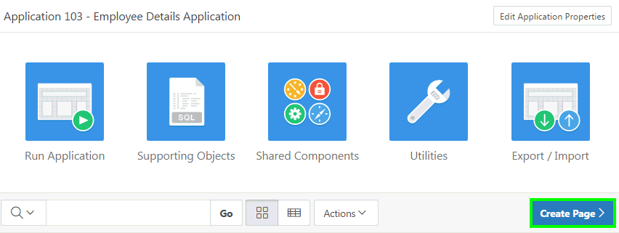
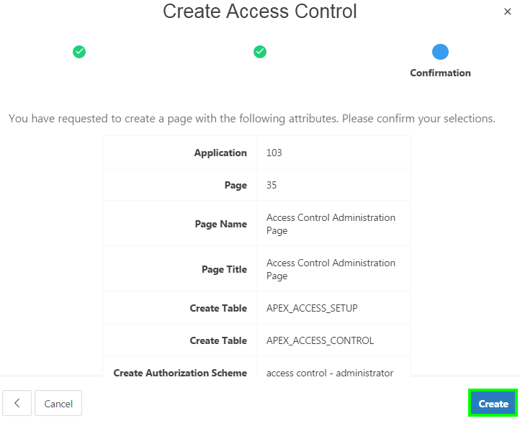
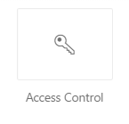
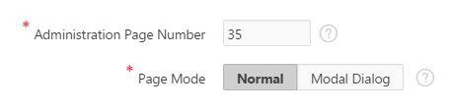
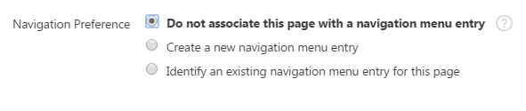
Creating the Access Control Administration Page
1
2
3
4
5
Notes:
You create an access control list by creating a page. You can create a page on the Application home page or while viewing a page.
To create an access control list from the Application home page, perform the following steps:
Navigate to your application home page and click Create Page.
Select Access Control for Page Type and click Next.
For Administration Page Number, specify an unused page number. Select a Page Mode and click Next.
Specify your navigation preference and click Next. The navigation options (for example, navigation menu or tabs) depends upon the current application theme.
Review the confirmation page and click Create.
This wizard creates two tables within this application's default parsing schema to manage the access control list. The access control list provides view, edit
and administration privileges which can be associated with users. A corresponding authorization scheme will also be created for each privilege. These
authorization schemes can be applied to pages and page components to manage access by user and privilege. All of these can be customized after they
are created to meet the needs of your application.

Slide 14
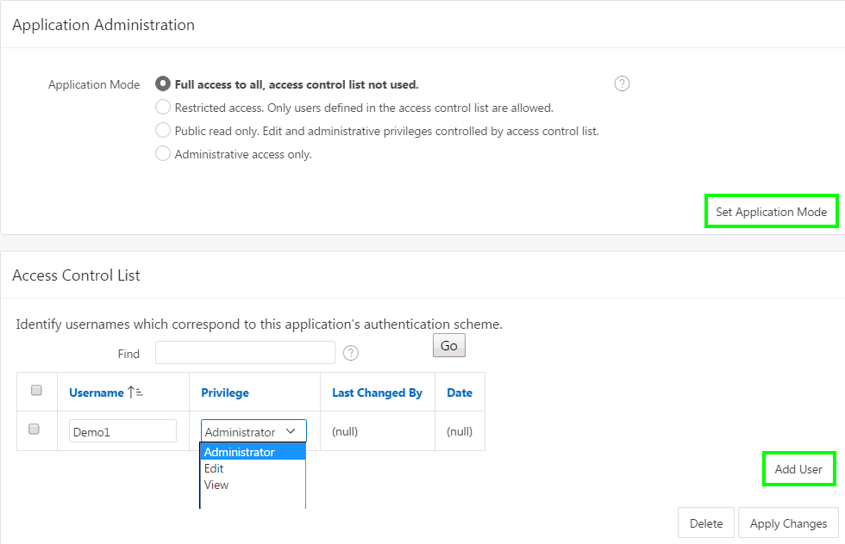
Configuring the Access Control Page
Steps:
    Run the Access Control Administration page.
    Set the application mode
    Add users to the Access Control List
Notes:
You can control access to an application by running the Access Control Administration page, selecting an application mode, and then adding users to the Access Control list.
Run the Access Control Administration page.
For Application Mode, select an option:
Full access to all, access control list not used: Select this option to enable all users access to an application.
Restricted access. Only users defined in the access control list are allowed: Select this option to restrict access to users on the Access Control List. Only users on the Access Control List can view pages and components associated with an authorization scheme.
Public read only. Edit and administrative privileges controlled by access control list: Provides public access to pages and components associated with the access control - view authorization scheme.
Administrative access only: Only users with Administrator privileges can access pages or components associated with an authorization scheme.
Click Set Application Mode.
Now, you add users to the Access Control List. To add users to the Access Control List, perform the following steps:
Under Access Control List, click Add User. A new row appears.
Enter a user in the Username field.
Associate a privilege with the user. Available options include:
Administrator
Edit
View
Click Apply Changes. Repeat steps 1-4 for all users.

Slide 15
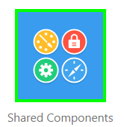
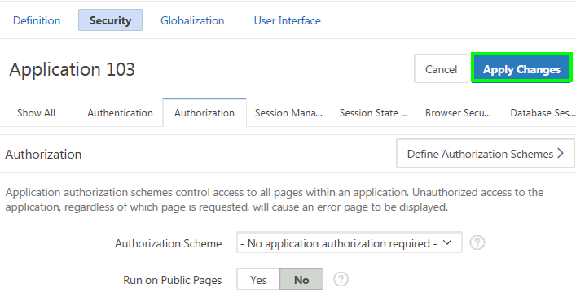
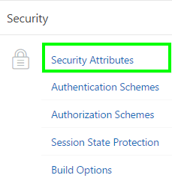
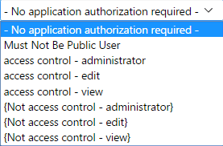
Attaching an Authorization Scheme to an Application
1
3
2
Notes:
The Access Control Wizard creates authorization schemes that correspond to the application mode list options and the privileges available in the Access Control List. You can control access to a specific page or page component by selecting one of the following authorization schemes on the page or component attributes pages:
Access control administrator. Only users with Administrator privileges can view the page or component.
Access control - edit. Users with both Edit and Administrator privileges can view the page or component. Users with View privileges cannot view the page or component.
Access control - view. Users with Administrator, Edit, or View privileges can view the page or component.
Not access control administrator. Users with Administrator privileges cannot view the page or component.
Not access control - edit. Users with both Edit and Administrator privileges cannot view the page or component. Users with View privileges can view the page or component.
Not access control - view. Users with Administrator, Edit, or View privileges cannot view the page or component.
The slide shows steps to attach an authorization scheme to an application. Perform the following steps:
Navigate to your application home page and click the Shared Components icon. The Shared Components page appears.
Under Security, click Security Attributes.
Scroll down to Authorization and make a selection from the Authorization Scheme list. For Run on Public Pages, select Yes or No to specify whether the application-level authorization scheme is checked on public pages (that is, pages that do not require authorization). Click Apply Changes.
To define a new authorization scheme, click Define Authorization Schemes.

Slide 16
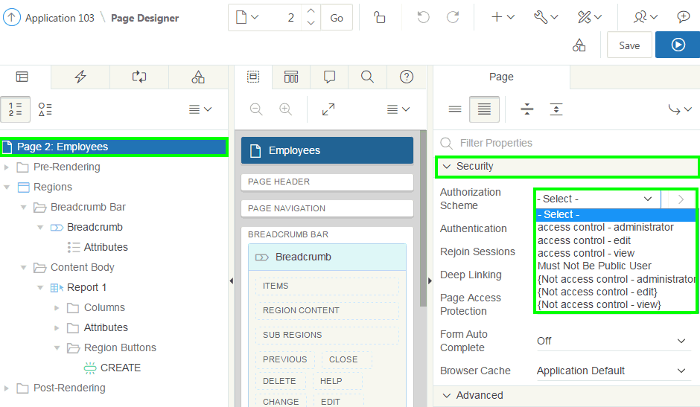
Attaching an Authorization Scheme to a Page
Notes:
To attach an authorization scheme to a page, perform the following steps:
Navigate to the page definition of the page to which you want to attach the authorization scheme.
Under Rendering, select the page name.
In the Property Editor, scroll down to Security. From the Authorization Scheme list, select a scheme. For the page to be rendered, this authorization scheme must evaluate to TRUE.
Click Save. Then, Click Save and Run Page.

Slide 17
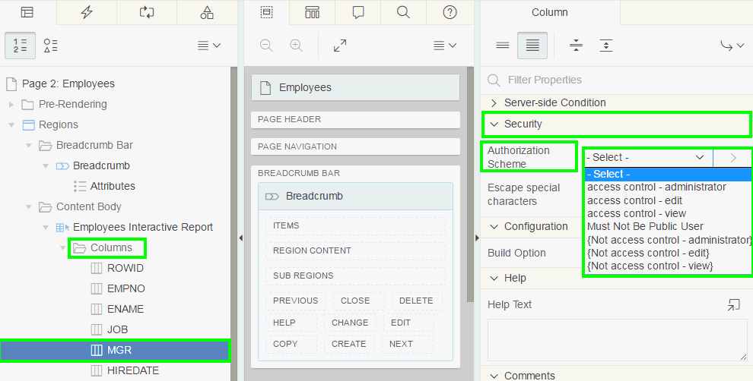
Attaching an Authorization Scheme to a Control or Component
Notes:
To attach an authorization scheme to a page component or control, perform the following steps:
In your application, select a page. View the page in page designer.
Click the name of the component or control to which you want to apply the authorization scheme.
Scroll down to Security and make a selection from the Authorization Scheme list.
Click Save.
The slide shows applying an authorization scheme to a column in an interactive report page. In page designer, expand columns, select the column for which you want to attach the authorization scheme. Under Column Properties, navigate to Security and select an authorization scheme from the list.

Slide 18
Summary
In this lesson, you learned how to:
  Create and use an authentication scheme for your application
  Create and apply an authorization scheme to your application, page, or components

Slide 19


Slide 20
Hands-On Lab

