Slide 2

Unit 12: Using Themes and Theme Styles

Slide 3
Lesson Objectives
After completing this lesson, you should be able to:
Describe themes and templates
Create and use a new theme
Describe Universal Theme, Theme Roller, and Template Options
Use Theme Styles
Use Theme Roller, and Live Template Options
Upload and use a CSS
Notes:
In this lesson, you learn how to alter your database application's user interface and page layout through themes and theme styles.

Slide 4
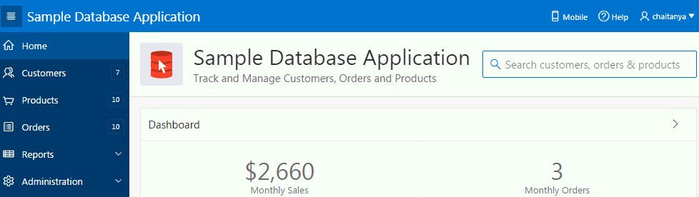
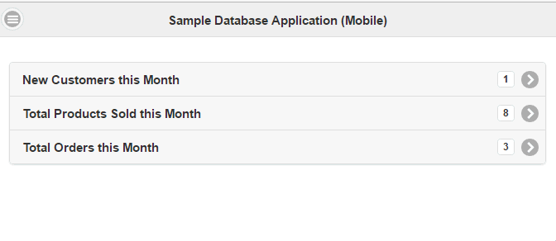
Understanding Themes
A theme identifies a collection of templates which define the look and feel of the application.
Universal Theme – Theme 42
Mobile – Theme 51
Notes:
A theme is a named collection of templates that defines the application user interface. Each theme contains templates for every type of application component and page control, including individual pages, regions, reports, lists, labels, breadcrumbs, buttons, and list of values. Templates contain HTML and variables that the Application Express engine substitutes with dynamic values at runtime.
Templates are organized first by template type and then by template class. Template types include page, region, report, list, button, label, and popup list of values (LOV).
Each template type has a number of template classes. A template class defines the purpose of a template within a template type. For example, a region template can be classified as a form region template, a report region template, and so on. These classifications enable Oracle Application Express to map templates among themes, making it easy to quickly change the entire look and feel of an application.
The slide shows applications using Universal Theme – Theme 42, and Mobile – Theme 51. Oracle Application Express ships with an extensive theme repository. There are two types of themes for desktop applications:
Standard Themes: Standard themes are supplied with Application Express. The Universal Theme (Theme 42) and the Mobile Theme (Theme 51) are the standard themes in Oracle Application Express release 5.1. Older themes are considered legacy and are deprecated. Applications using these themes should be migrated to the Universal Theme. Theme 42 and Theme 51 are list-based themes.
Custom Themes: Custom themes are additional themes available for use. For example, Workspace administrators can create themes that are available to all developers within the workspace. Also, instance administrators can create public themes by adding them to the Oracle Application Express Administration Services. Once added, these public themes are available to all developers across all workspaces in an instance.
Oracle Application Express applications define the position of regions and items on a page using grid settings. Older themes, such as such as Theme 26 - Productivity Applications, use a table-based grid. In table-based themes, you can position regions next to each one another and forms can have two or more items in a single row. Newer themes, such as Universal Theme - 42, use a DIV-based grid. Pages using a DIV-based grid offer the following advantages:
Easier to maintain and update: DIV-based pages have less code and therefore less complexity.
Faster loading: Pages using a DIV-based grid generally load faster.
If you switch from a table-based theme to a DIV-based theme, you need to configure the Reset Grid option, Reset fixed region position in the Switch Theme Wizard. Selecting Reset fixed region position removes existing settings and renders all regions and items stacked vertically. You learn how to use the Switch Theme Wizard, later in this lesson.

Slide 5
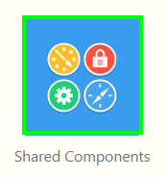
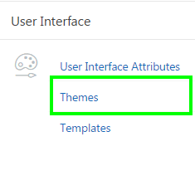
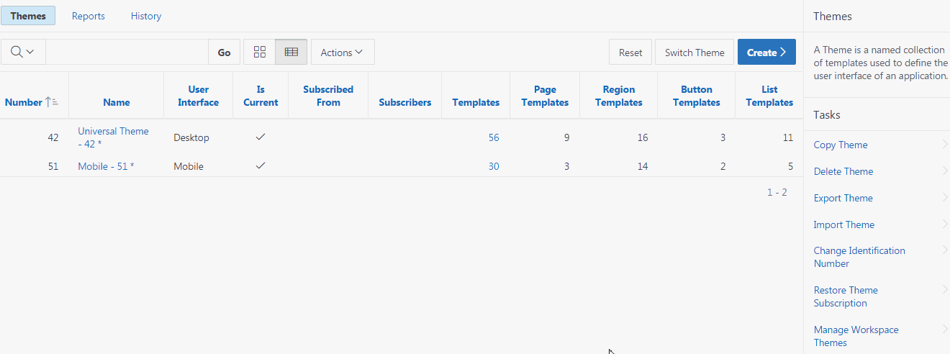
Accessing the Themes Page
Notes:
To access the Themes page, perform the following steps:
Navigate to your application home page and click Shared Components
Under User Interface, select Themes.
The Themes page appears as a report. The themes available for the application are displayed. A check mark in the Is Current column indicates which theme is selected. The Tasks section provides you options to copy a theme, delete a theme, export and import theme, and so on.
The slide shows two themes available for the application. The application uses both the desktop and mobile interfaces. In the slide, the theme current for desktop interface is
Universal Theme – Theme 42.

Slide 6
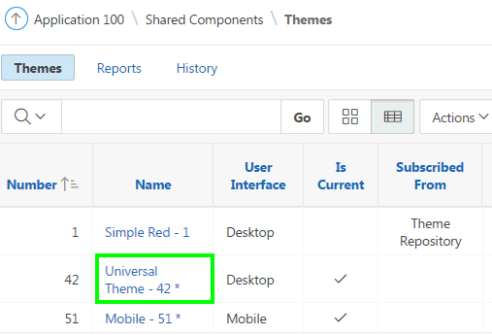
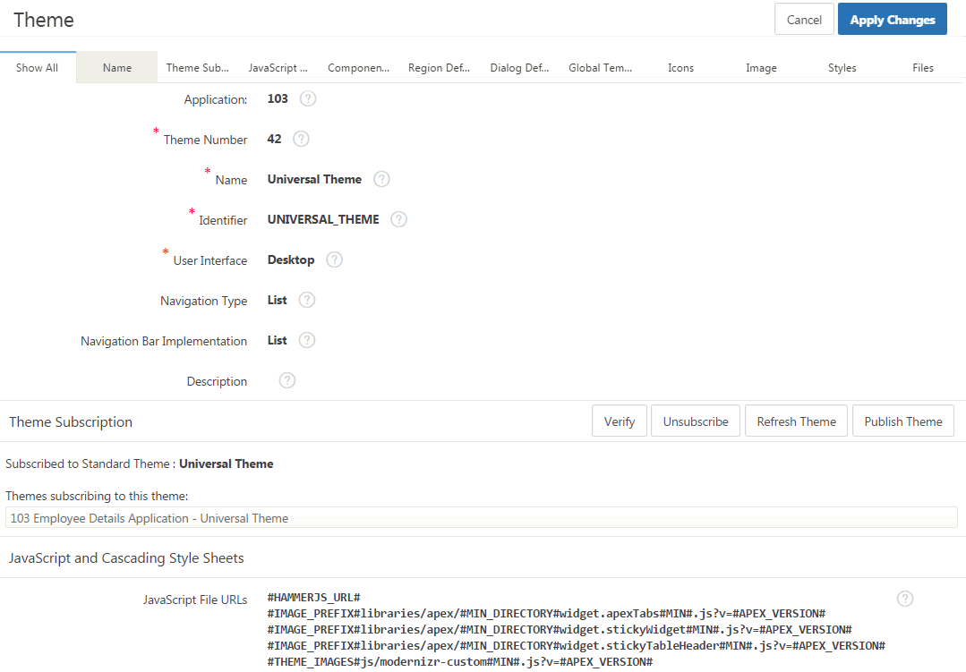
Editing a Theme
Notes:
To review or edit a theme, perform the following steps:
Navigate to the Themes page. Click the theme name.
The Create/Edit Theme page appears and is divided into sections. Edit the appropriate attributes.
To save any changes, click Apply Changes.
Note: Unlocking the Universal Theme to edit the templates will prevent you from taking update in future releases. Instead, create a copy of the Universal Theme and edit the copied theme.

Slide 7
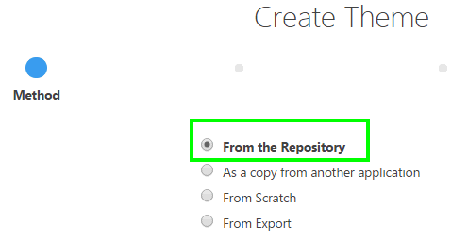
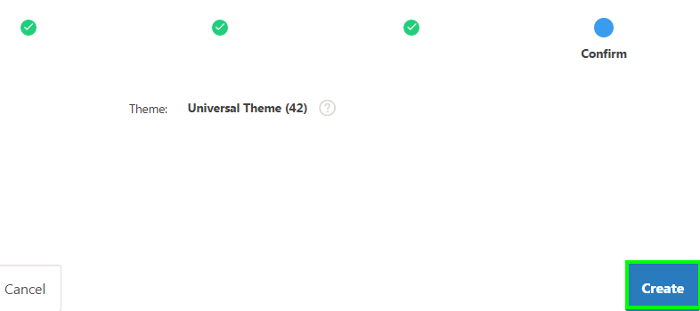
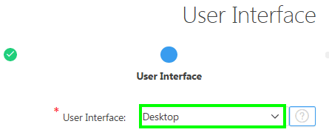
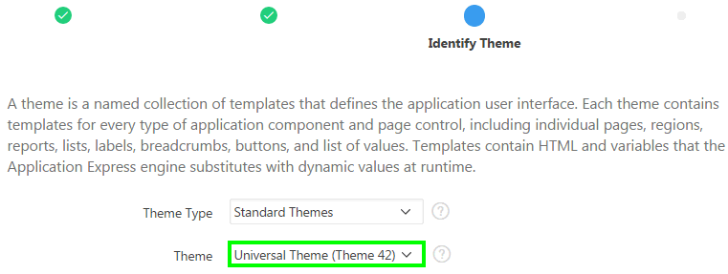
Creating a New Theme from the Repository
4
1
2
3
Notes:
Only themes currently associated with an application display on the Themes page. To access other themes, you must run the Create Theme Wizard. Once you create a theme, you can access it on the Themes page. You can create a theme from scratch or select an existing theme from the repository.
To create a new theme from the repository, navigate to the Themes page, click Create, and then perform the following steps:
Select From the Repository and click Next.
Select the User Interface and click Next. Select Desktop For applications primarily designed for desktop use. For other interfaces, such as smartphones or tablets, select the corresponding user interface.
Select a theme type and then select a theme. Then, click Next.
Click Create.

Slide 8
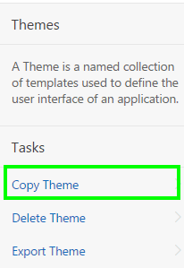
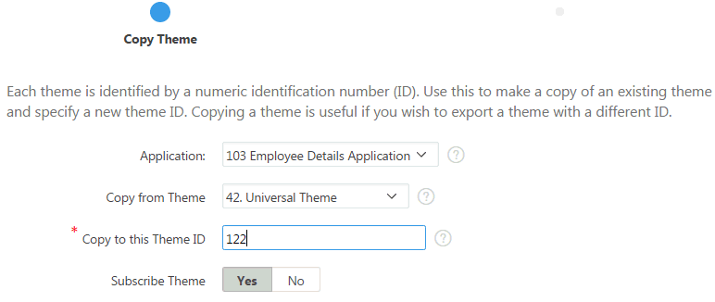
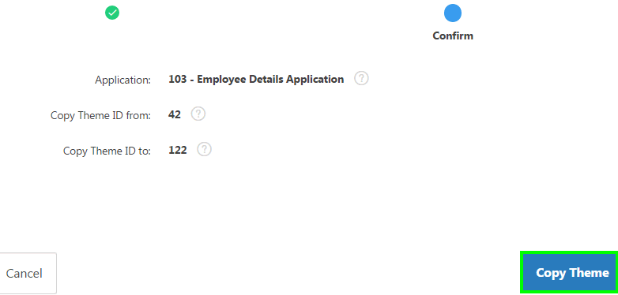
Creating a Copy of an Existing Theme
1
2
3
Notes:
The slide shows an example of creating a copy of Theme 42. Each theme is identified by a numeric identification number (ID). When you copy a theme, you specify a theme ID. Copying a theme is useful when experimenting with editing a theme or to export a theme with a different ID.
To copy a theme, navigate to the Themes page and perform the following steps:
On the Tasks list, click Copy Theme.
On Copy Theme :
Copy From Theme: Select the theme you want to copy.
Copy to this Theme ID: Enter a new ID for the theme.
Subscribe Theme: Select Yes or No.
Then, click Next.
Click Copy Theme.
Developers subscribe to a theme when:
Running the Create Application Wizard: When a developer select a built-in theme when running the Create Application Wizard, the theme is automatically subscribed to a master theme. As an alternative to using a built-in theme, the Create Application Wizard provides the option to copy a theme from an existing application. When copying a theme from an existing applications, developers can choose if they wish to have this theme be subscribed to.
Creating a new theme from the Theme repository: When you create a new theme the associated application automatically subscribes to it. When an application subscribes to a master theme, all theme attributes, subscribed template options, and subscribed templates are set to read-only. In other words, only the default templates can be changed. The advantage of subscribing to a master theme is that the theme can be upgraded during future Oracle Application Express releases. When a theme is subscribed to, developers cannot modify the theme or template metadata when they access it from the theme or template edit pages.

Slide 9
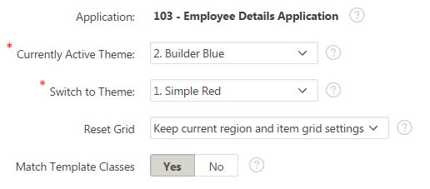
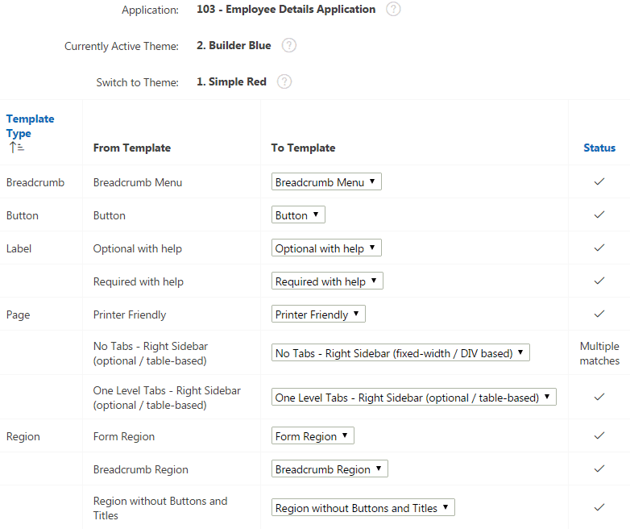
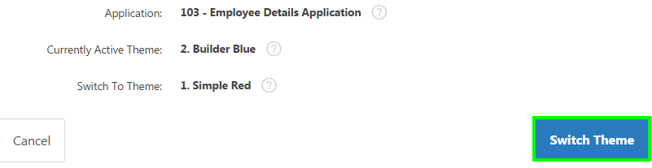
Switching an Active Theme
2
1
3
Notes:
To switch an active theme, navigate to the Themes page, click Switch Theme, and perform the following steps:
For Identify Theme:
Currently Active Theme: Select the current theme for the application.
Switch to Theme: Select the new theme for the application.
Reset Grid: Select whether to reset the grid. Grid settings define the positioning of your regions and items on a page.
Match Template Classes: Select Yes or No. When switching to a new theme, App Builder maps all currently used templates to a template in the new theme using the template class. When Match Template Class is set to No, then templates can be switched to any template with the same type, but irrespective of the template class.
Click Next.
The Verify Compatibility page appears. Review the Status column to identify problematic mappings:
Check indicates the mapping was successful.
Warning indicates there are more than one template in the theme you are switching to with the identified class. The warning provides a select list from which to choose the appropriate template.
Error indicates that App Builder was unable to map the class among the themes. Ensure that a class is identified for the templates in both themes.
Click Next to continue.
Click Switch Theme.
When you switch to a theme, all components with assigned templates are assigned to a corresponding template in the theme. App Builder accomplishes template mapping through the assignment of template class identifiers. When switching an active theme, remember:
You can only switch to a theme if the theme exists. For example, before you can switch to a theme available in the repository, you must first create it.
If the wizard locates multiple matches (that is, when several templates share the same template type and templates class), the wizard defaults to a template matching type, class, and name. If no match is found, you must select another template with the same type and class.
If no matching template is found (that is, no template with the same type and class exists) then you are prompted to select a template with the same type but with a different class. Then, a warning displays explaining this issue might lead to problems with page functionality, or issues with the page display. When no template of the same template type exists, then the theme cannot be switched. You are blocked from switching themes.
You cannot switch from Universal Theme to any other theme because it uses list-based navigation whereas the other themes use tab-based navigation.
You can switch from an older theme to Universal Theme. However, note that when switching from a theme using tabs to a theme using navigation menu lists, your application will be modified to support list based navigation. This includes migrating your tabs to a navigation menu list.

Slide 10
Understanding Universal Theme
Universal Theme is a user interface for Application Express that enables developers to build modern web applications without requiring extensive knowledge of HTML, CSS, or JavaScript
Three key aspects of Universal Theme that make it ideally suited for Application Express development are:
Responsive Design
Versatile UI
Easy Customization
Notes:
Universal Theme is a user interface for Application Express that enables developers to build modern web applications without requiring extensive knowledge of HTML, CSS, or JavaScript. With some working knowledge of Application Express, you can use Universal Theme to easily build a responsive application that is highly accessible, easily customizable, and easy to maintain.
There are three key aspects of Universal Theme that make it ideally suited for Application Express development: Responsive Design, Versatile UI Components, and Easy Customization.
Responsive Design: Universal Theme has been designed from the very beginning to work just as well on small screen devices (phones, tablet) as it does on larger screen devices (laptops, desktops). This means that the UI components in Universal Theme work across varying screen resolutions while maintaining the same or similar functionality. In addition, Universal Theme takes full advantage of ultra high screen resolutions by utilizing vector graphics where possible, and relying upon CSS3 features for UI styling.
Versatile UI: Universal Theme provides the components / building blocks necessary to build practically any type of business application UI. From Cards, Forms, Menus, Tabs, Reports, and so much more, these components have been developed with the best practices following common and popular UI patterns. You can browse all of the components provided with Universal Theme by navigating to the Components section of this application.
Easy Customization: Even for the most basic of requirements, theming and customization is a key and necessary ingredient to the success of your application. With Universal Theme, you can effortlessly customize and fully control the look and feel of your applications without becoming an expert in UI design, HTML, CSS, or JavaScript. Using Theme Roller and Template Options, you can easily customize your application to fit your company's brand, and customize the look and feel of various components using Template Options. All of this is possible during runtime, so what you see is what you really get.
To learn more about Universal Theme, see https://apex.oracle.com/ut

Slide 11
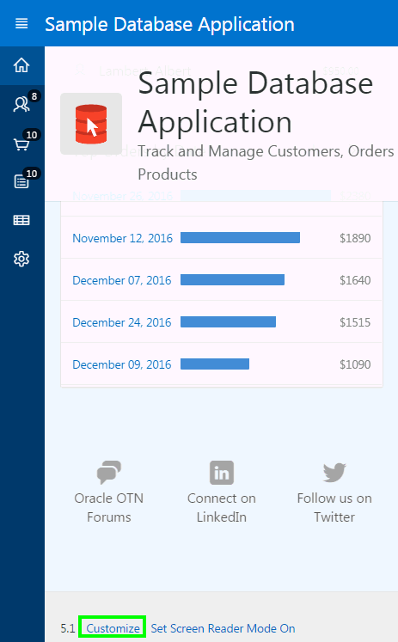
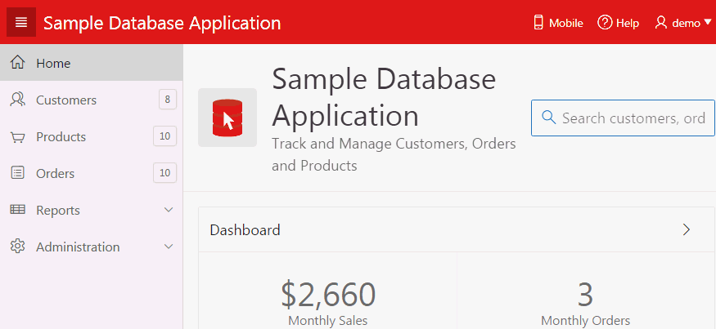
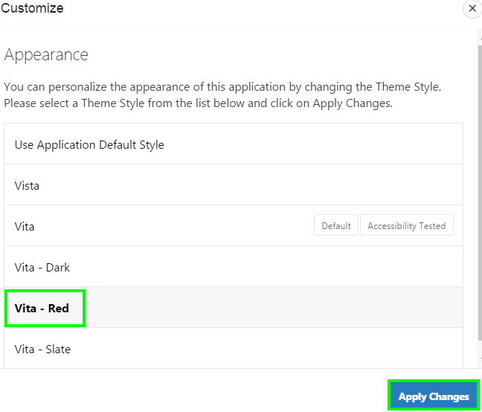
Using Theme Styles
Vita
Vita - Red
1
2
Notes:
The slide example shows that the user changes the theme style to Vita – Red. By applying a theme style on a running application, user can change the look and feel of an application. A theme style defines a CSS style sheet that is added to the base CSS to alter the look and feel of an application.
Developers create a theme style and can enable users to select a theme style in a running application. Once a developer has enabled a theme style, a Customize link appears in the running application, typically in the lower left corner.
End user clicks the Customize link a pop-up displays listing available theme styles.
In the Customize dialog, when a user selects a theme style, the theme style is stored persistently as a user preference and will be retained during future sessions.
The next few slides cover how to create a theme style and enable end users to select a theme style.

Slide 12
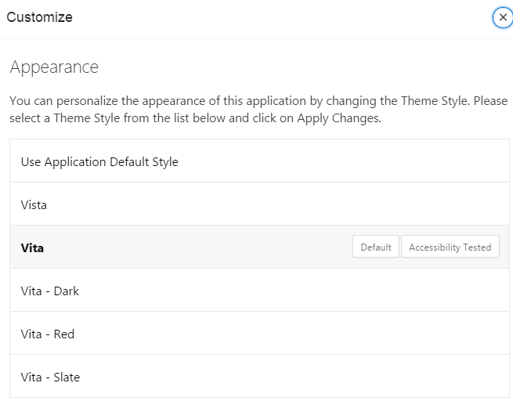
Understanding Theme Styles
You use theme styles to customize themes, switch to a different color scheme, apply a flat look, or make a theme responsive
A theme style defines a CSS style sheet that is added to the base CSS
Newer themes (Theme 42, Theme 51) can include a base CSS file plus the theme style CSS file.
Notes:
A theme style defines a CSS style sheet that is added to the base CSS to alter the look and feel of an application. Newer themes such as Universal Theme - 42 and Mobile - 51 can have a base CSS file plus the theme style CSS file. The theme style CSS file are referenced in the page template using the #THEME_STYLE_CSS# substitution string. The Application Express engine replaces this substitution string with the CSS file references defined in the theme style attributes. You use theme styles to customize themes, to switch to a different color scheme, apply a flat look, or make a theme responsive. A theme can have multiple theme styles with one style set as active. You can modify a theme style CSS file using Theme Roller.
The slide shows steps to create a new theme style. To add a theme style to any theme, perform the following steps:
Navigate to your application home page and select Shared Components. Select the theme in which you want a add a theme style. On the Create/Edit Theme page, click Styles tab and then click Add Style.
The Theme Styles page appears. Under Settings:
Name – Enter a name for the theme style.
Is Current - Select whether this style is the current style used by the theme.
Is Public - Select whether this style can be chosen by end users.
File URLs - Enter Cascading Style Sheet file URLs to be loaded on every page if the theme style is current.
Specify the Theme Roller Attributes and click Create. Under Theme Roller Attributes:
Read Only - Select Yes to prevent any updates to the theme style. Select No to enable the theme style to be edited and overwritten using Theme Roller.
Input Parameter File URLs - Enter the LESS file URLs that will be used to generate this theme style when using Theme Roller.
Output CSS File URL- Enter the URL for the CSS file that will be generated by Theme Roller for this theme style. .
Theme Roller JSON Configuration, JSON Configuration - The JSON configuration is generated by Theme Roller when the theme style is saved. Oracle does not recommend manually updating the configuration. However, you can copy a JSON configuration from another theme style, such as a theme style in another application, to manually update the configuration.
Once defined, developers can edit a theme style either of the following:
Navigating to Shared Components > User Interface > User Interface Attributes page
Navigating to Shared Components > Themes > <your theme> Styles > <your theme style>

Slide 13
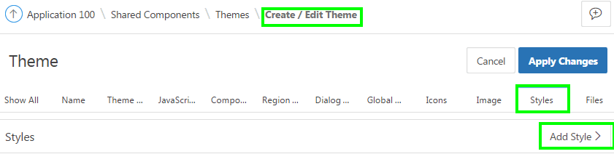
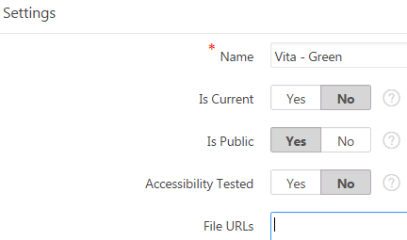
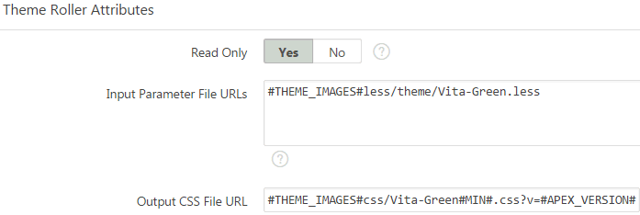
Creating a Theme Style
1
2
3
Notes:
The slide shows steps to create a new theme style. To add a theme style to any theme, perform the following steps:
Navigate to your application home page and select Shared Components. Select the theme in which you want a add a theme style. On the Create/Edit Theme page, click Styles tab and then click Add Style.
The Theme Styles page appears. Under Settings:
Name – Enter a name for the theme style.
Is Current - Select whether this style is the current style used by the theme.
Is Public - Select whether this style can be chosen by end users.
File URLs - Enter Cascading Style Sheet file URLs to be loaded on every page if the theme style is current.
Specify the Theme Roller Attributes and click Create. Under Theme Roller Attributes:
Read Only - Select Yes to prevent any updates to the theme style. Select No to enable the theme style to be edited and overwritten using Theme Roller.
Input Parameter File URLs - Enter the LESS file URLs that will be used to generate this theme style when using Theme Roller.
Output CSS File URL- Enter the URL for the CSS file that will be generated by Theme Roller for this theme style. .
Theme Roller JSON Configuration, JSON Configuration - The JSON configuration is generated by Theme Roller when the theme style is saved. Oracle does not recommend manually updating the configuration. However, you can copy a JSON configuration from another theme style, such as a theme style in another application, to manually update the configuration.
Once defined, developers can edit a theme style either of the following:
Navigating to Shared Components > User Interface > User Interface Attributes page
Navigating to Shared Components > Themes > <your theme> Styles > <your theme style>

Slide 14
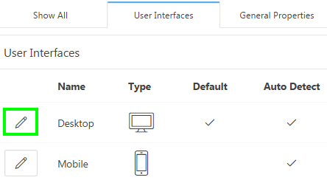
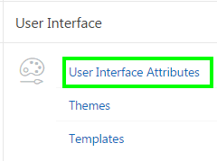
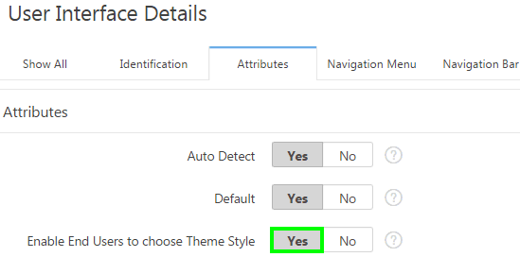
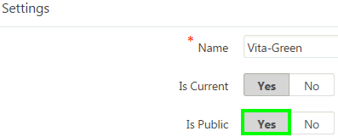
Enabling Users to Select a Theme Style
2
1
3
4
For each theme style, set "Is Public" to "Yes"
Notes:
After creating a theme style, developers can enable users to select this theme style in the running application. For users to select a theme style, you
should have at least two theme styles defined in your application.
Perform the following steps:
Go to the application User Interface page. Click Shared Components. Under User Interface, click User Interface Attributes. The User Interface Attributes page appears. Defined User Interfaces display at the top of the page.
Edit the User Interface Details. Click the Edit icon adjacent to the appropriate user Interface (for example, Desktop).
Under Attributes, set Enable End Users to choose Theme Style to Yes. Click Apply Changes. When set to Yes, end users can choose a Theme Style for their sessions within a customization dialog.
Only Theme Styles marked as "Public" are eligible for selection. Therefore, make sure you edit each theme style and set the Is Public attribute to Yes. To do this:
Navigate to the User Interface page, and click the theme style name
Under Settings, set Is Public to Yes.

Slide 15
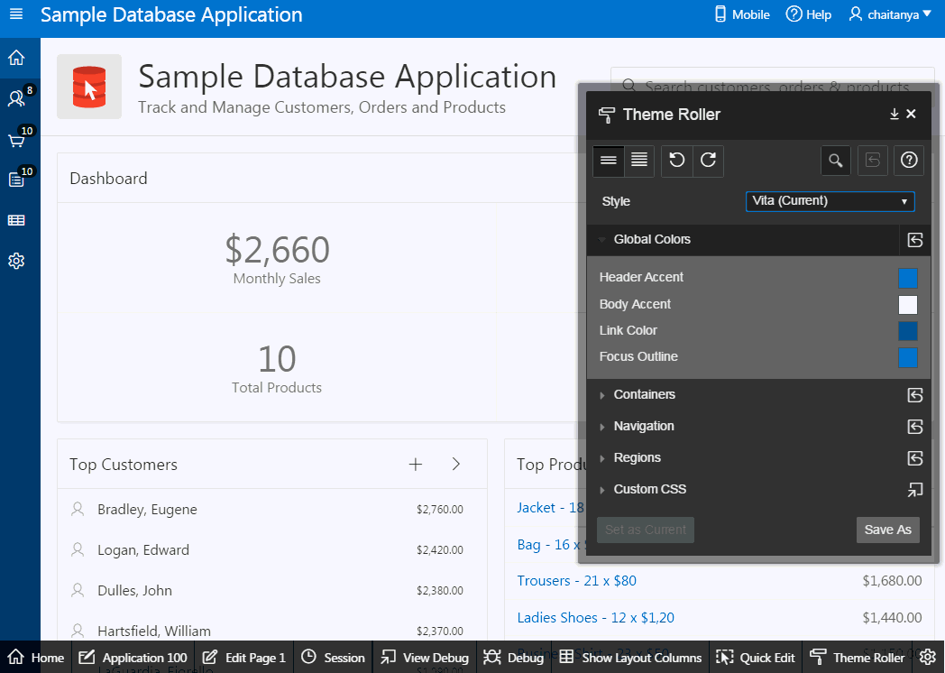
Using Theme Roller
Theme Roller:
Enables easy customization of the look and feel of your application
Allows you to modify a number of style attributes and see changes applied to your application in real time
Allows you to save your changes as a Theme Style
Notes:
Theme Roller is a live CSS editor that enables developers to quickly change the colors, rounded corners and other attributes of their applications without touching a line of code. Theme Roller displays in the Runtime Developer Toolbar if at least one of your theme styles has the Input Parameter File URLs attribute defined.
You can modify a number of style attributes and see changes applied to your application in real time. Once you are satisfied with the result, you can save your changes as a Theme Style directly to your application.
To use Theme Roller, preview a page by running it. When a developer run a desktop application, the Runtime Developer toolbar displays at the bottom of any editable running page. Theme Roller only displays in the Runtime Developer Toolbar if theme styles have been defined.
Perform the following steps:
Click Theme Roller on the Runtime Developer Toolbar. Theme Roller fetches the styles for your application and loads them in the editor.
From Style, select a new style, choose an existing style from the list.
Under Global Colors, click the color swatch to select new colors.
To edit a specific component, expand a group and select new colors or styling of the component you wish to edit.
To set the theme style you are working as the current one for the application, click Set as Current.
If the selected theme is read only, then click Save As to save your changes as a new theme.
Run a packaged application that uses the Universal Theme - 42 to see an example of Theme Roller.

Slide 16
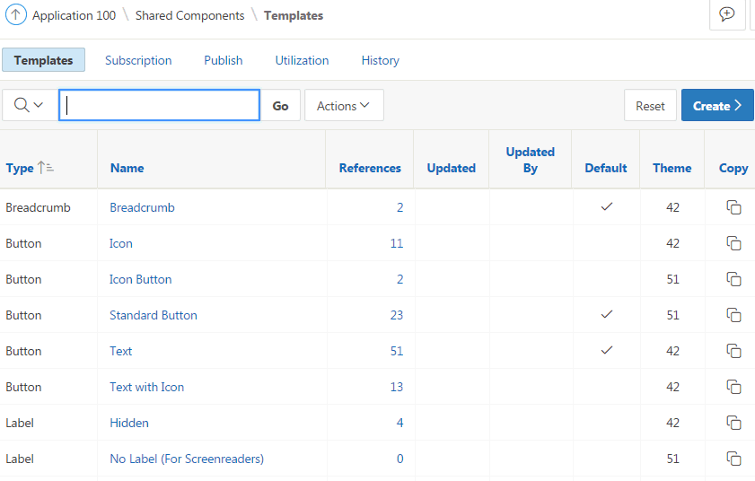
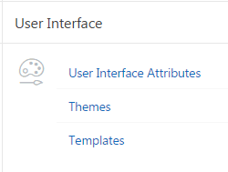
Understanding Templates
The Application Express engine constructs the appearance of each page in an application using Templates
Templates define how pages, page controls, and page components display
Notes:
The Application Express engine creates the user interface of an application based on a named collection of templates called a theme. Templates control the look and feel of the components in your application. If you must create a custom template, it is generally easier to start with an existing template and then modify it. Once you have created one or more default templates, you can modify those templates to fit your specific needs.
You can view all available templates on the Templates page. Alternatively, you can access a template associated with a specific page. The slide shows all the available templates in an application on the Templates page.
To view existing templates:
On the Workspace home page, click the App Builder icon. Select an application. Click Shared Components.
Under User Interface, select Templates. The Templates page displays as an interactive report.
To view or edit a template definition, click the template name. The template definition appears.
Edit the appropriate attributes.
Click Apply Changes.
Note: If you edit a template, you can make changes in one window and run your application in another by selecting the Return to Page check box on the right side of the template definition page. Selecting this check box keeps the page you are editing current after you click Apply Changes.
Templates are organized first by template type and then by template class. Template types include page, region, report, list, button, label, and popup list
of values (LOV).

Slide 17
Understanding Template Options
Template options provide a declarative way for developers to apply different styles to components on an application page
Examples of how developers can use template options include:
Applying different colors or accents
Applying different spacing and padding
Rendering buttons in different styles, with and without icons
Displaying form fields with different alignments
Application components that support template options:
Pages ,regions, classic reports
Breadcrumbs, lists, items and labels, and buttons
Notes:
Template options enable developers to declaratively apply CSS modifiers to the templates they have chosen for pages, regions, reports, lists, breadcrumbs, items and buttons. A CSS modifier is a reference to a CSS class defined in a CSS style sheet. CSS modifiers enable a developer to use the same HTML markup but present it in a variety of different styles simply by applying a CSS. Template options reduce the need to have a large number of nearly identical templates defined in a theme in order to achieve different styles for button colors, region widths, font settings, item label markup, and so on.
The slide shows a few examples of how developers can use template options. Without template options, applying the variations would require a large number of nearly identical templates, or in-depth knowledge of CSS. Components that support template options include: pages; regions; classic reports; breadcrumbs; lists; items and labels; and buttons.
Developers can select template options that are not part of a template option group to be the default for a template. App Builder automatically applies default template options by rendering the component that references the template. Default template options are not written to an actual component. Instead, a #DEFAULT# substitution string is defined for the component, thus enabling developers to centrally modify the template option defaults.
Developers can define the purpose of related template options by creating template option groups. Examples of template option groups include Button Size, Button Style, List Examples, List Style, and Form Label Position.

Slide 18
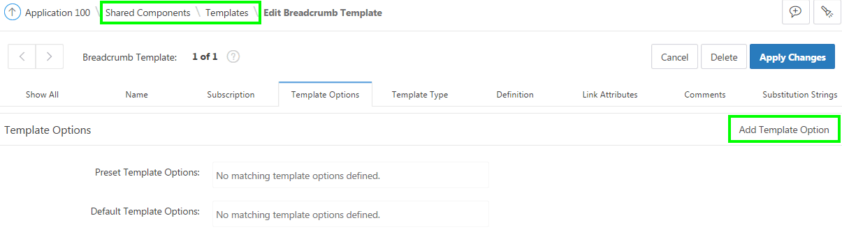
Creating Template Options
Notes:
To create a template option, perform the following steps:
On your application home page, click Shared Components
Under User Interface, select Templates. Select a template.
Select Template Options
Click Add Template Option.
Edit the appropriate attributes.
Click Create or Create and Add Another.

Slide 19
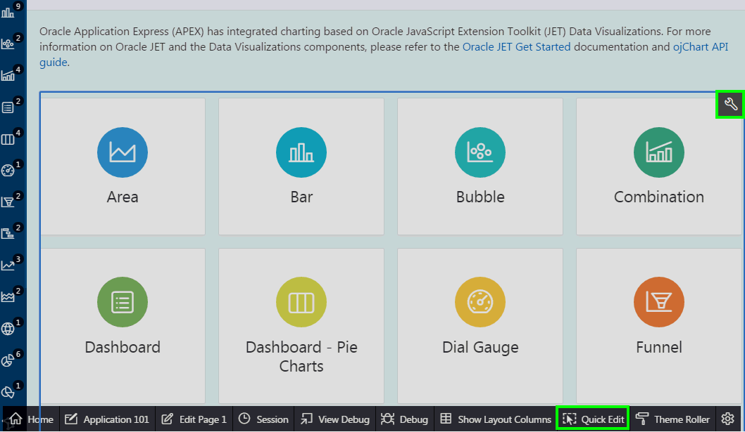
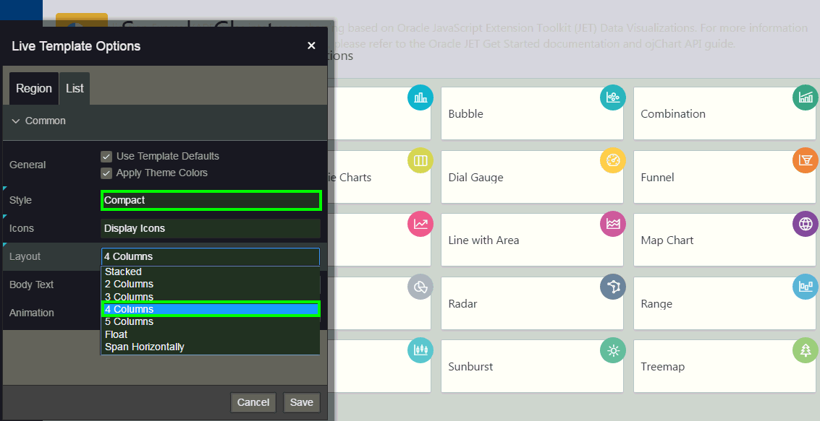
Using Live Template Options
Notes:
You can modify template options for your page components when running the application. Just like Theme Roller, Live Template Options enables you to customize your application in real time, allowing you to try out various template options to get the perfect UI for your application. Developers can simply use Quick Edit on the Runtime Developer toolbar to access the Live Template Options dialog. Using the Live Template Options dialog, developers can alter component's template options without refreshing the page.
The slide example shows using Live Template Options on the Sample Charts application home page. In the example, you change select Compact for Style, and under Layout, you specify 4 columns. As you modify the attributes, you see the changes applied to the UI without even refreshing the page.
To access the Live Template Options, perform the following steps:
Run the page. From the Runtime Developer toolbar, click Quick Edit.
Move the mouse over the component for which you want to modify template options.
Click the Wrench icon in the upper right corner. The Live Template Options dialog appears. For region-based components, such as lists and classic reports, the dialog includes an Attributes tab.
Select the appropriate tab, edit the appropriate attributes, and click Save.

Slide 20
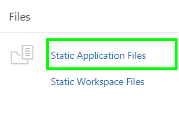
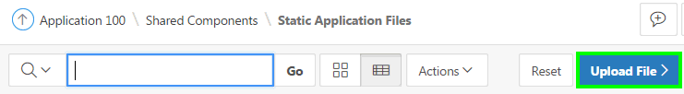
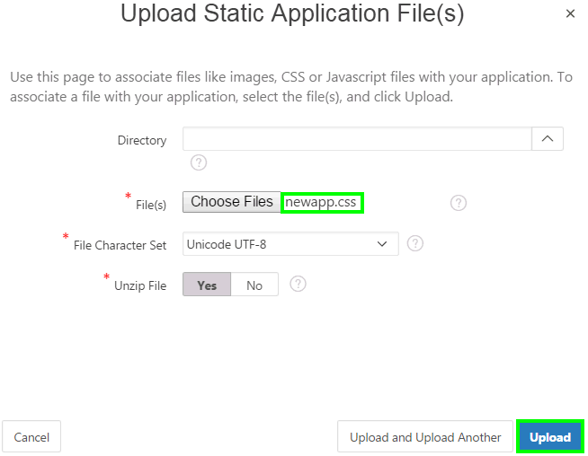
Using Custom Cascading Style Sheets
2
1
3
Notes:
The slide shows steps to upload a custom cascading style sheet. A cascading style sheet (CSS) provides a way to control the style of a web page without changing its structure. When used properly, a CSS separates visual attributes such as color, margins, and fonts from the structure of the HTML document. Oracle Application Express includes themes that contain templates that reference their own CSS. The style rules defined in each CSS for a particular theme also determine the way reports and regions display.
You can upload files (including CSS files) for use by a specific application or all applications within a Workspace.
To upload a CSS, perform the following steps:
Navigate to your application home page and click Shared Components.
Under Files, select Static Application Files.
Click Upload File.
Select the directory where the file has to be uploaded. You can leave it blank to save it under Root.
Browse to your local directory and locate your .css file. Then, click Upload. The file is now uploaded successfully.
You can reference an uploaded cascading style sheet within the Header section of the page template. You use the Header section to enter the HTML that makes up the <HEAD> section of the HTML document.
To reference an uploaded cascading style sheet, perform the following steps:

Slide 21
Referencing an Uploaded CSS in the Page Template
Navigate to your application home page and click Shared Components.
Under User Interface, select Themes. The Themes page appears.
Select your theme and then, on the Tasks list, click View Templates.
Select the name of the page template you want to edit.
Use the <link> tag within the Header section to reference the appropriate style sheet.
Use the substitution string #APP_IMAGES# to reference an uploaded file that is associated with a specific application
Use the substitution string #WORKSPACE_IMAGES# to reference an uploaded file that is associated with a specific Workspace
Notes:
You can reference an uploaded cascading style sheet within the Header section of the page template. You use the Header section to enter the HTML that makes up the <HEAD> section of the HTML document.
The slide shows steps to reference an uploaded cascading style sheet in an application.
To reference an uploaded file that is associated with a specific application, you would use the substitution string #APP_IMAGES#. For example:
<html>
<head>
<title>#TITLE#</title>
#HEAD#
<link rel="stylesheet" href="#APP_IMAGES#sample2.css" type="text/css">
</head>
...
To reference an uploaded file that is associated with a specific workspace, you would use the substitution string #WORKSPACE_IMAGES#. For example:
<html>
<head>
<title>#TITLE#</title>
#HEAD#
<link rel="stylesheet" href="#WORKSPACE_IMAGES#sample3.css" type="text/css">
</head>
...

Slide 22
Summary
In this lesson, you learned how to:
Create and use a new theme
Switch a Theme
Use Theme Styles
Use Theme Roller, and Live Template Options
Upload and use a CSS

Slide 23


Slide 24
Hands-On Lab

