Slide 2

Unit 8: Creating and Using Forms

Slide 3
Lesson Objectives
After completing this lesson, you should be able to:
Describe an application form in Application Express
List the different types of application forms that you can create in Application Express
List the different wizards you use to create forms
Create an editable interactive grid
Create a form on a table and link a report to a form
Create a single page master detail form
Create a two page master detail form
Modify a form

Slide 4

Understanding Forms in Application Express
Forms are application components that are used to manipulate database objects
You can create forms either manually or by using wizards
You can create a form as a:
New page in an application
Region on an existing page in an application
Notes:
Forms are application components that are basically used for data input from end users. An application form takes input from an end user and saves it into the Oracle Database when they submit the page by clicking Apply Changes or Save. For example, you use a form to insert data in to EMPLOYEES table.
Forms are made up of fields (called items) which can be selected from the multitude of built-in types (such as text fields, text areas, radio groups, select lists, check boxes, date pickers, and popup list of values). Developers can also create their own custom item types using plug-ins.
Using wizards, you can easily create forms on tables or on a stored procedure. These wizards provide automatic management of insert, update, and delete. Once you create a form, you can rearrange form fields (called items) using a visual representation, enabling you to quickly achieve the layout you want.
Some forms enable users to update a single row in a table, while other forms enable users to update multiple rows in a table. You can create a form either as a new page in an application or as a region on an existing page.

Slide 5
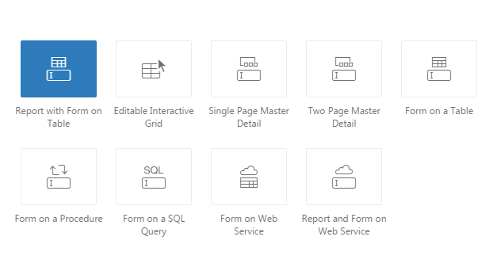
Understanding Form Types
Notes:
Developers can create forms using a number of wizards including the Create Application Wizard, Create Page Wizard, and Create Region Wizard. The available forms differ depending on the selected application user interface (for example, Desktop or Mobile).
The slide lists the form types you can create using the Create Page Wizard.
Report with Form on Table: Creates two pages. One page displays a report. Each row provides a link to the second page to enable users to update each record. You can select the table on which to build the report and form. Note that this wizard does not support tables having more than 127 columns.
Editable Interactive Grid: An interactive grid presents users a set of data in a searchable, customizable report. In an editable interactive grid, users can also add to, modify, and refresh the data set directly on the page. Functionally, an interactive grid includes most customization capabilities available in interactive reports plus the ability to rearrange the report interactively using the mouse.
Single Page Master Detail: Builds a single page report and form combination based on tables you select. Users can select a row to update and update the selected table or view and its associated detail.
Two Page Master Detail: Creates two related interactive grids. You choose the tables on which to build the master and detail regions. The first page is a non-editable interactive grid. Users click the Edit icon on the first page to edit details on the second page.
Form on a Table: Creates a form that enables users to update a single row in a database table. You can choose a table on which to build a form.
Form on a Procedure: Builds a form based on stored procedure arguments. You use this approach when you have implemented logic or Data Manipulation Language (DML) in a stored procedure or package.
Form on a SQL Query: Creates a form based on the columns returned by a SQL query such as an EQUIJOIN.
Form on Web Service: Creates a page with items based on a Web service definition. This wizard creates a user input form, a process to call the Web service, and a submit button.
Report and Form on Web Service: Creates a page with items based on a Web service definition. This wizard creates a user input form, a process to call the Web service, a submit button, and displays the results returned in a report.
For more information about form options, see Oracle Application Express App Builder User’s Guide.

Slide 6
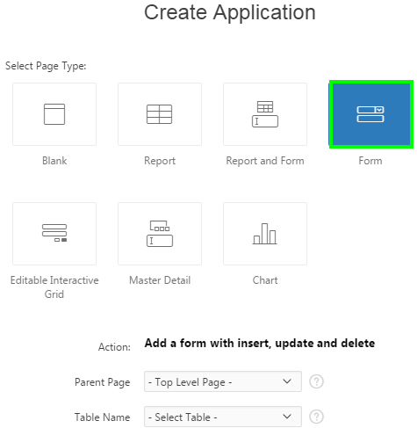
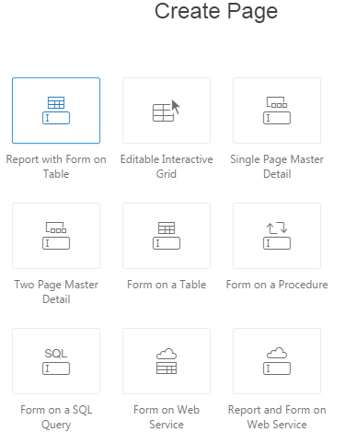
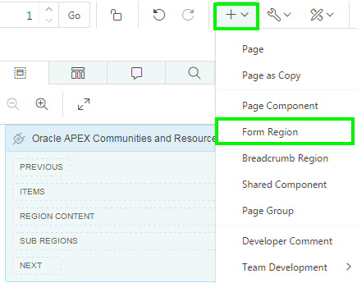
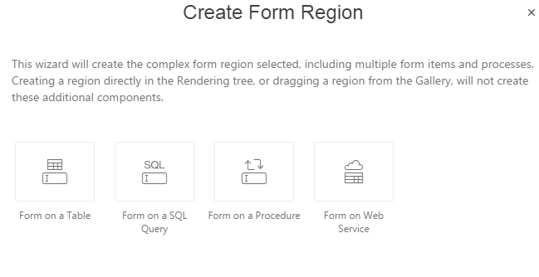
Using Wizards to Create Forms
Using the create application wizard
Using the create page wizard
Creating a Form region in Page Designer
Notes:
The slide shows three different wizards that you can use to create a form in your application.
Create application wizard: You can use the create application wizard to create a form to update a single row in a table. This wizard enables you to choose the table on which to build the form.
Create page wizard: The easiest way to create a form is to use the create page wizard. You already learned the different form options available with the create page wizard in the previous slide.
Create region wizard: You can create a form region in page designer. Perform the following steps:
View the page in Page Designer. Locate the Page Designer Toolbar at the top of the page.
On Page Designer Toolbar, click the Create menu and select Form Region. The Create Region Wizard appears.
Select the type of form you wish to create from the following options:
Form on a Table
Form on a SQL Query
Form on a Procedure
Form on a Web Service
Click Next and follow the on-screen instructions.
Note: You can also create a form manually by selecting it in the Gallery and dragging and dropping it in the Layout tab. However, Oracle does not
recommend a manual approach when creating forms since it does not create all the necessary underlying form items and processes.

Slide 7
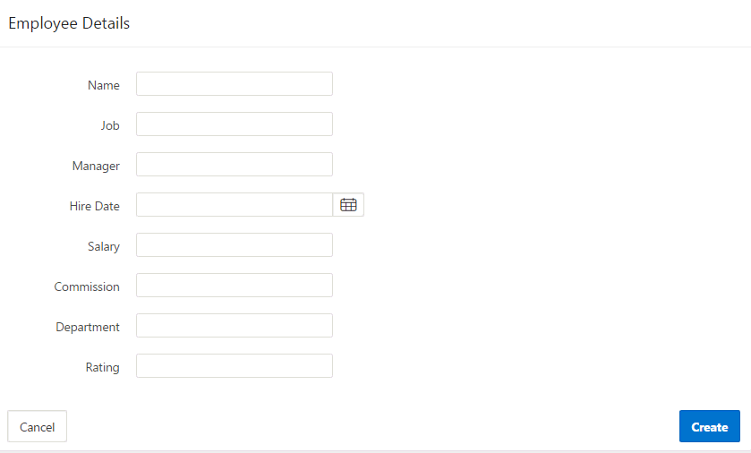
Creating a Form on a Table
Form created on a table
Notes:
The slide shows the Employee Details form which is created on the EBA_DEMO_IG_EMP table using the create page wizard. A form on a table basically enables users to update a single row in a database table. The wizard allows you to choose a table on which to build a form. The wizard creates the Create and Cancel buttons on the page. You can create a new row in the table by entering the details in this form and clicking the Create button. The form inserts data into the table and you are redirected to the page that you specified while creating the form. If you click Cancel, you are returned to the page that you specified while creating the form.
Using ROWID: For the DML operations to function properly in a form, each row in a table should be uniquely identifiable. You generally specify a primary key for a table. A primary key can be either a single column or a combination of two or more columns in a table. The Create Form wizards in Application Express allow you to specify a maximum of two columns for a primary key. If your table does not have a primary key or if the primary key is a combination of more than three columns, then you must use ROWID. ROWID is a pseudo column, that uniquely identifies a row in a table. In the Create Form wizard, the default Primary Key Type is Managed By Database (ROWID).

Slide 8
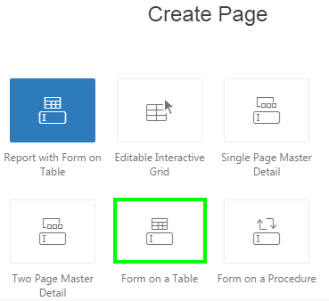
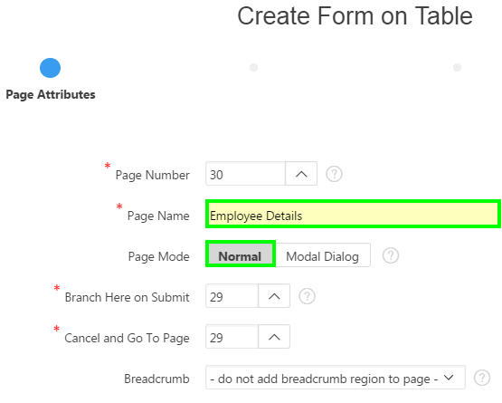
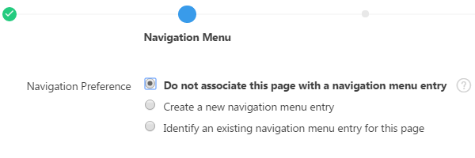
Creating a Form on a Table: Steps
1
2
3
Notes:
The slide shows steps to create a form on a table. Perform the following steps:
First, access the "Form on a Table" wizard. On your application home page, click Create Page, select Form and then select Form on a Table.
On the Page Attributes dialog, enter a name for Page Name. Then, select an option for Page Mode. You can either select Normal or Modal Dialog. In the slide example, you select Normal. For Branch Here to Submit, select a page to branch to after the page processing is complete. Select a page that you should be redirected to if you click the Cancel button on the form. Click Next.
Select an option for Navigation Preference and click Next. In the example, you accept the default.
The example shows creating a form as a Normal page. Instead of choosing Normal, you can choose Modal Dialog for Page Mode. A modal dialog is an overlay window positioned
within the viewport, which remains active and focused until the end user dismisses (closes) it. The underlying page is grayed out and the end user is prevented from interacting
with the rest of the page until the dialog is closed. You cannot run dialog pages directly from Page Designer. You can review such page by running a page that launches the
dialog.

Slide 9
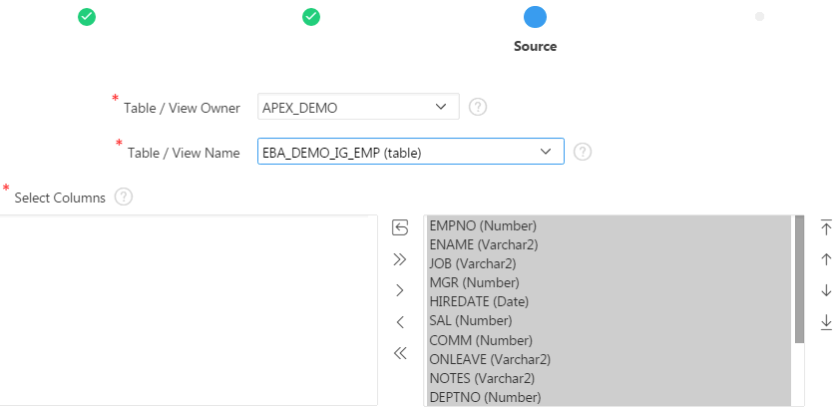
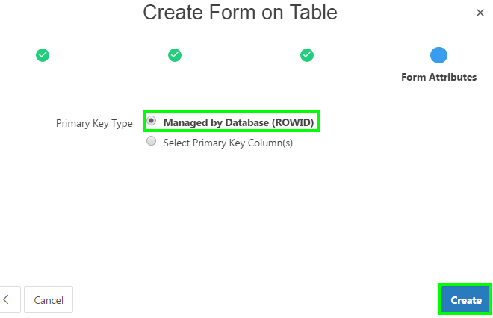
Creating a Form on a Table: Steps
4
5
Notes:
Select the table or view on which the form will be based. Select the columns to include in the form and click Next.
On the Form Attributes dialog, select an option for Primary Key Type and click Create. In the slide example, you select Managed by Database (ROWID) for Primary Key Type.
The form is now created. Click Save and Run Page.

Slide 10
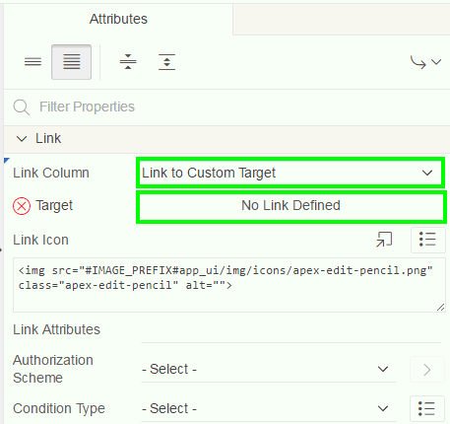
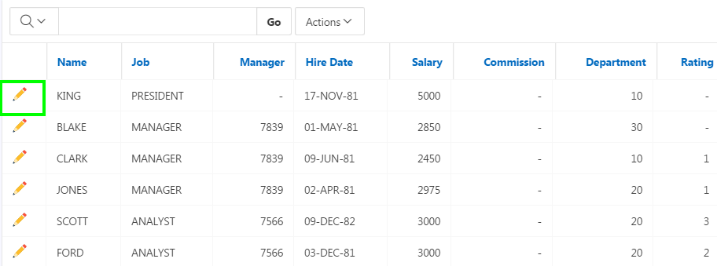
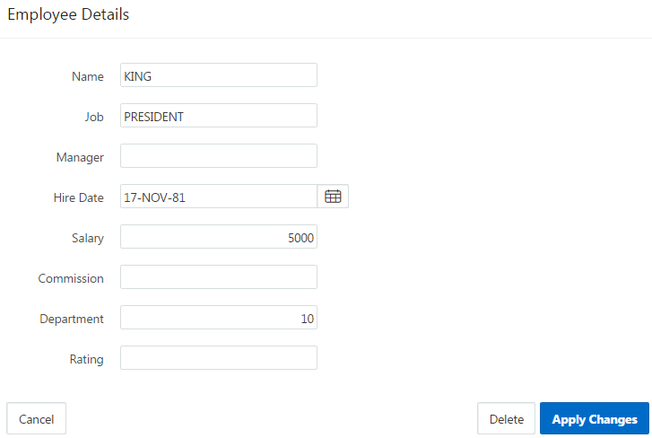
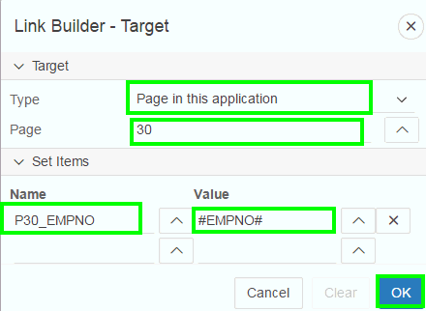
Linking a Report to a Form
1
2
Notes:
The slide example shows how to link an interactive report to a form. When you create a "Report with Form on Table," the wizard automatically creates the required report and form and links between them. You can also link interactive and classic reports to existing forms. In the slide example, you link an interactive report to the form that you just created in the previous slide. For this example, you already have an interactive report built using the EBA_DEMO_IG_EMP table.
To link a report to a form, perform the following steps:
View the report page in page designer.
Under Rendering, select Attributes.
Then, locate Link in the right pane and select Link to Custom Target for Link Column.
Click Target and a dialog page opens.
In the Link Builder – Target dialog box:
Select the target form page. For example, in the slide, select the Employee Details page, Page <n>.
Select the item and value that is to be passed with the link. For example, in the slide, you select P<n>_EMPNO for Name and #EMPNO# for Value
Click OK
Now, click Save. Then, click Save and Run Page. Click the edit icon for any employee and you see the Employee Details form displayed.

Slide 11
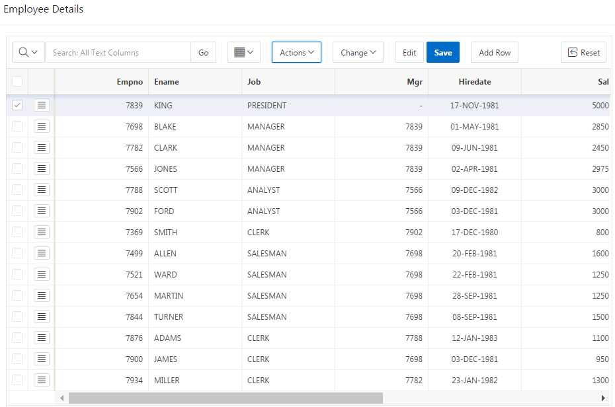
Creating an Editable Interactive Grid
Notes:
In an editable interactive grid, users can add to, modify, and refresh the data set directly on the page. Editable interactive grids expand the functionality of regular interactive grids to enable users to more directly update a grid’s structure and contents. Users can add and delete rows, edit cell contents, and refresh the grid with the latest updates. The slide shows the Employee Details editable interactive grid created using the Create Page wizard. In the next slide, you learn the steps to create an editable interactive grid.
An Interactive Grid - Automatic Row Processing (DML) process is added by default when an Interactive Grid is made editable.
Key features of editing an Editable Interactive Grid:
The grid is in navigation mode where arrow keys move from cell to cell. To enter edit mode press the Edit button or double click or press Enter key or F2 key in a cell. To exit edit mode press the Edit button or press Escape key in a cell.
In edit mode the [Shift] Tab key moves to the previous or next cells. The [Shift] Enter key moves to the same column in the previous or next row.
Edit controls such as radio groups or text areas that don't fit in a cell are displayed in a floating popup. The popup can be moved or collapsed to see the data under it. The Ctrl+F6 key will collapse or expand the floating popup.
Use the Delete key to delete the selected rows. Use the Insert key to add a row.
The Actions menu allows you to perform actions on the row such as Delete or Duplicate. The menu in the header is a selection actions menu that acts on the current selection.
Editing is also supported in Single Row View. All edits are stored locally until you press the Save button. If you try to leave the page while there are unsaved changes you will be warned.
Any action that causes refreshing the data such as changing a filter or sorting will warn if there are unsaved changes. Pagination does not affect changes.

Slide 12
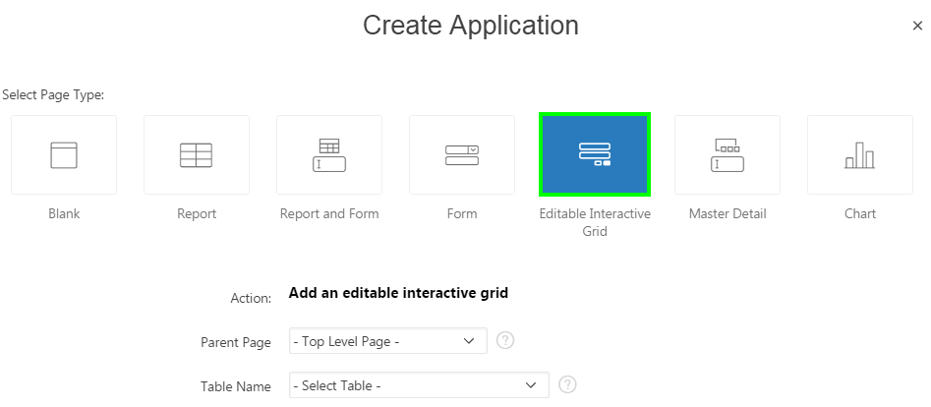
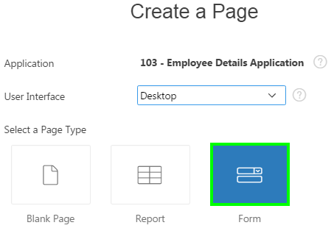
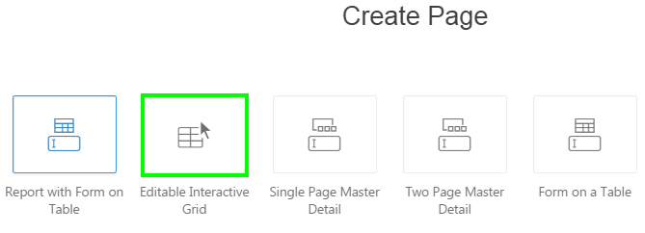
Creating an Editable Interactive Grid: Different Wizards
Create Application Wizard
Create Page Wizard
Notes:
The slide shows the two different wizards that allow you to directly create an Editable Interactive Grid in Application Express: Create Application wizard, and Create Page wizard.
In the Create Page wizard, you first select Form for Page Type and then you select an Editable Interactive Grid.
In the Create Page wizard, you select Report for Page Type and then select Interactive Grid. To create an editable interactive grid, in the Report Source dialog of the wizard, you can then set Editing Enabled to Yes. You already learned how to create an interactive grid in the Developing Reports lesson. In the next slide, you learn how to directly create an editable interactive grid using the Create Page wizard.

Slide 13
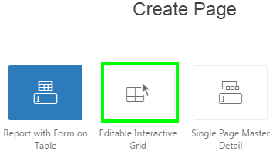
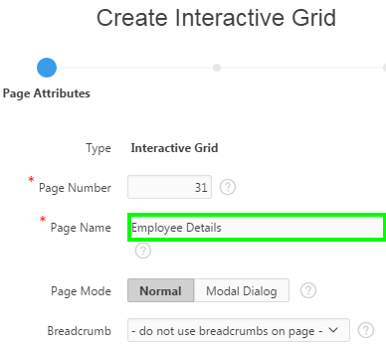
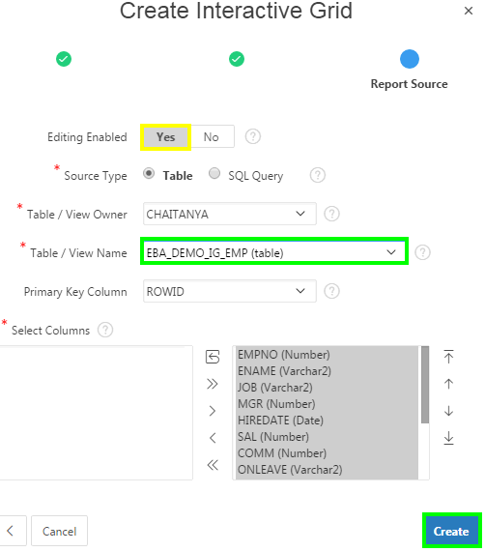
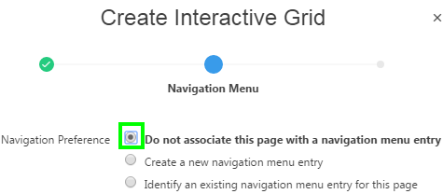
Creating an Editable Interactive Grid: Steps
1
2
3
4
Notes:
The slide shows steps to create an editable interactive grid. Perform the following steps:
On your application home page, click Create Page, select Form and then select Editable Interactive Grid.
On the Page Attributes dialog, specify the interactive grid page name, accept the remaining defaults and click Next.
On the Report Source dialog:
Select Yes for Editing Enabled
For Source Type, you can either select Table or SQL Query. In the slide example, select Table.
From Table/View Name list, select the table that is the source for your interactive grid. In the slide, select EBA_DEMO_IG_EMP table.
For Primary Key Column, select ROWID
Select the columns to include in the form and click Create.

Slide 14
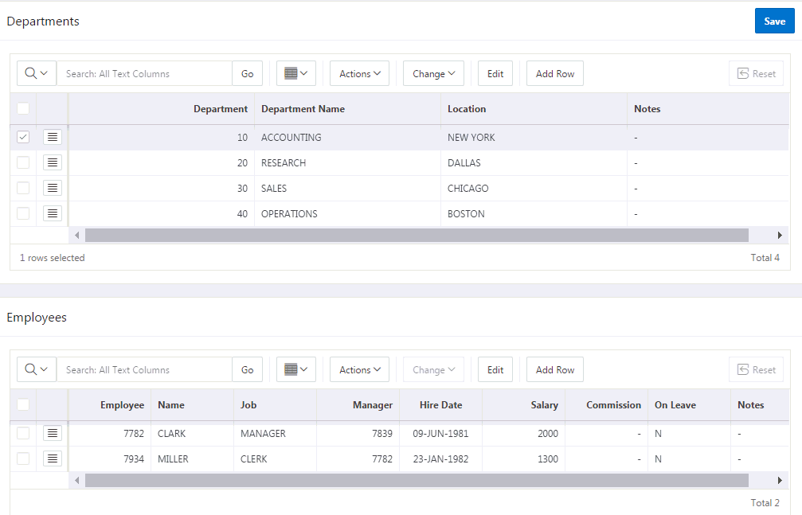
Creating a Single Page Master Detail
Notes:
A master detail form reflects a one-to-many relationship between two tables in a database. Typically, a master detail form displays a master row and multiple detail rows within a single HTML form. With this form, users can insert, update, and delete values from two tables or views. When you create a master detail form using the Create Page or Create Application Wizards, you choose the tables on which to build the master form and the detail form.
A single page master detail features two editable interactive grids based on two related tables or views. Users select a row in the master grid to update the detail grid. Developers can create a single page master detail with either the Create Application Wizard or the Create Page Wizard.
Users select a row on the master grid to update the detail grid. In the slide example, a user selects a department on the master grid to view details of the employees corresponding to that department in the detail grid.

Slide 15
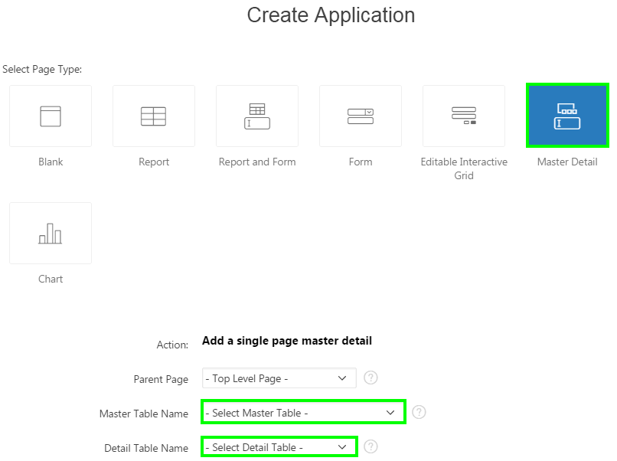
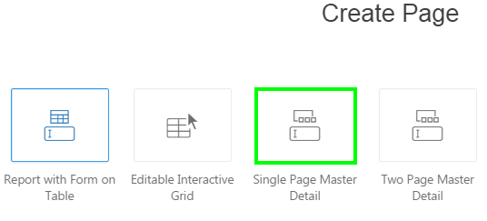
Creating a Single Page Master Detail: Different Wizards
Create Page Wizard
Create Application Wizard
Notes:
The slide shows the two different wizards that allow you to directly create a Single Page Master Detail in Application Express: Create Application wizard, and Create Page wizard.
In the Create Page wizard, you first select Form for Page Type and then you select Single Page Master Detail.

Slide 16
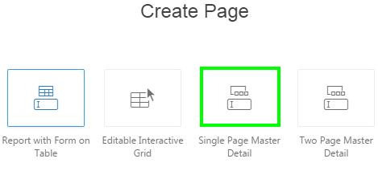
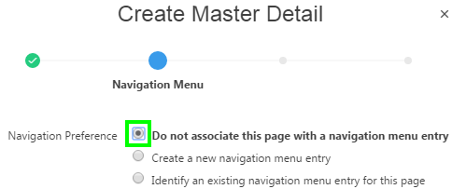
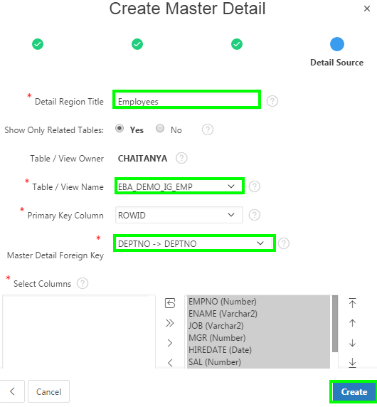
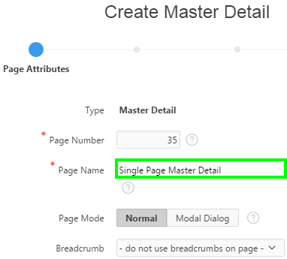
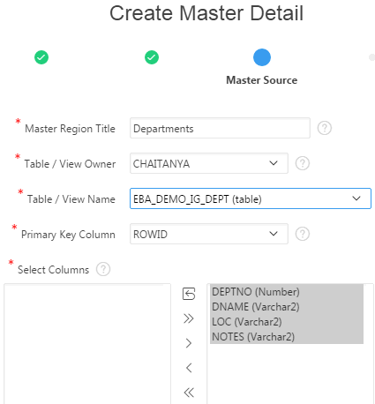
Creating a Single Page Master Detail: Steps
1
3
4
2
5
Notes:
The Create Application wizard allows you to create a Single Page Master Detail. This slide shows how to create a Single Page Master Detail using the Create Page wizard. Perform the following steps:
On the Workspace home page, click the App Builder icon. Select an application. Click Create Page. Select Form for Page Type and click Next. Then, select Single Page Master Detail and click Next.
Specify the page name, select the page mode, and click Next.
Specify your navigation preference and click Next.
In the Master Source dialog:
Master Region Title: Enter a title for the master region
Table / View Owner: Select the table owner
Table / View Name: Select the master table from the list
Primary Key Column: Specify the primary key column. In the slide example, select ROWID
Select Columns: Select the appropriate columns from the master table
In the Detail Source dialog:
Detail Region Title: Enter a title for the detail region
Show Only Related Tables: Select Yes
Table / View Name: Select the detail table from the list
Primary Key Column: Specify the primary key column. In the slide example, select ROWID
Master Detail Foreign Key: Select the foreign key that relates between the master and detail tables. In the slide example, accept the default
Select Columns: Select the appropriate columns from the detail table.
Click Create.

Slide 17
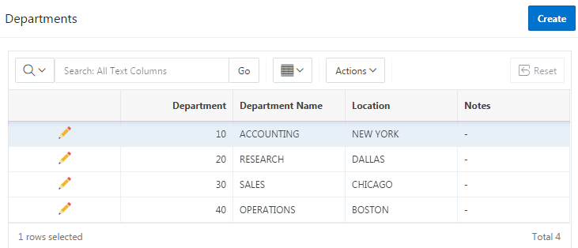
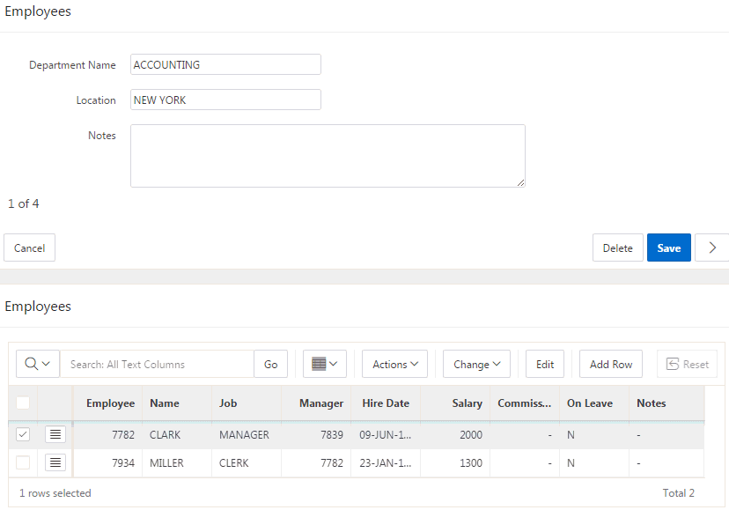
Creating a Two Page Master Detail
Standard form for the master
Non-editable interactive grid
Editable interactive grid
Notes:
A two page master detail features two pages based on two related tables or views. The first page is a non-editable interactive grid. Users click the Edit icon on the first page edit details on the second page.
In the slide example, users click the Edit icon to access all employees within a department. The second page includes both a standard form (for the master) and editable interactive grid of employees.
For numeric and date fields, you can also pre-define date and number format masks, or apply those format masks after generating the initial form. Wizard generated master detail forms also automatically create validations for some columns. Validations are created for columns that are set to NOT NULL in the underlying table and columns of type NUMBER, DATE or TIMESTAMP. Note that validations are not created for columns if the column is set to read-only, either based on the user's selection, or defined user interface defaults.

Slide 18
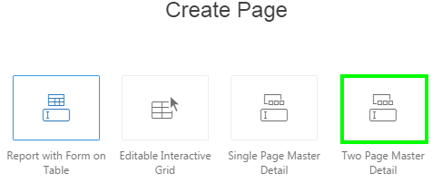
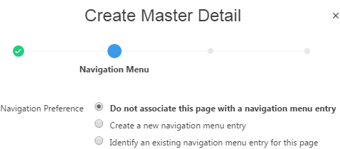
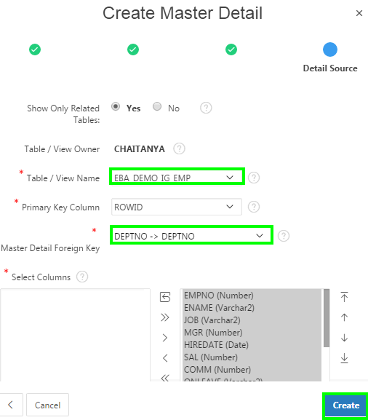
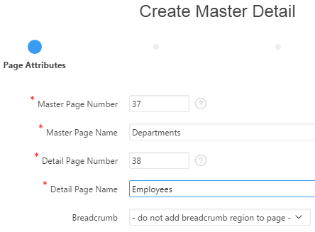
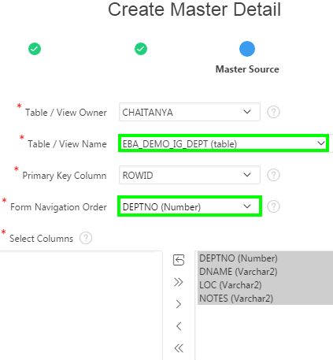
Creating a Two Page Master Detail: Steps
1
3
5
4
2
Notes:
This slide shows how to create a Two Page Master Detail using the Create Page wizard. Perform the following steps:
On the Workspace home page, click the App Builder icon. Select an application. Click Create Page. Select Form for Page Type and click Next. Then, select Two Page Master Detail and click Next.
In the Page Attributes dialog, specify the master page name, and detail page name, and click Next.
Specify your navigation preference and click Next.
In the Master Source dialog:
Master Region Title: Enter a title for the master region
Table / View Owner: Select the table owner
Table / View Name: Select the master table from the list. In the slide, you select EBA_DEMO_IG_DEPT.
Primary Key Column: Specify the primary key column. In the slide example, select ROWID
Form Navigation Order: Select the navigation order column used by the previous and next buttons on the Detail Page, which navigates to a different master record. In the slide, you select DEPTNO.
Select Columns: Select the appropriate columns from the table
In the Detail Source dialog:
Show Only Related Tables: Select Yes
Table / View Name: Select the detail table from the list. In the slide, you select EBA_DEMO_IG_EMP.
Primary Key Column: Specify the primary key column. In the slide example, select ROWID
Master Detail Foreign Key: Select the foreign key that relates between the master and detail tables. In the slide example, accept the default
Select Columns: Select the appropriate columns from the detail table.
Click Create.

Slide 19
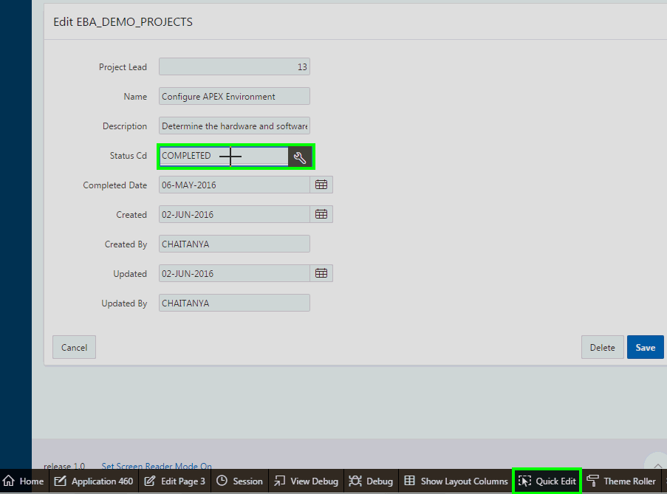
Editing a Form
Notes:
When working with forms, you might want to quickly change the format of a page item, or rename a label. When you run a page, modifying objects is easy with using Quick Edit. Use the Quick Edit control in the Runtime Developer toolbar and select a desired component to instantly access that component in Page Designer. When you click on the Quick Edit, it changes the cursor to a + symbol. Moving this + over the page highlights individual components such as regions, buttons, or items. When the page component you want to edit is highlighted, click that component and APEX automatically opens the page in page designer with the same component pre-selected. This makes it easy for you to edit the properties in the property editor and quickly make the desired changes.

Slide 20
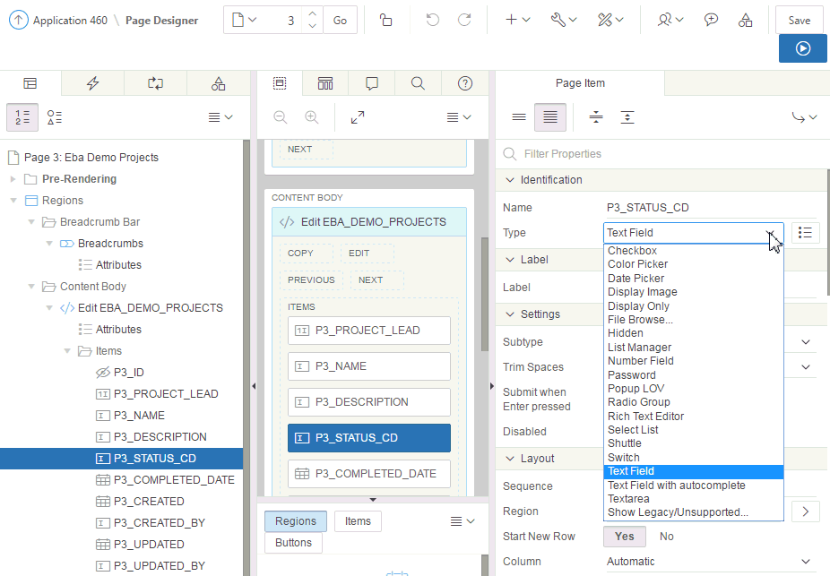
Modifying the Display Type of a Page Item
Notes:
The slide shows editing a form in page designer. Under the Rendering tab, navigate to Regions and locate the form region. Expand Items node to see the list of page items. An item is part of an HTML form. An item can be a text field, text area, password, select list, check box, and so on. Item attributes affect the display of items on a page. For example, these attributes can impact where a label displays, how large an item is, and if the item will display next to or below the previous item. You learn more about page items and editing page items in the Creating Application Page Controls lesson.
Selecting an item in page designer displays the item attributes in the right pane. You can change the display type of a page item. To do this, perform the following steps:
View the form in page designer.
Select the page item under Rendering.
In the Property Editor, from the Type list, select the new display type that you want to apply to the item. For example, a Text Field can be changed to Select List.
Click Save.

Slide 21
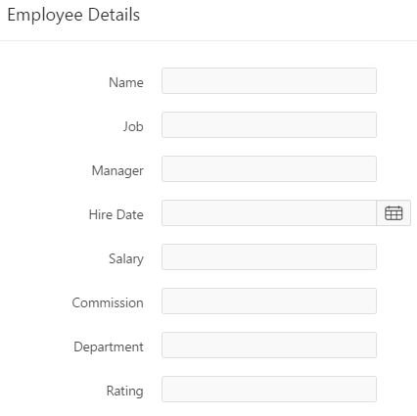
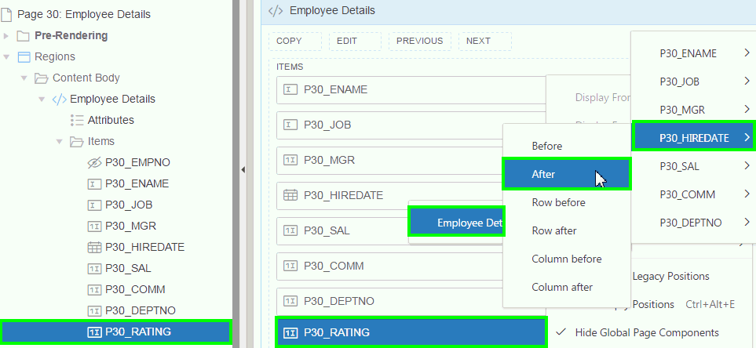
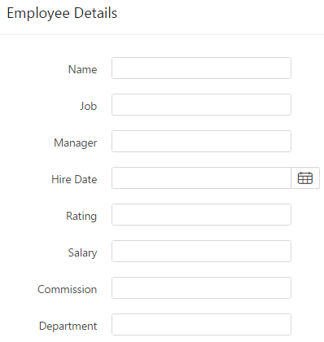
Altering the Display Order of Page Items
Before reordering
Drag and drop in Rendering
Drag and drop or Use Context Menu in Layout
After reordering
Notes:
The slide shows an example of reordering page items on the Employee Details form page. You want to move Rating immediately after Hire Date.
To reorder items on a form, view the page in page designer. Expand Rendering and locate Items. Select the item you want to move, drag it and drop in the desired location. Alternatively, you can drag and drop the item in the Layout. You can even use the context menu in the Layout tab. For example, in the slide, you navigate to Layout in page designer. Select and right-click P<n>_RATING and select Move To > Employee Details > Items > P<n>_HIREDATE > After. This will place the P<N>RATING item immediately after the P<n>_HIREDATE item. Once you reorder items as required, click Save. Then, click Save and Run Page to see the changes implemented on the form page.

Slide 22
Summary
In this lesson, you learned how to:
Create an editable interactive grid
Create a form on a table and link a report to a form
Create a single page master detail form
Create a two page master detail form
Modify a form

Slide 23
Hands-On Lab

Slide 24


