Slide 2

Unit 5: Developing Reports

Slide 3
Lesson Objectives
After completing this lesson, you should be able to:
  List the type of reports that you can create in Application Express
  Describe the different ways of creating reports in Application Express
  Create an interactive report
  Create an interactive grid
  Create a classic report
  Create a report and form
Notes:
In this lesson, you learn the different types of reports that you can create in Application Express. You learn how to use the Create Application and Create Page wizards to create different types of reports. This lesson also includes how to use the context menus and drag and drop feature in page designer to create report regions on an existing page in a database application.

Slide 4
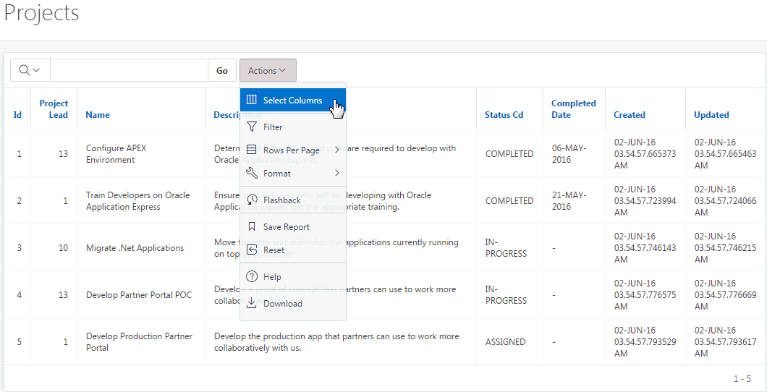
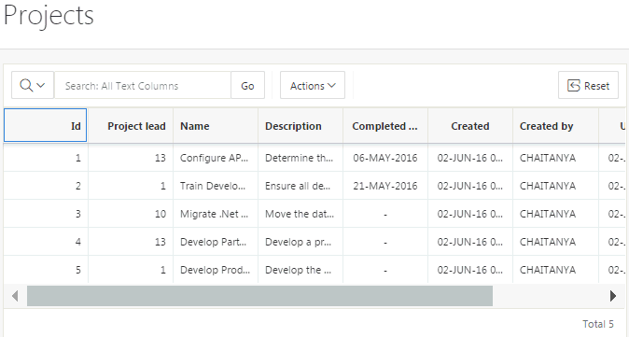
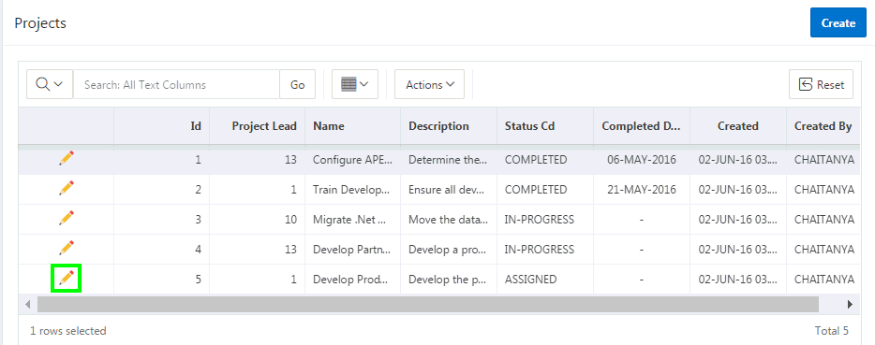
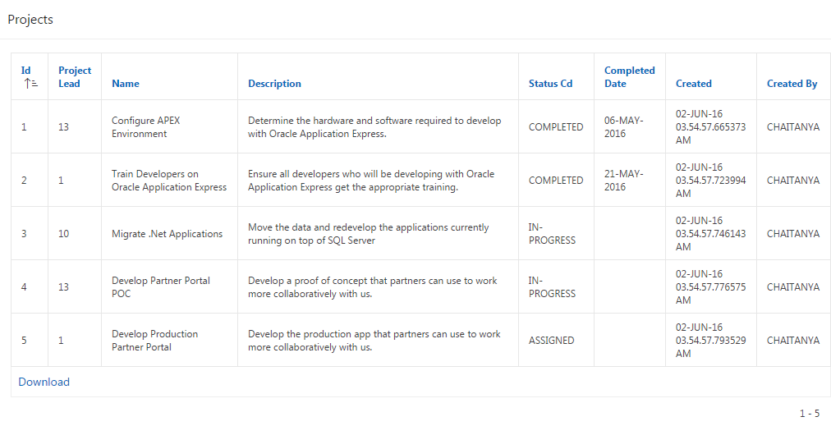
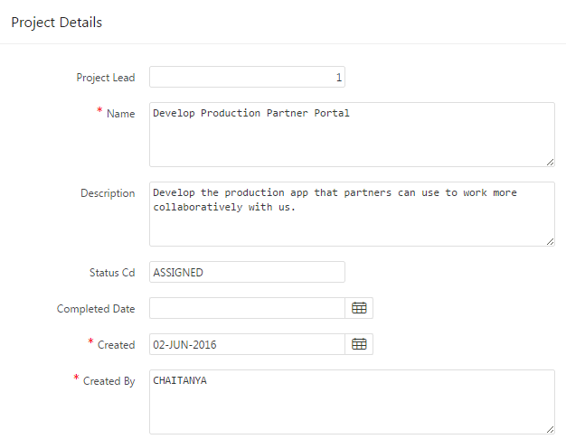
Understanding Different Report Types
A report is the formatted result of a SQL query.
Interactive Report
Interactive Grid
Report and Form
Classic Report
Notes:
In Oracle Application Express, a report is the formatted result of a SQL query. You can generate a report in a database application by selecting and running a built-in query, or by defining a report region based on a SQL query.
When creating a database application, you can create four basic report types:
Interactive Report
Interactive Grid
Report on a form on a table
Classic Report
The main difference between these different report types is the extent and way in which end users can customize the appearance of the data through searching, filtering, sorting, column selection, highlighting, and other data manipulations. You learn more about each of these report types in this lesson.

Slide 5
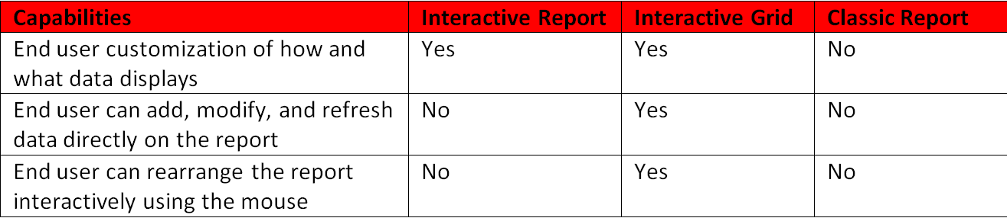
Selecting an Appropriate Report Type
Notes:
The slide shows three different report types: Interactive Report, Interactive Grid, and Classic Report.
Interactive Report: When viewing an interactive report, end users can customize how and what data displays. By default, interactive reports include a search bar, an Actions menu, column heading menus, and Edit icons in the first column of each row. Using options on the Actions menu, users can alter the report layout by hiding or exposing specific columns and applying filters, highlighting, and sorting. You choose an interactive report if your requirement is end user customization.
Interactive Grid: An interactive grid presents users a set of data in a searchable, customizable report. In an editable interactive grid, users can also add to, modify, and refresh the data set directly on the page. Functionally, an interactive grid includes most customization capabilities available in interactive reports plus the ability to rearrange the report interactively using the mouse. You choose an interactive grid if your requirement is to allow end user editing and refreshing directly on the report page along with end user customization of the report.
Classic Report: If you do not need any of the customization, or built-in search bar and drill-down capabilities, then you choose a Classic Report.

Slide 6
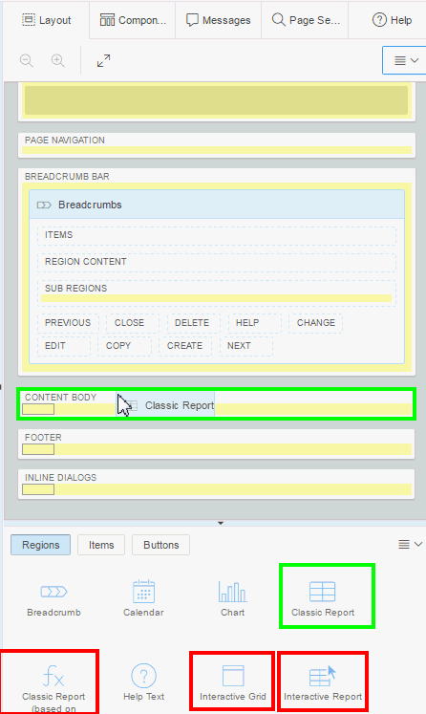
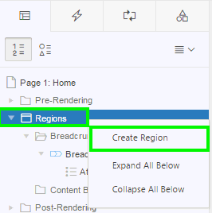
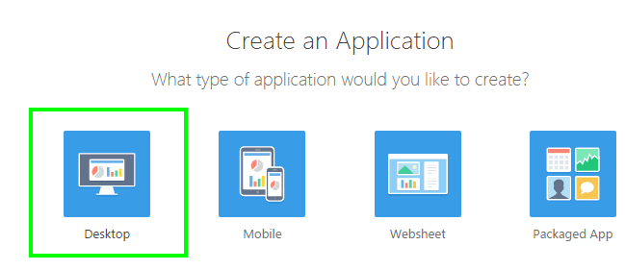
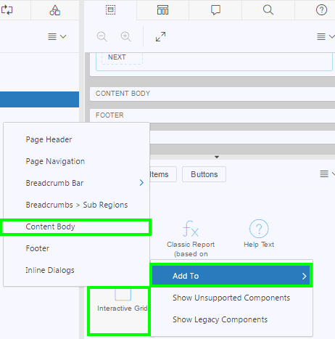
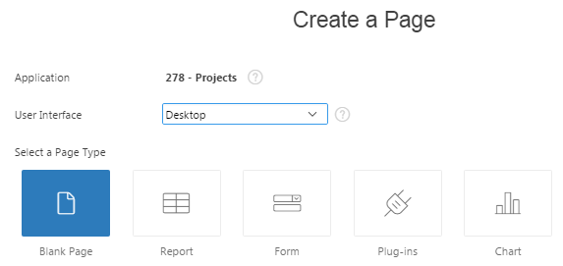
Understanding Different Ways of Creating Reports
Create a report when you create
a new database application
Create a report region on a page
Create Application Wizard
Using context menu
Dragging and dropping from the gallery
Using gallery context menu
Create a report as a new page
Create Page Wizard
Notes:
Application Express allows you to create reports by running a wizard, or by dragging and dropping the region type in Page Designer. App Builder includes built-in wizards that enable you to generate reports. Using these wizards, you can create a report when you create the following:
A database application
A new page in a database application
You can also create a report as a region on an existing page in an application. To do this, you view the page definition in page designer. Then, you create a report region by using any of the following options:
Drag and drop a report region from the gallery
Use context menu under the Rendering tab. Click the Rendering tab on the left-pane, and then right-click Regions to view the context menu. Select Create Region
Use gallery context menu. Right-click a report region in the gallery to view a context menu. From the Add To option, select the location where you want to add the report region on the page.
When you create an application, you choose a target user interface. The user interface you select determines the available report types. In some wizards you select the table and in others you provide the SQL query. If you need any assistance in writing the SQL query, you can click the Query Builder button.

Slide 7
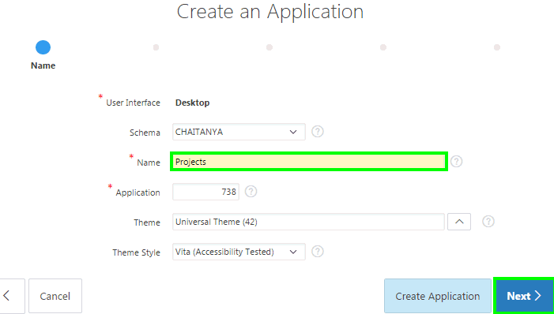
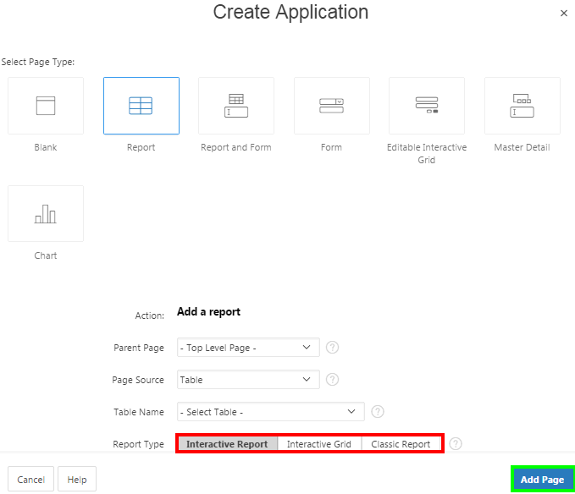
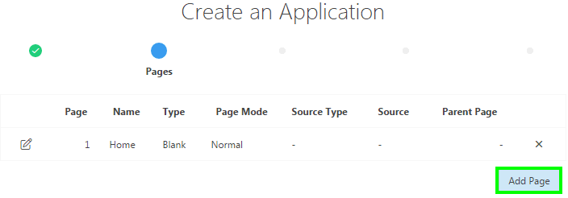
Creating a Report Using the Create Application Wizard
1
3
2
Notes:
By running the Create Application Wizard, you can create a new application that contains one or multiple report pages. The create application wizard has already been covered in detail in the lesson titled Creating a Database Application.
To create a report using the create application wizard, perform the following steps:
On your Workspace home page, click App Builder and then click Create. Select Desktop for application type and click Next. Enter a name for your application, accept the remaining defaults and click Next.
You can now add pages to your application. For Pages, click Add Page.
Select the type of page you want to add. The following are the report options that are available when running the create application wizard:
Report: Creates a page that contains the formatted result of a SQL query. You choose a table on which to build a report, or provide a custom SQL SELECT statement or a PL/SQL function returning a SQL SELECT statement. Once you select a page source (that is Table or SQL Query) you choose a Report Type (interactive report, interactive grid, or classic report). In this case, the interactive grid that is created is read-only.
Report and Form: You choose a table on which to build a two page report and form combination. You then choose the report implementation.
Editable Interactive Grid: An interactive grid presents users a set of data in a searchable, customizable report. In an editable interactive grid, users can also add to, modify, and refresh the data set directly on the page.
If you select Report for Page Type, you can choose from the three types of report implementation: Interactive Report, Interactive Grid, and Classic
Report. Optionally select a page from the Parent Page list. Specify if the page source is a table or a SQL query and then click Add Page. Click Next
and follow the on-screen instructions.
If the page source is a table, then you need to select a table from the Table Name select list
If the page source is SQL query, then you need to enter SQL for Query. You can also click Query Builder to create a query
In the slide example, you select Report for Page Type.

Slide 8
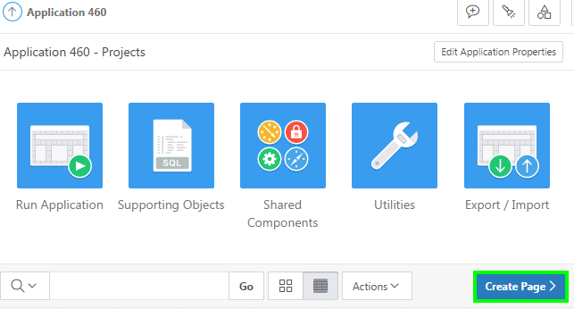
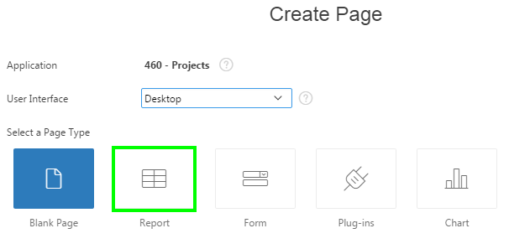
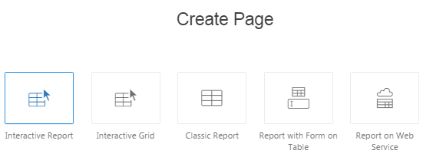
Creating a Report Using the Create Page Wizard
1
2
3
Notes:
By running the Create Page Wizard, you can add a new page containing a report to an existing application. To create a report as a new page, perform the following steps:
Navigate to your application home page. Click Create Page
Select Report for page type and click Next
Select a report type and click Next. The report options that display depend upon the application user interface (for example, Desktop or jQuery Mobile Smartphone). Follow the on-screen instructions.

Slide 9
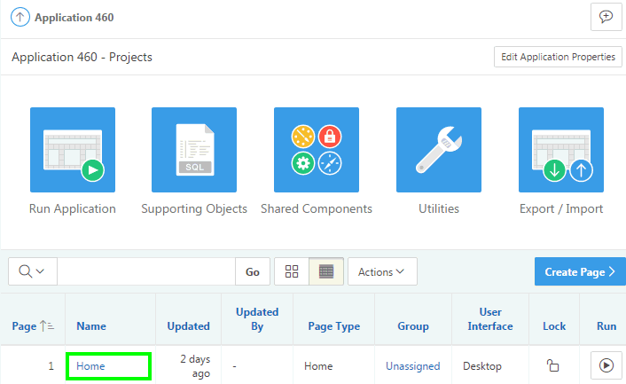
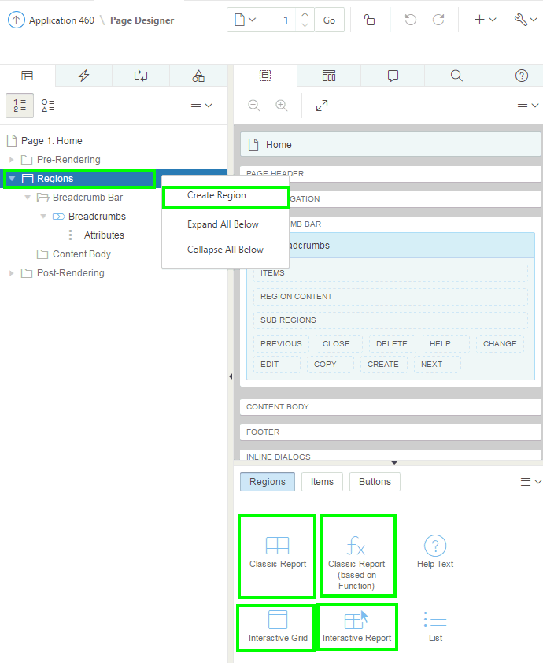
Creating a Report Region in Page Designer
Using the context menu
1
2
Drag and drop from the gallery
Notes:
You can create a new report region on an existing page in an application. When you create a new report region on a page, you have the following two options in page designer:
Use the context menu
Drag and drop region from the gallery
To use the context menu, perform the following steps:
On your application home page, click a page
View the page definition in page designer.
In the left pane, select Rendering tab.
Right-click the Regions node and select Create Region.
Edit the appropriate attributes in the Property Editor.
Then, click Save or Save and Run Page.
To drag and drop a report region, perform the following steps:
On your application home page, click a page
View the page definition in page designer.
In the gallery at the bottom of the central pane, locate the report region you want to add.
Click and hold the mouse on the region and drag it to the desired location on the Layout tab. When the mouse is over the appropriate location, the Layout tab displays as a darkened yellow tile. Release the mouse to drop the region.
Page Designer indicates what actions are required next. The Messages tab displays a red or yellow badge indicating the number of messages you need to address. Edit the appropriate attributes in Property Editor.
Then, click Save or Save and Run Page
Note: Apart from dragging and dropping from the gallery, you can also use the gallery context menus.

Slide 10
What is an Interactive Report?
Notes:
An interactive report is a formatted result of a SQL query. Both the Create Application Wizard and Create Page Wizard support the creation of interactive reports. You choose a table on which to build a report, or provide a custom SQL SELECT statement or a PL/SQL function returning a SQL SELECT statement. Interactive reports are only supported for Desktop applications. End users can customize the report layout and data displayed by selecting options on the Actions menu.
You can restrict the capabilities of interactive reports available to end users (such as disabling download or support for hiding column).
When viewing an interactive report, end users can customize how and what data displays. By default, interactive reports include a search bar, an Actions menu, column heading menus, and Edit icons in the first column of each row. Using options on the Actions menu, users can alter the report layout by hiding or exposing specific columns and applying filters, highlighting, and sorting. They can also define breaks, aggregations, charts, group bys, and add their own computations. Once customized, the report can be saved as either a private or public report.
When defining an interactive report you can:
Include multiple interactive reports per page
Display 100 columns using report columns.
Include 999 rows per column heading filter (if no custom LOV is specified in the column attributes)

Slide 11
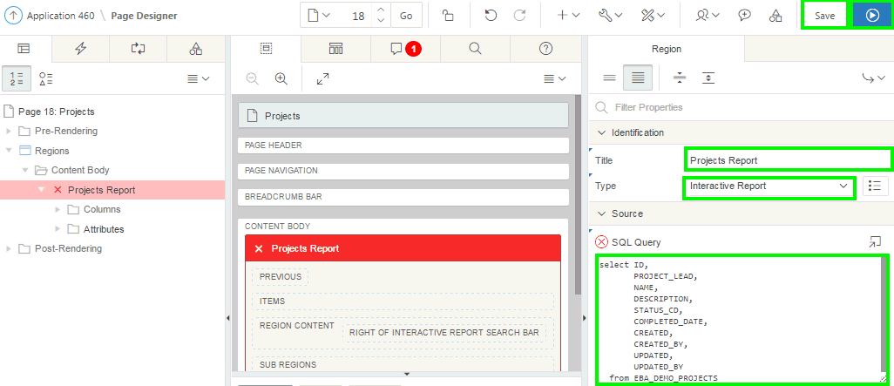
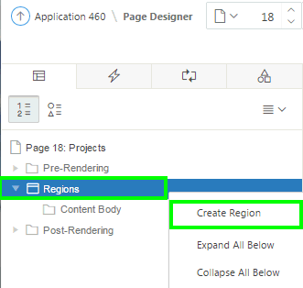
Creating an Interactive Report Region: Example
Using the context menu
Notes:
To use the context menu, perform the following steps:
On your application home page, click a page
View the page definition in page designer.
In the left pane, select Rendering tab.
Right-click the Regions node and select Create Region.
Edit the appropriate attributes in the Property Editor.
Then, click Save or Save and Run Page.

Slide 12
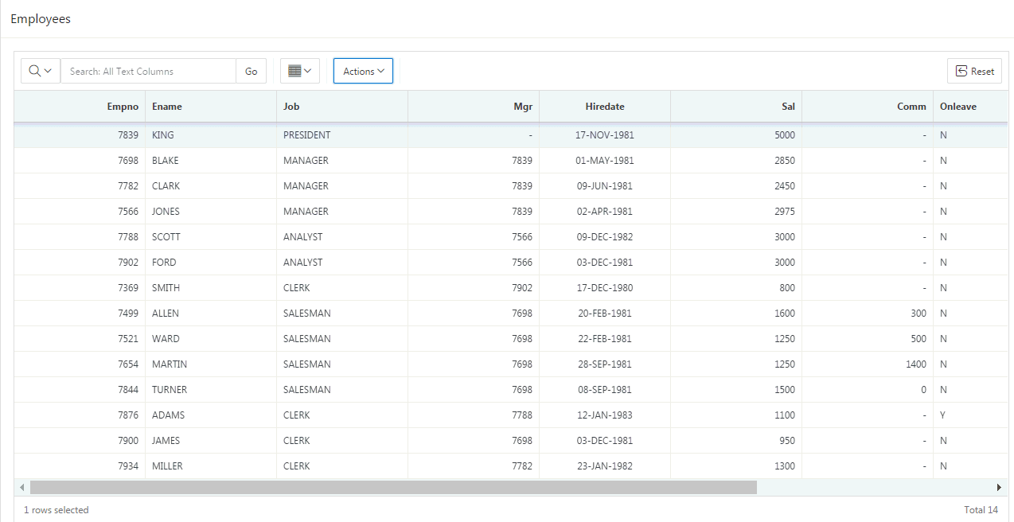
What is an Interactive Grid?
Notes:
An interactive grid presents users a set of data in a searchable, customizable report. In an editable interactive grid, users can also add to, modify, and refresh the data set directly on the page. Functionally, an interactive grid includes most customization capabilities available in interactive reports plus the ability to rearrange the report interactively using the mouse.
Users can lock, hide, filter, freeze, highlight, and sort individual columns with the Actions and Column Heading menus. Advanced users can also define breaks, aggregations, and computations against columns. Users can also directly customize the appearance of an interactive grid. Users can use the mouse to resize the width of a column and drag and drop columns into different places in the grid. Both the Create Application wizard and Create Page wizard support the creation of interactive grids.
Note: Interactive Report generates all the HTML markup on the server as part of the APEX page. The data returned from the SQL query is rendered along with all the other markup that makes up the UI; the toolbar, the dialogs, and everything. The client side behaviors are implemented in a single monolithic JavaScript module. In contrast, Interactive grid does all the HTML rendering on the client. The server provides the data in JSON format. Edits in an interactive grid are saved to the server in JSON format as well.

Slide 13
Understanding Interactive Grid: Key Features
  Modern, rich, and interactive multi-row editing component
  JSON-based, lightweight AJAX communications
  Extensible and customizable
  Accessible, key board support, right-to-left support
  Upgrade utility for tabular forms
  Master Detail / Detail
Master Detail Layout – Any Combination
Notes:
Interactive grid is a rich, client-side region type that allows rapid editing of multiple rows of data in a dynamic, JSON-enabled grid. You can use multiple interactive grids on a single page. Interactive grid includes all the features you expect for powerful reporting, including fixed headers, frozen columns, scroll pagination, multiple filters, sorting, aggregates, computations, and more. You can easily edit your text, numerical data, list of values, and much more.
Built using modern guidelines and techniques, this component of Application Express provides outstanding keyboard support and usability. You can migrate any existing tabular forms to Interactive Grids using the Upgrade Application wizard.
Interactive grid is designed to support all item types and item type plug-ins. With interactive grids, you can now easily create master-detail relationships, and go any number of levels deep and across. You can create all types of master-detail-detail screens with ease. The slide graphic shows Master Detail Layout of any combination

Slide 14
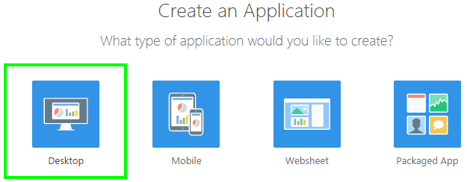
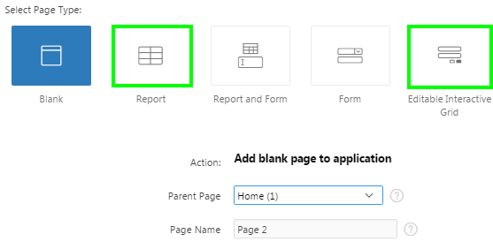
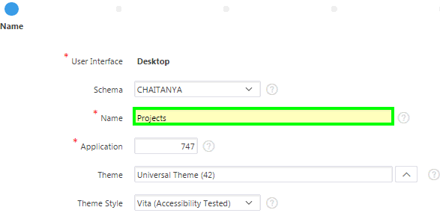
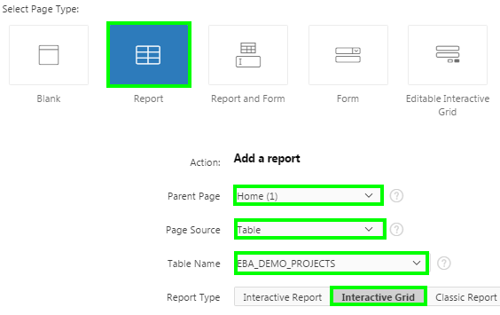
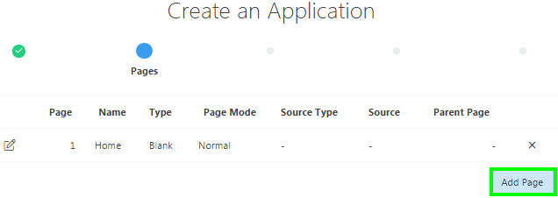
Creating an Interactive Grid: Steps
1
Using the create application wizard
4
2
3
Notes:
You learned that by running the Create Application wizard, you can create a new application that contains one or multiple report pages. To add an interactive grid page in the Create Application wizard, perform the following steps:
On the Application Builder home page, click Create. For the application type, select Desktop and click Next.
For Name, enter the name used to identify the application to developers. Accept the remaining defaults on this page, and click Next.
Now, you add pages to your application. Click Add Page.
You can add an interactive grid page to your application. To do this, for Select Page Type, you choose either Report or Editable Interactive Grid. If you select an Editable Interactive Grid, you choose a table on which to build the interactive grid. In an editable interactive grid, users can also add to, modify, and refresh the data set directly on the page.
If you select a Report, you select Interactive Grid for Report Type. If your page source is a table, then you select a table from Table Name select list. If Your page source is SQL Query, enter the report query for Query. Alternatively, if you want to build your query graphically, click Query Builder. In the slide example, you select / enter the following:
Select Page Type: Report
Parent Page: Home
Page Source: Table
Table Name: EBA_DEMO_PROJECTS
Report Type: Interactive Grid
Follow the on-screen instructions.
You already learned how to create a database application in the lesson titled Creating a Database Application.

Slide 15
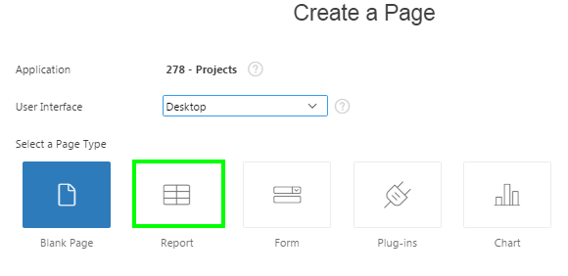
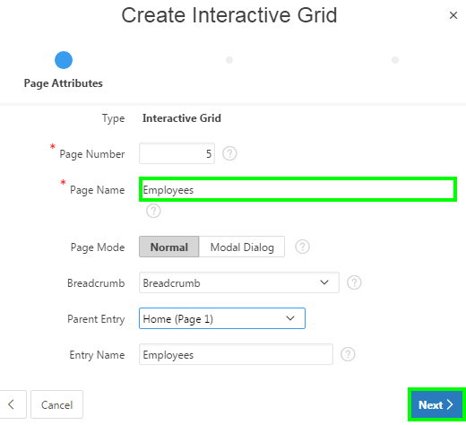
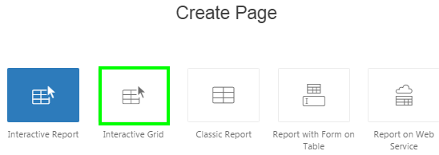
Creating an Interactive Grid: Example
Using the create page wizard
1
2
3
Notes:
The slide example shows how to create an interactive grid using the create page wizard. To create an interactive grid, perform the following steps:
Navigate to your application home page. Click Create Page. Select Report for page type and click Next.
Select Interactive Grid for report type and click Next.
For Page Attributes, enter a name for Page Name, accept the remaining defaults and click Next.
In this step, you can specify if you want to use a breadcrumb navigation control on your page. In the slide example, you select Breadcrumb for Breadcrumb, Home for Parent Entry and specify Employees for Entry Name.

Slide 16
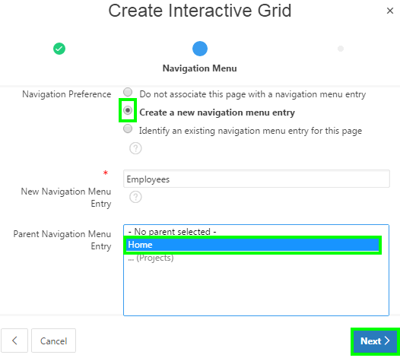
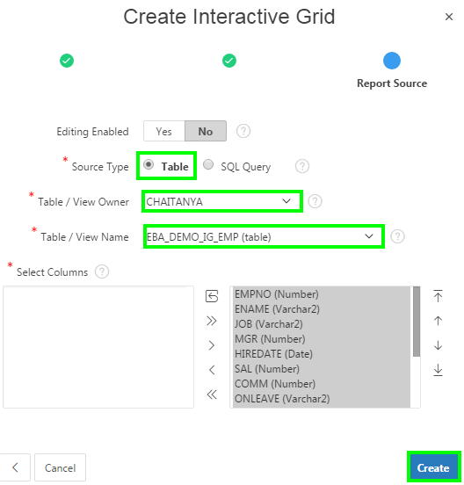
Creating an Interactive Grid: Example
4
5
Notes:
Select how you want this page to be integrated into the navigation menu and click Next. In the slide example, you select / enter:
Create new navigation menu entry for Navigation Preference
Employees for New Navigation Menu Entry
Home for Parent Navigation Menu Entry
For Report Source:
Select whether to enable editing for this Interactive Grid. The default selection is No.
Specify the source type to be either a table or a SQL query:
If you select SQL Query source type, enter the SQL and click Create.
If you select Table source type, select the table name, select the columns to be displayed in the report and click Create.

Slide 17
What is a Classic Report?
Notes:
A classic report is the formatted result of a SQL query. Developers choose a table on which to build a report, or provide a custom SQL SELECT statement or a PL/SQL function returning a SQL SELECT statement. With the exception of sorting and simple filtering, end users cannot customize a classic report.

Slide 18
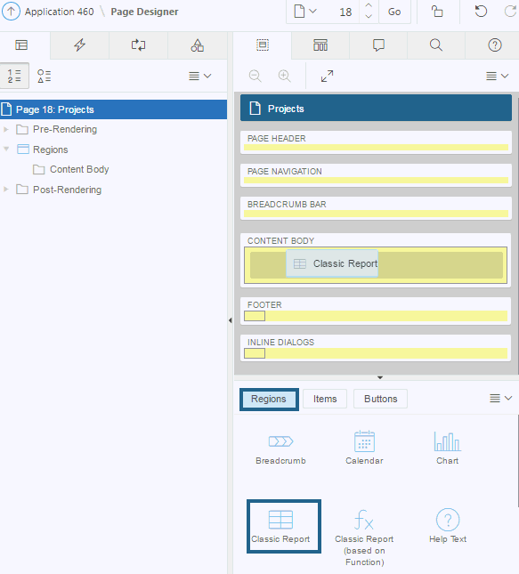
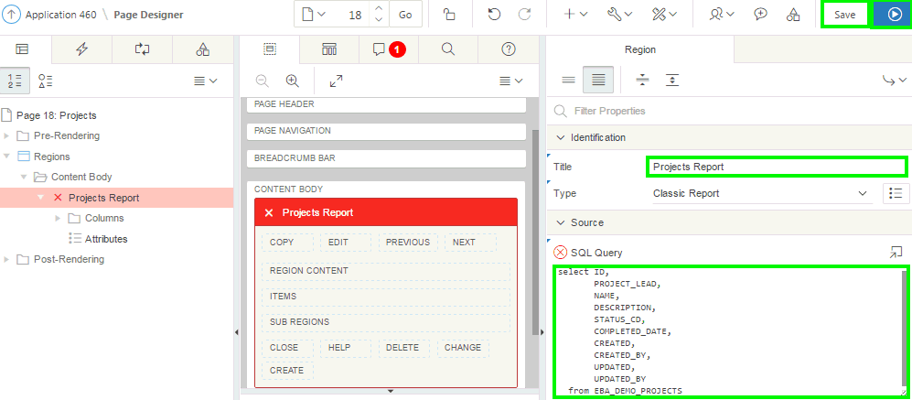
Creating a Classic Report in Page Designer: Example
Dragging and dropping from the gallery
Notes:
The slide example shows creating a Classic Report by dragging the report region from the gallery and dropping it in the CONTENT BODY section of the page.
To drag and drop a classic report region, perform the following steps:
On your application home page, click a page
View the page definition in page designer.
In the gallery at the bottom of the central pane, select Classic Report.
Click and hold the mouse on Classic Report and drag it to the desired location on the Layout tab. When the mouse is over the appropriate location, the Layout tab displays as a darkened yellow tile. Release the mouse to drop the region.
Page Designer indicates what actions are required next. The Messages tab displays a red or yellow badge indicating the number of messages you need to address. Edit the appropriate attributes in Property Editor.
Then, click Save or Save and Run Page

Slide 19
Creating a Report and Form
Notes:
The slide example shows a report and form created on a table. In the report page, each row provides a link (Edit icon) to the second page (form) to enable users to update each record.
Using the Create Application and Create Page wizards you can create a report and form combination. You can select the table on which to build the report and form. In the wizard, you select a Report Type to determine if the report is an interactive grid, interactive report, or a classic report. The main difference between the Create Application Wizard and Create Page Wizard is the amount of customization. The Create Page Wizard enables the developer to specify whether to include and configure breadcrumbs or a navigation menu and select the columns and the order in which they display.
Note: This wizard does not support tables having more than 127 columns. Selecting more than 127 columns generates an error.

Slide 20
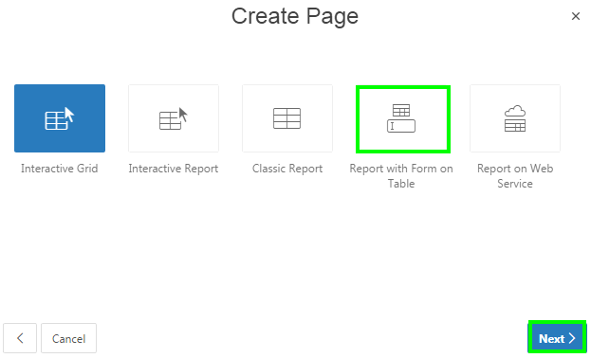
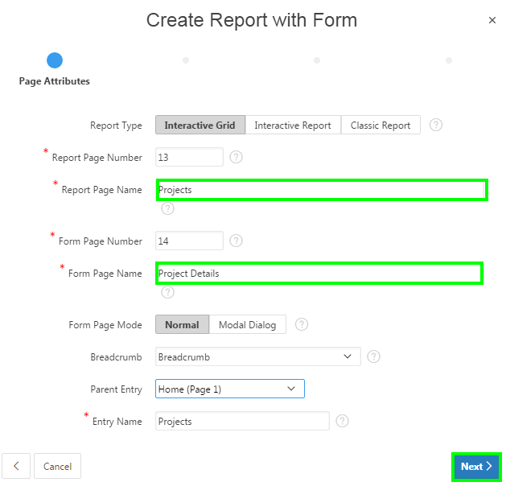
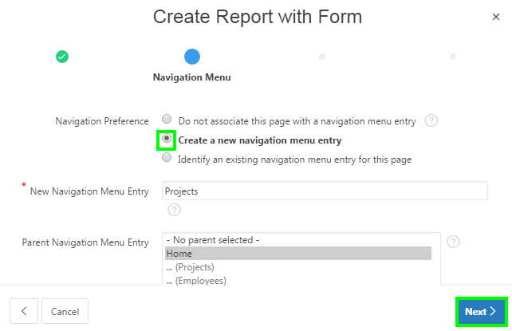
Creating a Report and a Form: Example
2
1
3
Notes:
The slide example shows creating a report and form on a table by using the Create Page wizard. Perform the following steps:
Navigate to your application home page. Click Create Page. Select Report for page type and click Next. Select Report with Form on Table and click Next.
Specify the page attributes and click Next.
Report Page Name: Enter the title of the page that will contain the report
Form Page Name: Enter the title of the page that will contain the form
Form Page Mode: Select the page mode to be either Normal or Modal Dialog. You learn more about page modes later in this course.
Breadcrumb: Select whether you want to use a breadcrumb navigation control on your page. Select a page for Parent Entry and specify the breadcrumb name for Entry Name
Specify your preferences for navigation menu and click Next

Slide 21
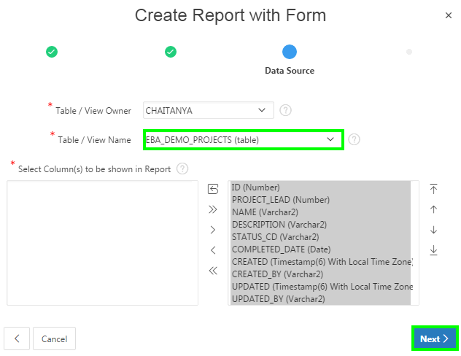
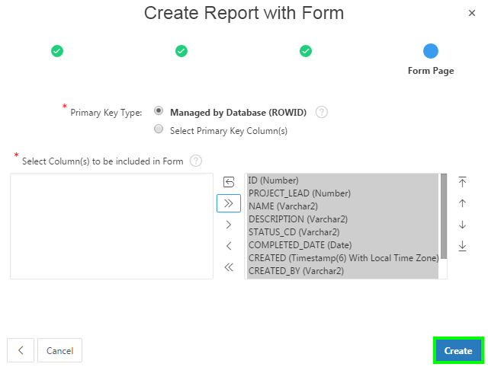
Creating a Report and a Form: Example
4
5
Notes:
Select the table or view on which the form will be based. Select column(s) that you want to be shown in the report and click Next
Select your choice for Primary Key Type. Choose Managed by Database (ROWID) to have the form use the ROWID pseudo column to identify rows to update and delete. Choose Select Primary Key Column(s) to use the source table's primary key column(s).
Select column(s) to be included in the form and click Create. To view the report and form that you just created, click Save and Run Page.

Slide 22
Summary
In this lesson, you learned how to create different types of reports in Oracle Application Express. You learned to create:
  Interactive reports
  Interactive grids
  Classic reports
  Report with Form on table
Notes:
In this lesson, you learned how to create different types of reports in Oracle Application Express.

Slide 23


Slide 24
Hands-On Lab

