Slide 2

Unit 3: Creating a Database Application

Slide 3
Lesson Objectives
After completing this lesson, you should be able to:
  Explain App Builder concepts
  Describe the types of applications you can build using Application Express
  List the components of a database application
  Determine your application user interface
  Create a database application from scratch
  Create a database application from a spreadsheet
  Create a mobile web application
  Create a Websheet application
Notes:
This lesson introduces you to App Builder. First, you understand some of the basic concepts of App Builder. You learn the different types of applications that you can build using Application Express. You understand the components of a database application. You learn how to quickly create an application from scratch and from a spreadsheet. You also learn how to create a mobile web application. This lesson covers steps to create a Websheet application.

Slide 4

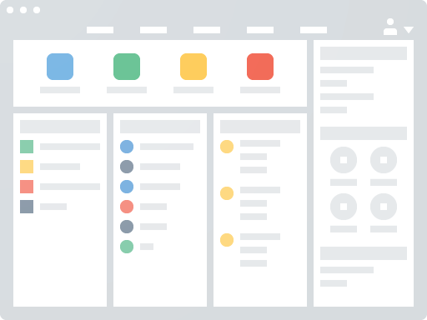

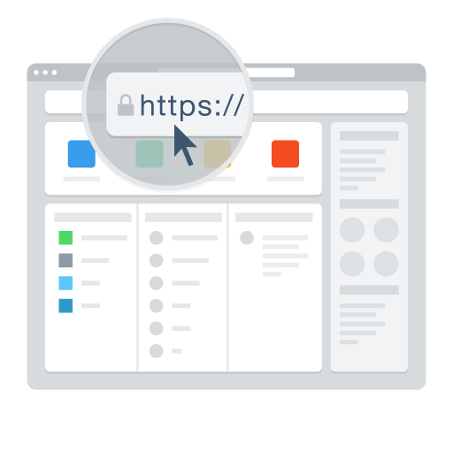

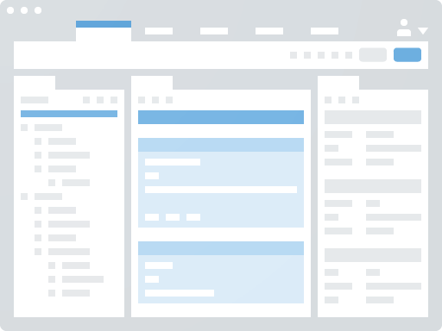
Understanding App Builder Concepts
Application Express Application
Application Page
Application User Interface
Session State
Page Processing and Page Rendering
Application URL Syntax
Notes:
An application is an HTML interface that exists on top of database objects such as tables or procedures. You use App Builder to build the pages that make up an Oracle Application Express application. Before using App Builder, you need to understand some basic concepts about Application Express applications, viewing rendered application pages, managing session state, and understanding URL.
Application Express Application
An application is an HTML interface that exists on top of database objects such as tables or procedures. You (Application Developer) use App Builder to build the pages that make up an Oracle Application Express application.
Application Page
A page is the basic building block of an application. Every application consists of one or multiple pages. Each page can have buttons and fields (called items) which are grouped into containers called regions. Pages can include application logic (or processes). You can branch from one page to the next using conditional navigation; perform calculations (called computations); perform validations (such as edit checks); and display reports, calendars, and charts. You can view and edit a page in Page Designer. Page Designer is a full featured Integrated Development Environment (IDE) designed to maximize developer productivity in maintaining application pages.
The Application Express engine dynamically renders and processes pages based on data stored in database tables. To view a rendered version of your application, you run or submit it to the Application Express engine. As you create new pages, you can run them individually, or run an entire application.
Application User Interface
App Builder supports multiple user interfaces within a single application. You can choose to build an application for the desktop, for a mobile device, or for both. Each user interface defined for an application has its own theme, login page, home page, and global page. When you create a page within an application, you must specify which user interface is associated with that page. The user interface you select determines the options that display when creating pages and regions. For example, only desktop pages support maps, data loading, and interactive reports. Similarly, on mobile pages the most common construct is a list and form, instead of report and form.
Applications built with the default desktop theme, Universal Theme, are responsive and can readily be run on any device including tablets and smartphones. Building mobile specific pages is only recommended when end users will be performing extensive data entry from a mobile device. Because mobile applications are designed to run specifically on smartphone devices, they are built with extremely minimal, semantic HTML that is optimized for mobile connections. Mobile applications developed with Oracle Application Express are browser-based applications that run inside the browser on the mobile device. Therefore, these applications must have a connection in order to communicate with the Oracle Database and cannot operate in a disconnected environment.
Session State
A session is a logical construct that establishes persistence (or stateful behavior) across page views. Each session is assigned a unique identifier. The Application Express engine uses this identifier (or session ID) to store and retrieve an application's working set of data (or session state) before and after each page view. Because sessions are entirely independent of one another, any number of sessions can exist in the database at the same time. A user can also run multiple instances of an application simultaneously in different browser programs.
Sessions are logically and physically distinct from Oracle database sessions used to service page requests. A user runs an application in a single Oracle Application Express session from sign in to sign out with a typical duration measured in minutes or hours. Each page requested during that session results in the Application Express engine creating or reusing an Oracle database session to access database resources. Often these database sessions last just a fraction of a second.
Page Processing and Page Rendering
When you create an application in Application Builder, you link pages together using tabs, navigation menus, buttons, or hypertext links. Each page can have buttons and items and can include application logic. You can branch from one page to the next using conditional navigation, perform calculations and validations, and display reports, calendars, and charts. You can generate reports, charts, and forms using built-in wizards, static HTML, or deliver more custom rendering with PL/SQL programming.
The Application Express engine dynamically renders and processes pages based on data stored in Oracle database tables. To view a rendered version of your application, you request it from the Application Express engine with a URL. When you run an application, the Application Express engine relies on two processes: Show Page is the page rendering process. It assembles all the page attributes (including regions, items, and buttons) into a viewable HTML page.
Accept Page performs page processing. It performs any computations, validations, processes, and branching.
When you request a page using a URL, the engine is running Show Page. When you submit a page, the Application Express engine is running Accept Page or performing page processing during which it saves the submitted values in the session cache and then performs any computations, validations, or processes.
Application URL Syntax
When you run a page, the URL that displays in your browser indicates the location of Oracle Application Express and identifies the address of Oracle Application Express, the application ID, page number, and session ID. For example:
http://apex.somewhere.com/pls/apex/f?p=4952:1:220883407765693447 This example indicates:
http: is the scheme.
apex.somewhere.com is the domain name of the server. It can also include a port number or an IP address.
pls is the indicator to use the mod_plsql cartridge (if applicable)
apex is the Database Access Descriptor (DAD) name. The DAD describes how HTTP Server connects to the database server so that it can fulfill an HTTP request. The default value is apex.
f?p= is a prefix used by Oracle Application Express to route the request to the correct engine process.
4952 is the ID of the application being called. The application ID is a unique number that identifies each application.
1 is the number of the page within the application.
220883407765693447 is the session number. When you run an application, the Application Express engine generates a session number that serves as a key to the user's session state.
To learn more about Application URL Syntax, see App Builder Concepts chapter in the Application Express App Builder User's Guide.

Slide 5
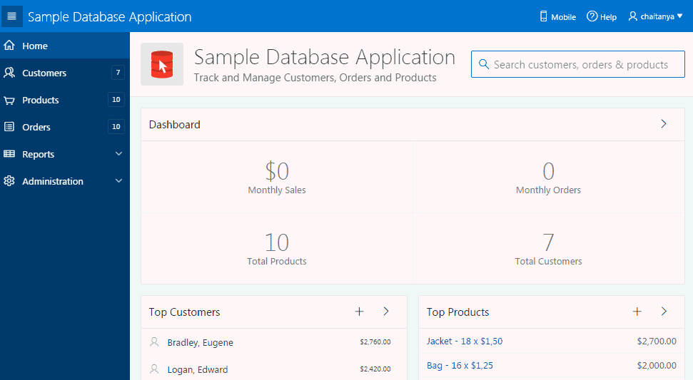
Database and Websheet Applications
Database Application
Notes:
Using App Builder you can create two different types of applications: Database applications and Websheet applications.
Database Applications
A database application is a collection of pages linked together using navigation menus, tabs, buttons, or hypertext links. Application pages share a common session state and authentication.
To create a database application, an application developer runs wizards to declaratively assemble pages and navigation. Individual pages are organized using containers called regions. Regions can contain text, custom PL/SQL, reports, charts, maps, calendars, web service content, or forms. Forms are made up of fields (called items) which can be selected from the multitude of built-in types (such as text fields, text areas, radio groups, select lists, check boxes, date pickers, and popup list of values).
Developers can also create their own custom item types using plug-ins. Session state (or application context) is transparently managed and the user interface presentation is separated from the application logic enabling developers to manage the look and feel of an application by simply selecting a different theme.
Database applications enable developers to have full control over all aspects of the development process and final application functionality. With database applications, developers can directly leverage their SQL and PL/SQL programming skills. Database applications use declarative controls for developing, enhancing, and maintaining applications. They also support full user interface customization through the use of templates and themes.

Slide 6
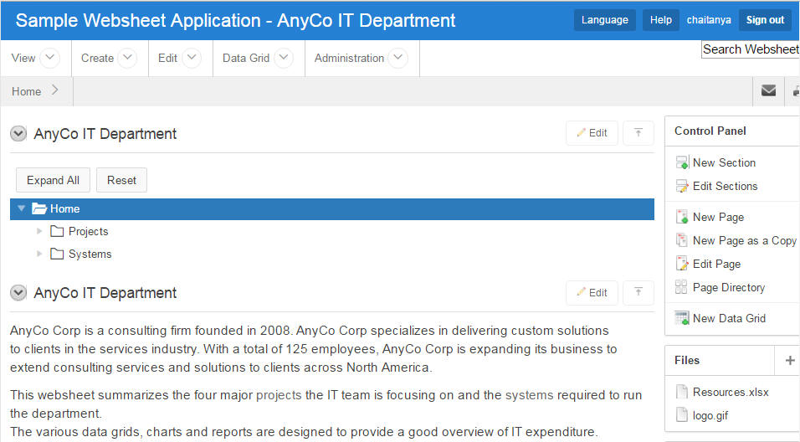
Database and Websheet Applications
Websheet Application
Notes:
Websheet Applications
Websheet applications are interactive web pages that combine text with data. By creating Websheet applications, end users can manage structured and unstructured data without developer assistance. Websheet applications are simplified applications that support pages, data grids, and reports. Page sections contain unstructured data which can be edited using a WYSIWYG editor. Data Grids enable users to manage structured data without the need for writing SQL. Using runtime dialog boxes, users can add columns, rename columns, and validations. Each page and row of data grid data can be annotated with files, tags, notes, and links. Pages can contain sections, reports, and data grids and everything can be linked together using navigation. All information is searchable and completely controlled by the end-user.

Slide 7
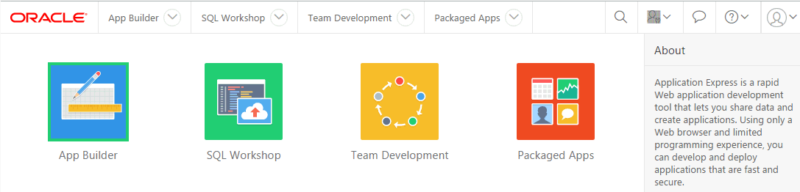
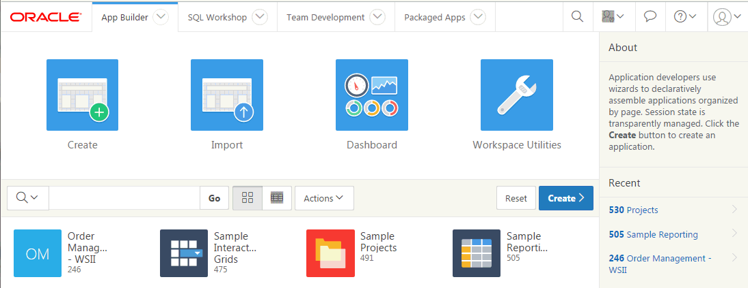
App Builder Home Page
Notes:
After logging in to your Workspace, on the Workspace home page, click App Builder. The App Builder home page displays all installed applications in the
current Oracle Application Express instance. You use the App Builder home page to:
Select an application to edit
Create new applications
Import previously exported applications,
View the Dashboard
Access workspace
You can customize the appearance of the App Builder home page using the navigation bar in the center of the page. Once you select an application to edit on the App Builder home page, the Application home page appears.

Slide 8
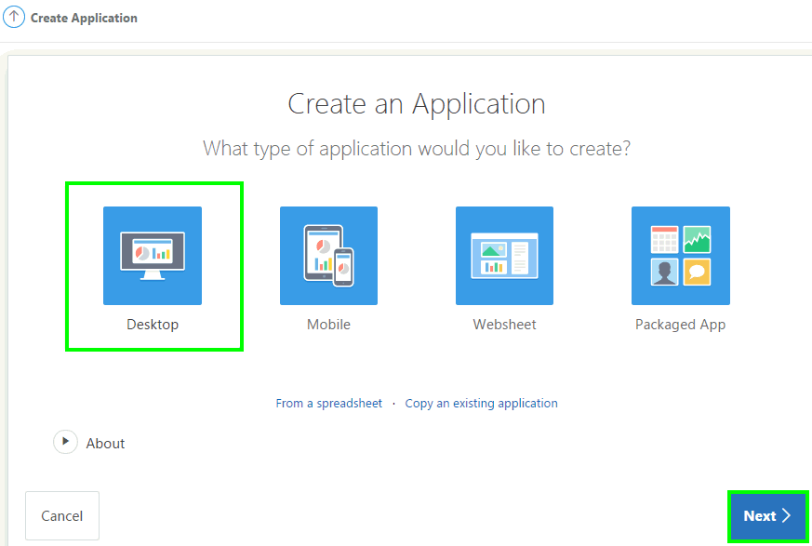
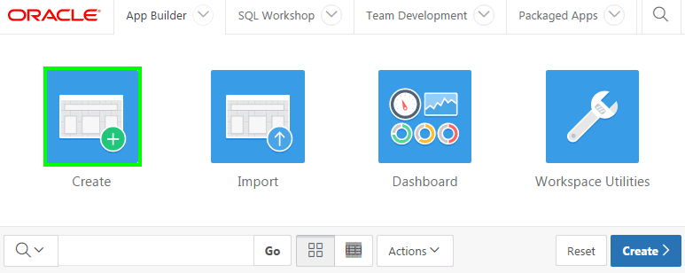
Using the Create Application Wizard
2
1
Notes:
The Create Application Wizard enables developers to design and quickly create basic Oracle Application Express applications. By using the Create Application Wizard, you can create a complete application containing multiple pages including a variety of different reports and forms. After you create an application using this wizard, you can modify pages and add additional pages using the Create Page Wizard.
You can use the Create Application Wizard to create an application with just a blank page or pages based on SQL queries on existing database tables. Applications based on tables can consist of a simple report, a form and report, or an editable interactive grid. You can create SQL queries by manually typing SQL, or by using the graphical user interface of Query Builder. The Create Application Wizard enables you to build a complete application containing multiple pages. How the Create Application Wizard works depends upon the type of pages are creating.
To run the Create Application Wizard, click the Create button on the App Builder home page. The wizard prompts you to choose the type of application you want to create. Desktop and mobile database applications with both desktop and mobile user interfaces defined can utilize auto-detection to run the most appropriate user interface based on the screen size of the device. If the application is started from a personal computer then it will utilize the desktop user interface. However, if the application is run on a smartphone then it will utilize the mobile user interface. In order to develop applications with multiple user interfaces, you must define the application with one user interface and then add the other from User Interface attributes.
Desktop and Mobile Database Applications
When building a Desktop database application, the user interface is optimized for larger displays, such as desktop, laptop and tablet screens. The Universal Theme provides responsive features that allows having the page content to scale to different screen sizes and make efficient use of the available screen size.
When building Mobile database applications, the user interface is primarily targeted at smaller screens like those found on smartphones. Using responsive features, such as reflow table, column toggle and panels, the page content scales up for use on larger devices as well. Using the jQuery Mobile framework, Mobile database applications respond to mobile specific events, such as touch and orientation change.
Websheet Applications
Websheet applications enable users to build data centric applications without any SQL programming knowledge. These applications are very easy to build and are designed to support community contributions.
Packaged Applications
Packaged Applications include a set of business productivity and sample applications which can be installed with just a few clicks. Productivity applications are fully developed point-solutions designed to provide real functionality, such as project management, surveys, shared calendars and tracking applications. These applications can be installed, run and removed. By default they are 'locked' and are fully supported. Once unlocked the application is no longer supported but it can be updated to meet specific requirements. Sample applications provide reference implementations of specific functional areas that can be readily incorporated into developer's applications.

Slide 9
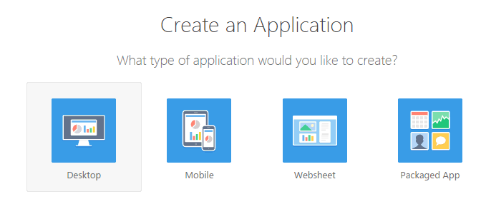


Determining your Application User Interface
Notes:
Application Builder supports multiple user interfaces within a single application. You can choose to build an application for the desktop, for a mobile device, or for both. Each user interface defined for an application has its own theme, login page, home page, and global page (formerly called Page 0). When you create a page within an application, you must specify which user interface is associated with that page. The user interface you select determines the options that display when creating pages and regions. For example, only desktop pages support maps, data loading, and interactive reports. Similarly, on mobile pages the most common construct is a list and form, instead of report and form.
When building a Desktop database application, the user interface is optimized for larger displays, such as desktop, laptop and tablet screens. The Universal Theme provides responsive features that allows having the page content to scale to different screen sizes and make efficient use of the available screen size.
When building Mobile database applications, the user interface is primarily targeted at smaller screens like those found on smartphones. Using responsive features, such as reflow table, column toggle and panels, the page content scales up for use on larger devices as well. Using the jQuery Mobile framework, Mobile database applications respond to mobile specific events, such as touch and orientation change.

Slide 10
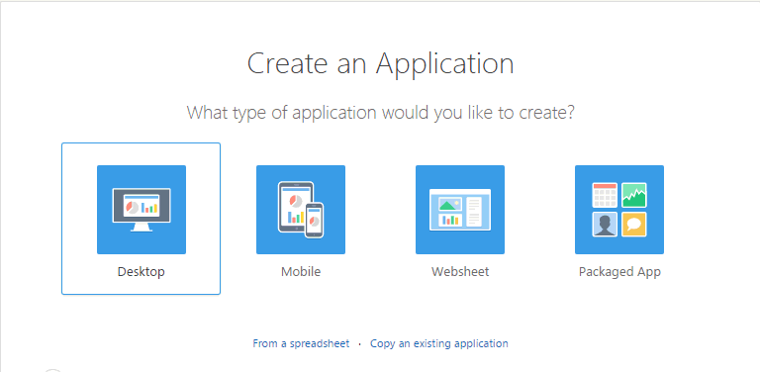
Creating a Database Application
Creating an application from scratch
Creating an application from a spreadsheet
Notes:
From the App Builder, you can create a database application in three different ways.
From scratch: By using the Create Application wizard, you can actually create an application from scratch. The wizard allows you to assemble an initial set of application pages including blank, reports, and forms. The create an application from scratch, first click Create button on the App Builder home page. Click Desktop, then click Next and follow on-screen instructions
From a spreadsheet: You can quickly create a fully functional application from an existing spreadsheet. The wizard allows you to either upload a spreadsheet or copy and paste tab delimited data from a spreadsheet. The wizard first creates a table based on the spreadsheet data and then application with a report and a form is created. To create an application from a spreadsheet, click the Create button on the App Builder home page. Then, click the From a spreadsheet link.
Copy an existing application: To create a copy of an existing database application, click the Create button on the App Builder home page. Then click Copy an existing application and follow the on-screen instructions.
In this lesson, you learn to create a database application from scratch and also how to convert a spreadsheet in to a database application.

Slide 11
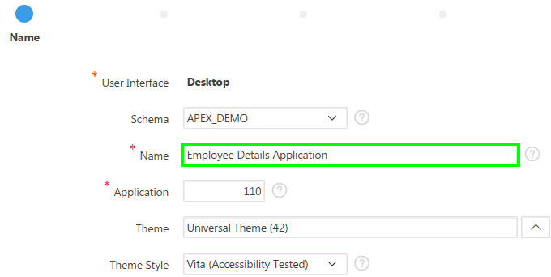
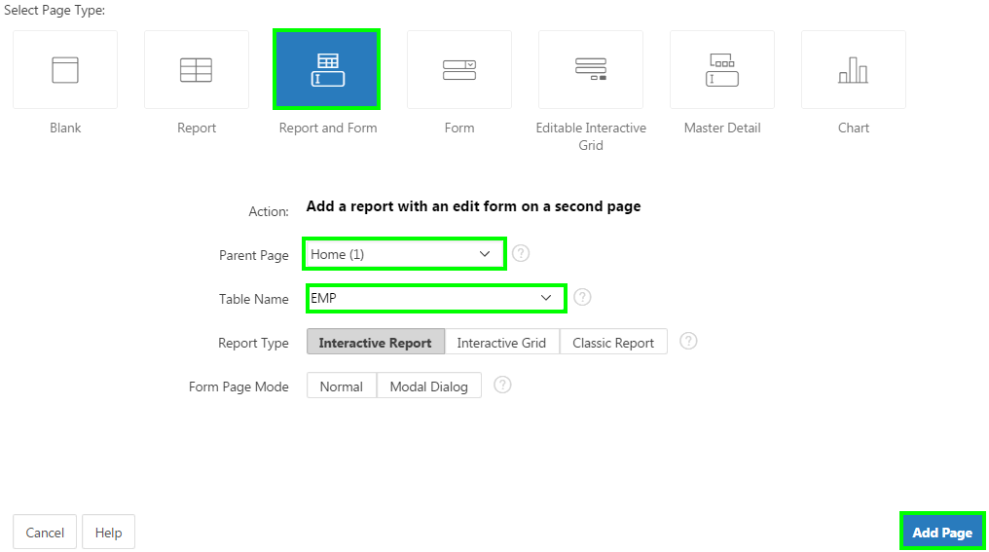
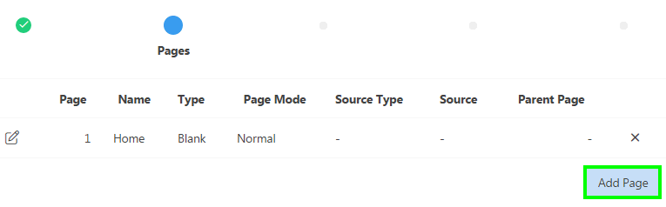
Creating a Database Application from Scratch
1
2
3
Notes:
You can create an application from scratch by using the Create Application wizard or from spreadsheet data. In this lesson, you first learn how to create a database application from scratch by using the Create Application wizard.
To create a database application based on a table, query, or drill-down query, on the Application Builder home page, click Create. For the application type, select Desktop and click Next. Then, perform the following steps:
For Name, enter the name used to identify the application to developers. Accept the remaining defaults on this page, and click Next.
Note: The application ID must be unique within your Application Express instance. Application IDs between 3000 to 9000 are reserved for internal use by Oracle Application Express. The default value for Theme is Universal Theme (42). The default value for Theme Style is Vita.
Now, you add pages to your application. Click Add Page.
You see the supported page types available for desktop applications. For Select Page Type, select the type of page you want to add. Based on the Page Type, the wizard prompts you for different information, such as selecting a table name or report implementation. Finally, click Add Page.
In the slide example, you add a Report and Form page type. (To delete a page, click the Delete icon (the X in the far right column))
In the slide example, you select the following:
Page Type: Report and Form
Parent Page: Home
Table Name: EMP
Note that the default report type is Interactive Report.

Slide 12
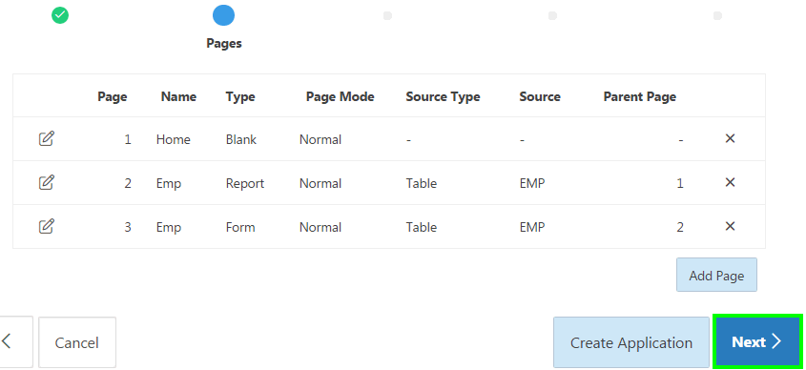
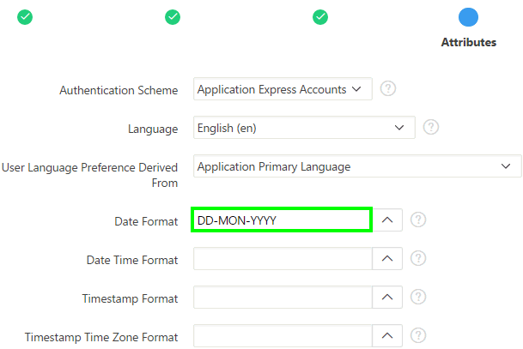
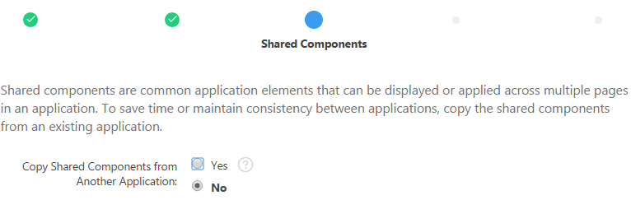
Creating a Database Application from Scratch
4
6
5
Notes:
Repeat steps 2 and 3 until all you pages have been added. Click Next.
For Shared Components, indicate whether to copy shared components from another application. Select Yes or No. Then, click Next. In the slide example, you select No.
Note: If you select Yes, select where to copy them from and which components to import. Shared components are common application elements that can be displayed or applied across multiple pages in an application. To save time or maintain consistency between applications, copy the shared components from an existing application. The types of shared components you can copy include: user interface themes, lists of values, navigation bar entries, authorization schemes and authentication schemes. If copying the theme from another application, you are to subscribe the theme
On the Attributes page, specify your authentication scheme for the application. You use an authentication scheme to determine how to establish user identity before accessing an application. You learn more about authentication later in this course. In the slide example, you select Application Express Accounts authentication scheme. Specify your options for the remaining attributes on this page: Language, User Language Preference Derived From, Date Format, Date Time Format, Timestamp Format, Timestamp Time Zone Format. The slide example shows a value of DD-MON-YYYY for Date Format. After specifying/selecting the attributes, click Next.

Slide 13
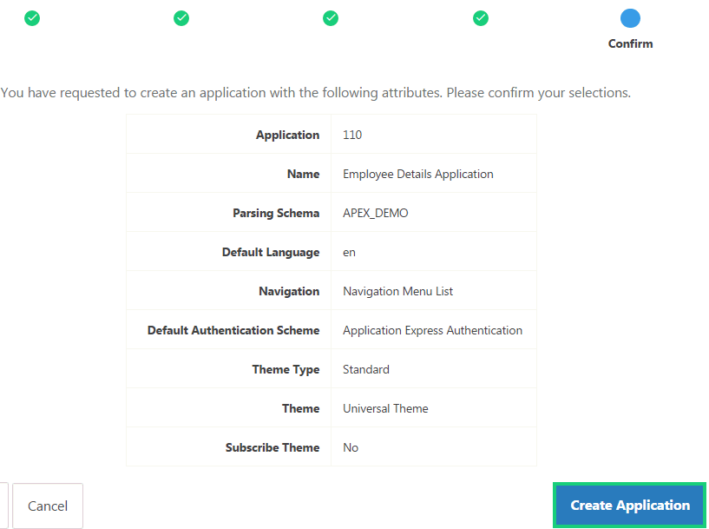
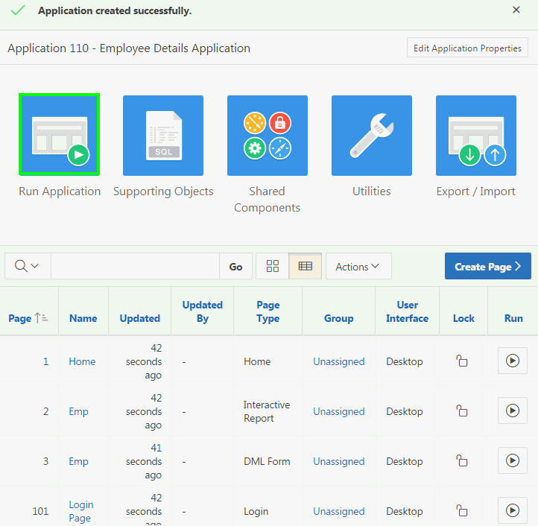
Creating a Database Application from Scratch
7
8
Notes:
Confirm your selections and click Create Application.
Now, you see the Application home page. Click Run Application.
Note: In the slide example, have chosen the Application Express authentication scheme. Therefore, the Login page appears. Enter your workspace username and password, and then click Login to log in to your application.

Slide 14
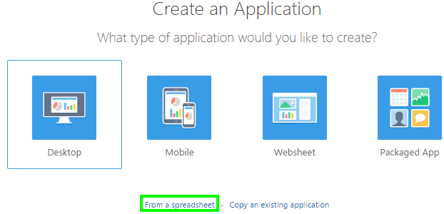
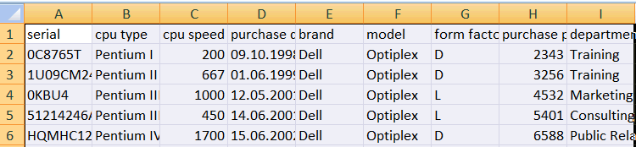
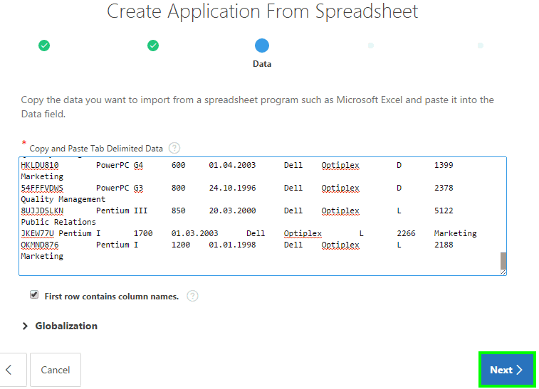
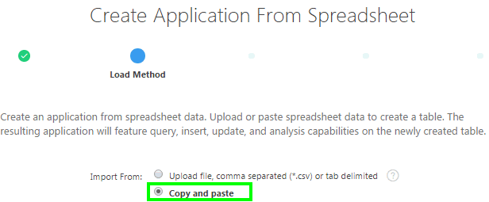
Creating a Database Application from a Spreadsheet
1
3
2
4
Notes:
You can create a desktop application based on spreadsheet data by selecting From Spreadsheet in the Create Application Wizard. By using this option, your data is loaded in to a single table and also an application with a report and a form is created. Later, you can expand and include additional functionality in to this application.
To create an application from spreadsheet data, perform the following steps:
On the Workspace home page, click the App Builder icon. Click the Create button. Select From a spreadsheet.
For Load Method, specify how spreadsheet data is imported. Select either Upload file, comma separated (*.csv) or tab delimited or Copy and paste and click Next. In the slide example, you select Copy and paste.
Now, open the spreadsheet that has the data you want to import, and copy the data.
Navigate to your browser and then paste the tab delimited data you just copied from the spreadsheet. Note that the First row contains column names check box is selected by default. Click Next.

Slide 15
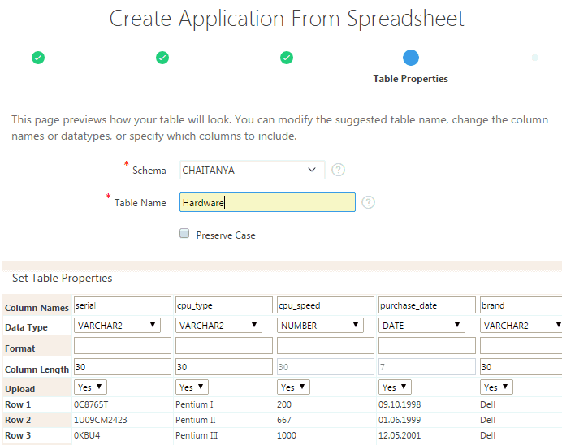
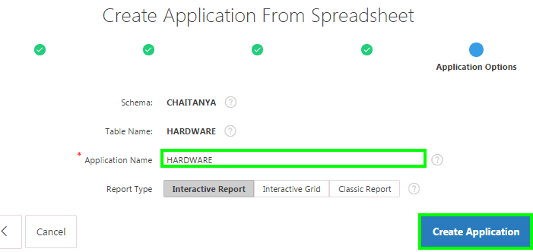
Creating a Database Application from a Spreadsheet
6
5
Notes:
For Table Name, enter a name for the table being created. Review the table properties, modify the data types or enter format masks. Specify whether to include a column by selecting Yes or No from the Upload list. Then, click Next.
On the Application Options page, enter a name for Application Name. You can choose the Report Type to be an Interactive Report, Interactive Grid, or a Classic Report. Then, click Create Application. In the slide example, you accept the default.
Your application is now created successfully and you can run the application by clicking the Run Application button on the application home page.
Also, you can navigate to the Object Browser and browse through the tables to review the table that has been created.

Slide 16
Creating a Mobile Web Application: Steps
  On the Application Builder home page, click Create.
  Select Mobile for Application Type
  Enter the name for your application, and accept the remaining defaults. Notice that the Theme selected by default is Mobile (51).
  Click Add Page to add pages.
  Specify whether to copy shared components from another application.
  Specify the attributes such as authentication, date time format etc.
  Confirm your selections and click Create Application.
  Click Run Application.
Notes:
To support mobile application development, Oracle Application Express incorporates jQuery Mobile. jQuery Mobile-based web pages use a lightweight
framework that enables you to create compact and minimalistic web sites that include only a few images and CSS files. Using jQuery Mobile, these
applications can run on the following mobile operating systems: iOS, Android, Blackberry, and Windows Mobile. jQuery Mobile supports mobile device-
specific events, such as orientation change and touch events. You easily change the look and feel of jQuery Mobile-based applications by modifying the
CSS using tools such as ThemeRoller.
Creating a mobile web application is similar to creating a desktop application from scratch. The slide shows the summary of steps involved in creating a
mobile web application.

Slide 17
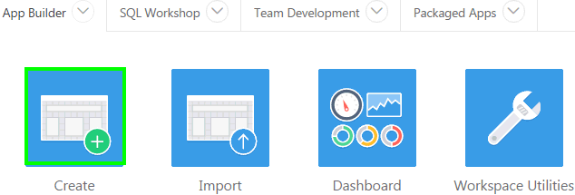
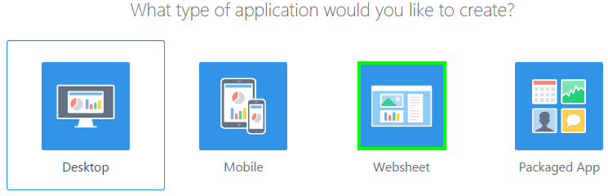
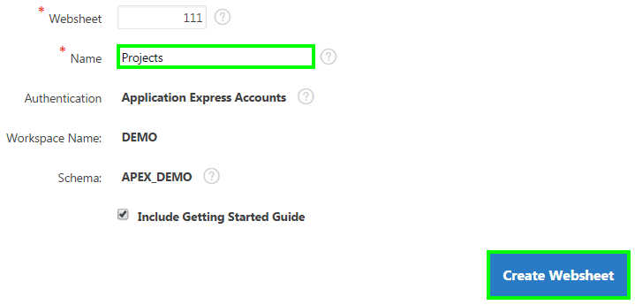
Creating a Websheet Application
1
2
3
Notes:
Websheet applications are interactive web pages that combine text with data. To create a Websheet application, perform the following steps:
On the Workspace home page, click the App Builder icon. Click the Create button.
For the application type, select Websheet and click Next.
On Create Websheet:
Websheet - Enter a unique integer value to identify the application. Application IDs between 3000 to 9000 are reserved for internal use.
Name - Enter a name to identify the application.
Allow SQL - Determines whether you can define SQL tags and SQL reports. Select Yes or No. By default, this attribute is disabled and set to No.
Include Getting Started Guide - Select this option to include basic information about using Websheets in the first text section of the Websheet home page. Once reviewed, you can edit or remove this text section.
Confirm your selections and click Create Websheet. A success message appears.

Slide 18
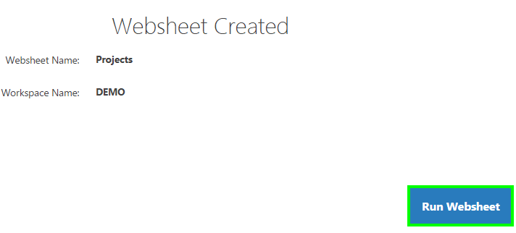
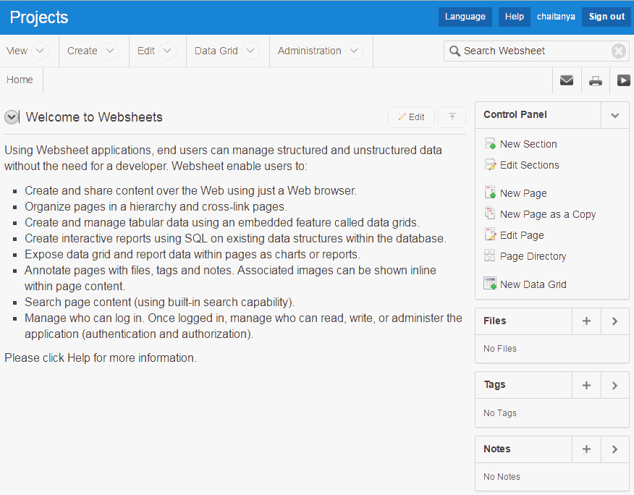
Creating a Websheet Application
4
5
Notes:
To view a rendered version of your Websheet application, click Run Websheet. If needed, you may have to enter username and password and then click Sign In.
Your Websheet application appears in a new window. You can now add Websheet content.

Slide 19
Summary
In this lesson, you learned how to:
  Create a database web application from scratch
  Convert a spreadsheet in to a database web application
  Create a mobile web application
  Create a Websheet application
Notes:
In this lesson, you learned how to use the App Builder to create database web applications for both desktop and mobile interfaces. You learned how to create a database web application by using the Create Application wizard. This lesson also covered how to convert a spreadsheet in to a fully functional database application. You reviewed the steps to create a mobile web application. Finally, you learned how to create a Websheet application.

Slide 20


Slide 21
Hands-On Lab

