Slide 2

Unit 2: Using SQL Workshop

Slide 3
Lesson Objectives
After completing this lesson, you should be able to:
  Describe SQL Workshop and list its components
  Browse through database objects using the Object Browser
  Create and modify database objects
  Create a lookup table
  Run SQL commands and SQL scripts
  Load and unload data using Data Workshop utility
  Build a SQL query using Query Builder
  Generate DDL statements
Notes:
In this lesson, you are introduced to the SQL Workshop. You learn how to interact with the database by using the different components of SQL Workshop.

Slide 4
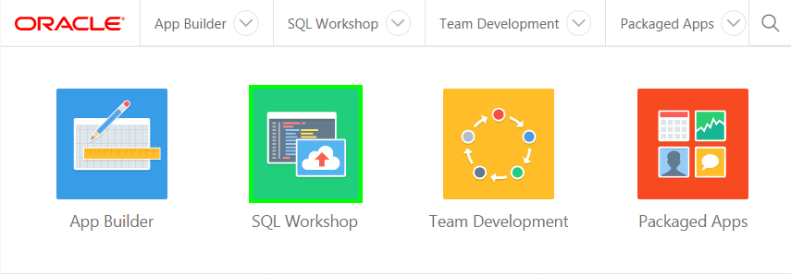
What is SQL Workshop?
SQL Workshop provides tools to view and manage database objects
Notes:
Oracle Application Express includes the SQL Workshop for application developers to maintain database objects, from the browser. This feature is particularly important when developing in hosted environments, or where the application developer does not have access to the underlying database, and can not use tools such as SQL Developer or SQL*Plus to manage the database objects.

Slide 5
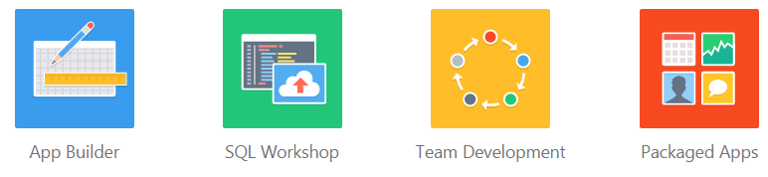
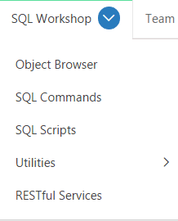
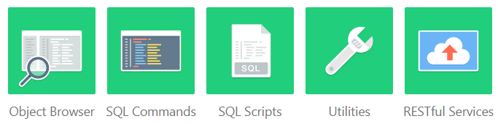
Accessing SQL Workshop Components
Notes:
From the Application Express home page, you can access SQL Workshop by either of the following two ways:
Click the SQL Workshop icon and then select the component you want to access
Click the down arrow on the SQL Workshop tab. Then, select the component you want to access

Slide 6
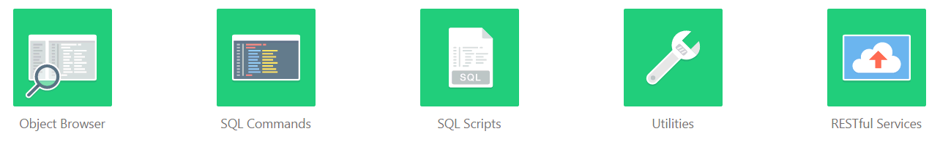
Using SQL Workshop Components
Create database objects and view database object properties
Declaratively specify RESTful services
Store and run scripts
Enter and run SQL
Load and unload data, generate DDL
Notes:
The SQL Workshop provides tools that enable you to view and manage database objects. Based on the task, you use the following component of SQL Workshop:
Object Browser: This component enables developers to browse, create, and edit objects in a database
SQL Commands: You use SQL Commands to create, edit, view, run, and delete database objects. A SQL command can contain SQL statements or PL/SQL blocks.
SQL Scripts: A SQL script is a set of SQL commands saved as a file in SQL Scripts. A SQL script can contain one or more SQL statements or PL/SQL blocks. You use SQL Scripts to create, edit, view, run, and delete database objects..
Utilities: You use Oracle Application Express utilities to build SQL queries, load and unload data from an Oracle database, generate DDL, view object reports, manage User Interface Defaults, restore dropped database objects, compare schemas, monitor the database, and view database details
Restful Services: RESTful Services enable the declarative specification of RESTful services used to access the database. These services work with the Oracle REST Data Services (formerly known as Oracle Application Express Listener) to enable the consumption of these services. This component helps you to create, edit and delete RESTful Services. If the instance administrator has disabled RESTful Services for this Application Express instance, RESTful Services are not available for this instance and the RESTful Services icon does not display.

Slide 7
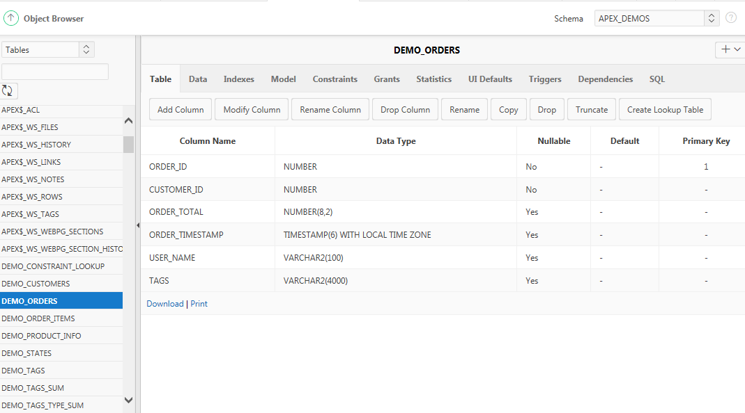
Managing Database Objects with Object Browser
Object Selection Pane
Detail pane
Notes:
Object Browser enables developers to browse, create, and edit objects in a database. To access Object Browser, on the Workspace home page, click SQL Workshop. Then click Object Browser.
The Object Browser page is divided into two panes:
Object Select Pane: This pane displays on the left side of the Object Browser page. It lists database objects of a selected type within the current schema. You can further narrow the results by filtering on the object name.
Detail Pane: This pane displays to the right of the page. It displays detailed information about the selected object.
To view object details, select an object in the Object Selection pane. Click the tabs at the top of the Detail pane to view additional details about the current object. To edit an object, click the appropriate button. The graphic shows DEMO_ORDERS table is selected and the detail information of this table is displayed in the Detail pane.
To create an object:
Click the Create icon (+), located in the upper right corner of the Detail pane.
From the list of object types, select the type of object you want to create. Follow the on-screen instructions.

Slide 8
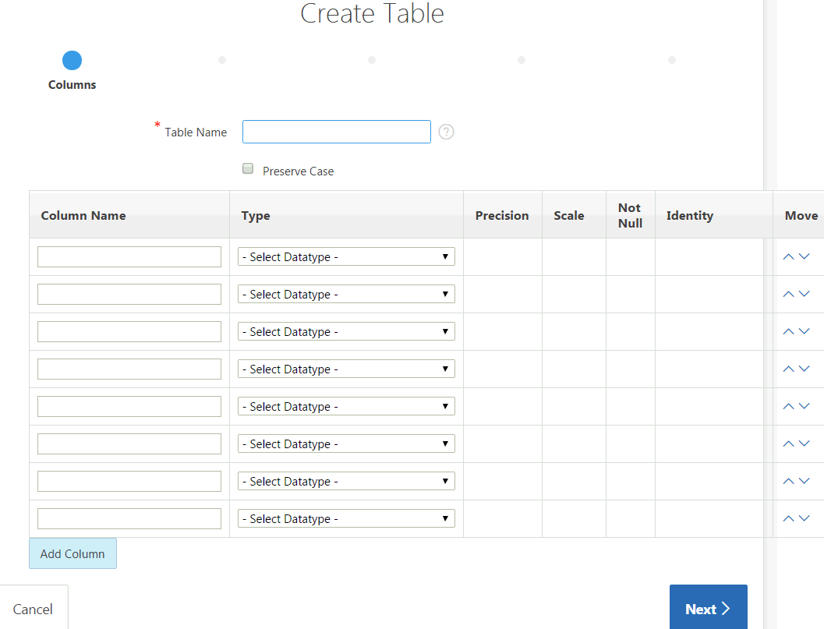
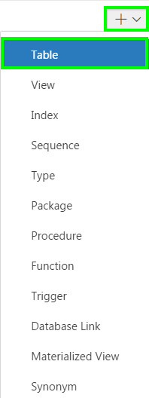
Creating a Database Object
Notes:
The slide shows how to create a table in Object Browser. You create database objects using the Create Database Object Wizard. Once you select an object, a set of tabs and buttons appears at the top of the Detail pane. To create an object, perform the following steps:
Click the Create icon (+), located in the upper right corner of the Detail pane.
From the list of object types, select the type of object you want to create. Follow the on-screen instructions.

Slide 9
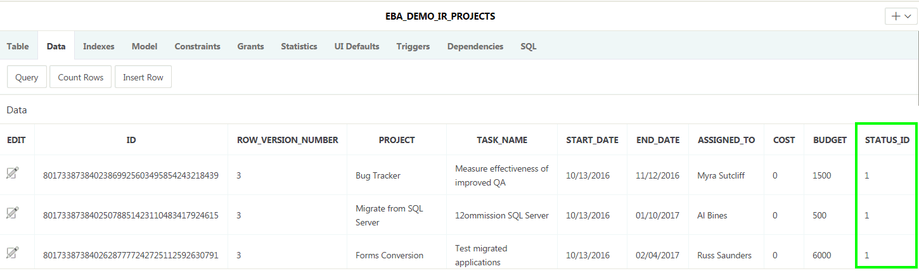
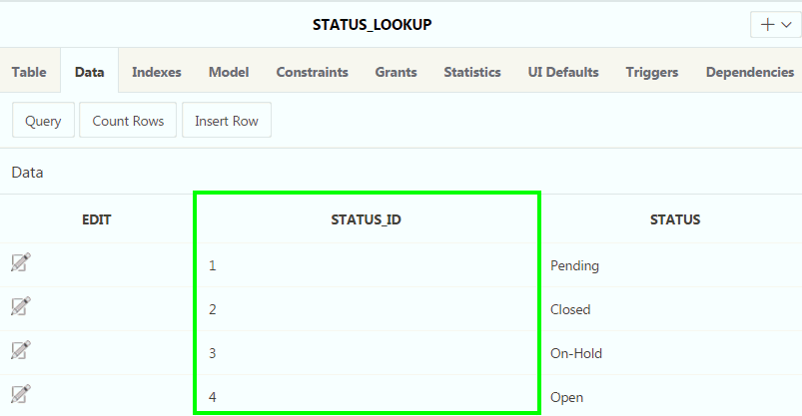
Creating a Lookup Table
STATUS column is extracted from EBA_DEMO_IR_PROJECTS table
Lookup table
Notes:
Using the Object Browser, you can create a lookup table. A lookup table is a new table that is created by extracting a column from an existing table.
A new primary key column is created in the new table and a foreign key is created between the source table and the new lookup table.
The slide shows that a new look up table STATUS_LOOKUP is created by extracting the STATUS column from the existing EBA_DEMO_IR_PROJECTS table. A primary key column in the new STATUS_LOOKUP table, and a foreign key to the EBA_DEMO_IR_PROJECTS table are created. The lookup table contains the column that you selected when you created the table (for example, STATUS) as well as a new ID column (STATUS_ID).

Slide 10
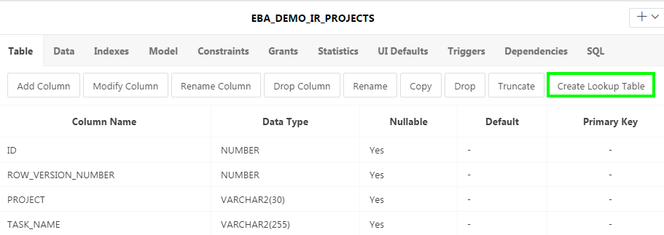
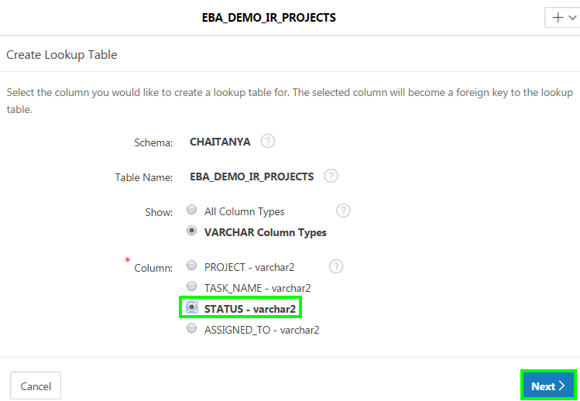
Creating a Lookup Table: Steps
1
2
Notes:
Steps to create a lookup table:
From the object selection pane, select the table for which you want to create a lookup table. In the detail pane: Click the Create Lookup Table button.
Select the column that you want to use to create the lookup table. Click Next.

Slide 11
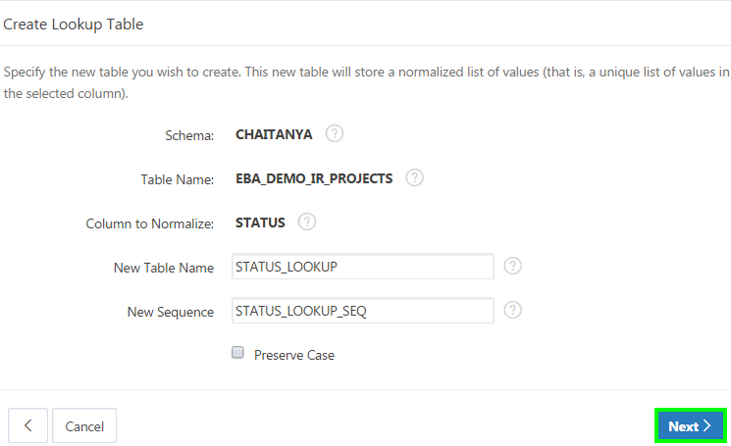
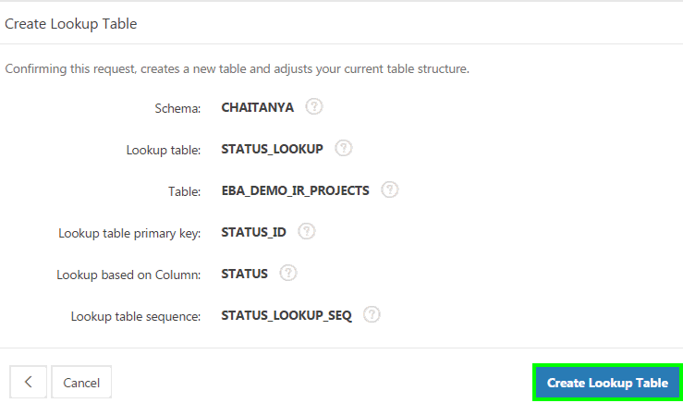
Creating a Lookup Table: Steps
3
4
Notes:
Change the name of the lookup table or sequence (optional step). Click Next.
Click Create Lookup Table.

Slide 12
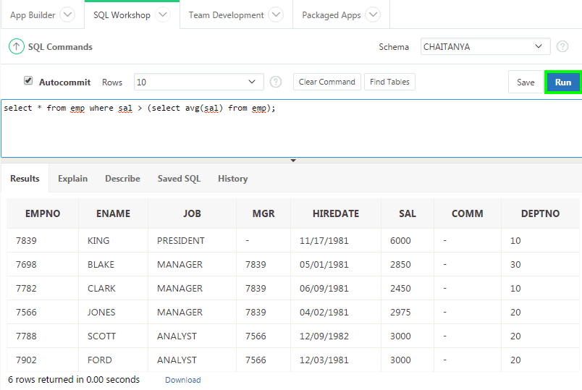
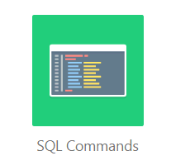
Executing SQL Commands
Command editor
Display Pane
Notes:
You use SQL Commands to create, edit, view, run, and delete database objects. A SQL command can contain SQL statements or PL/SQL blocks. The SQL Commands home page is divided into two sections: a command editor and a display pane. You use the command editor to execute SQL commands and the display pane to view output, saved command lists, and history lists.
The graphic shows a SQL Command is executed and results are displayed in the display pane.
To execute a SQL command:
Select SQL Workshop > SQL Commands
Enter the SQL or PL/SQL statement in the command editor
Click the Run button
View the output on the Results tab of the display pane
Click the Download link to export the results of the query to a spreadsheet (optional step)

Slide 13
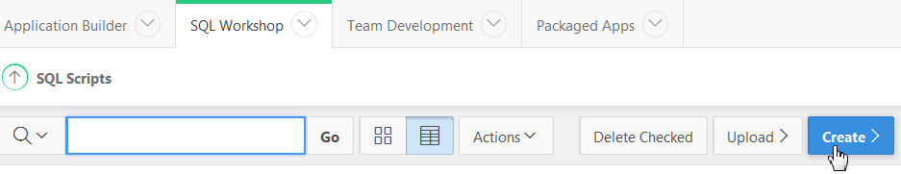
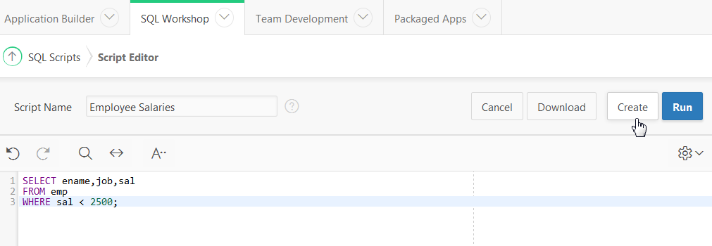
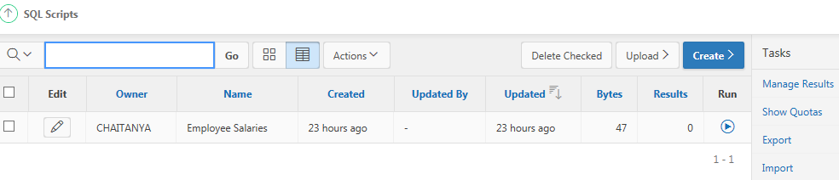
Creating and Running SQL Scripts
1
2
3
Notes:
You use SQL Scripts to create, edit, view, run, and delete script files. The slide shows steps involved in creating and running a SQL script.
Navigate to SQL Workshop > SQL Scripts. Click the Create button.
Enter a name for Script Name. Enter the SQL statements, PL/SQL blocks you want to include in your script. Remember that SQL*Plus commands are ignored at runtime. Click Create.
The SQL Scripts page appears listing your newly saved script. You can now run this script.
You can upload a script from your local file system. Perform the following steps:
Navigate to SQL Workshop > SQL Scripts.
Click the Upload button. The Upload Script dialog appears.
Click Browse to locate the script you want to upload. Optionally enter a new name in the Script Name field. This name displays in the Script Repository.
Click Upload. The SQL Scripts page appears listing your newly uploaded script. You can now run the SQL script that you just uploaded.

Slide 14
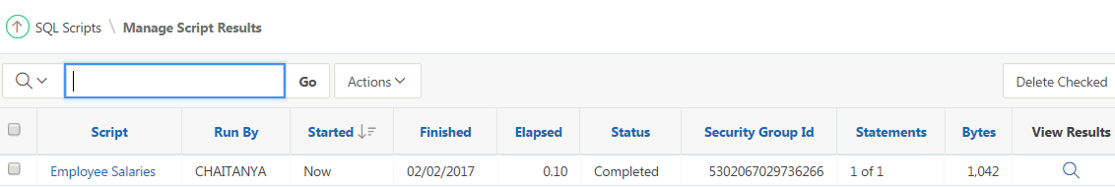
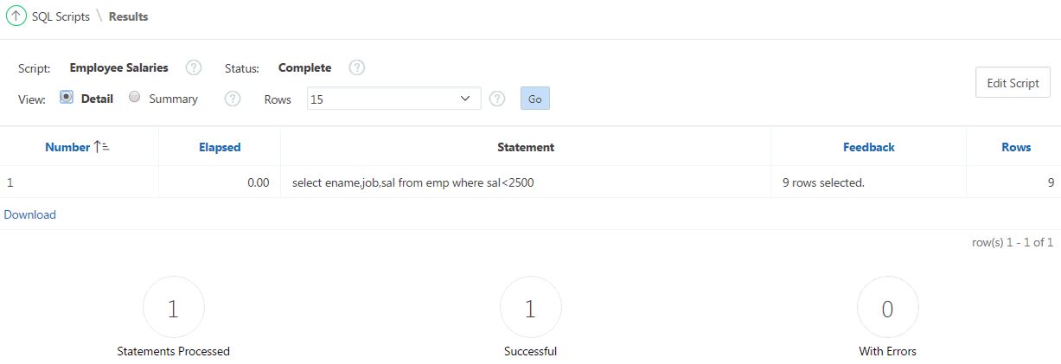
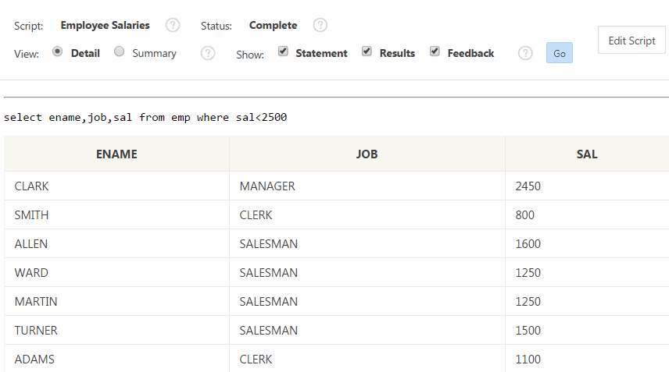
Viewing SQL Scripts Results
Notes:
This slide shows how to view the results of the SQL script that you created in the previous slide. To view the results, first click the Run button for the script
that you created. Then, click Run Now. Perform the following steps:
In the Manage Script Results page, click the View Results icon in the far right column.
The Results page displays a summary. To view details, select Detail radio button and click Go.
Now, you see the script along with the results in detail.

Slide 15
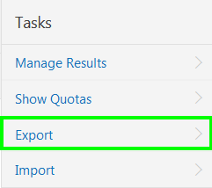
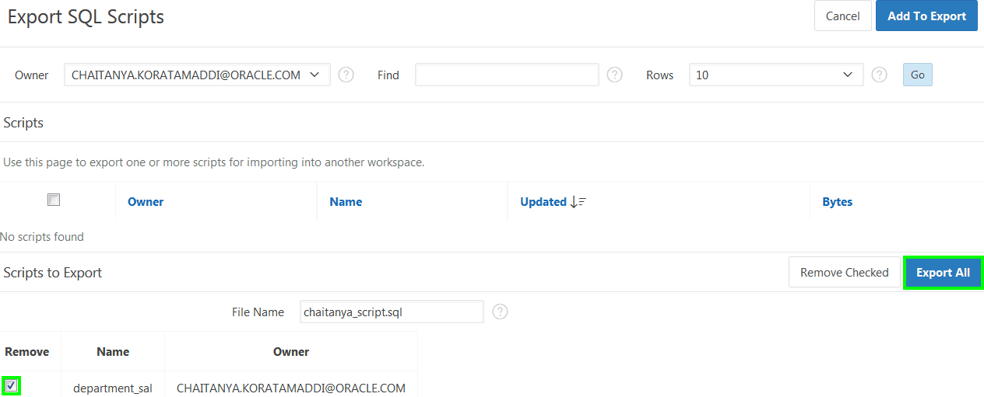
Exporting and Importing SQL Scripts
Notes:
You can transfer scripts from your current Script Repository to a Script Repository in a different workspace by using the Export and Import tasks. Exported scripts are encoded in a single file on your local file system. Once exported, you then log in to another workspace and import the file. During import, the file is run to re-create the scripts in the current Script Repository.
By default, the Export SQL Scripts page lists all scripts in the Script Repository created by the current user. The slide shows that there are two panes on the Export SQL Scripts page: the Scripts pane and the Scripts to Export pane. You use the Scripts pane to select scripts to export. Then, you use the Scripts to Export pane to finalize the scripts to export, to choose a name for the export script, and to save the selected scripts in the export script on your local file system.
To export a script, perform the following steps:
Navigate to SQL Workshop > SQL Scripts.
On the Tasks list, click Export. The Export SQL Scripts page appears.
Select the scripts you want to export. To select all displayed scripts, click the column head check box. Click Add to Export.
The selected scripts are added to the list of scripts in the Scripts to Export pane. Enter a name for the export script in the File Name field. The default script name is workspace_name_script.sql. For example, the slide shows the default script name.
Click Export All to export the scripts to the export script. You are prompted to enter the directory where you want to save the export script.
You can import a script file exported from a different workspace into your current workspace. Note that only script files exported from the scripts repository can be imported. If you try to import any other script, you see a “script not compatible” error. To import a script, perform the following steps:
Click Import on the Tasks list.
Click the Browse button and locate the file to import from your local file system.
Then, click Next and click Import Scripts.

Slide 16
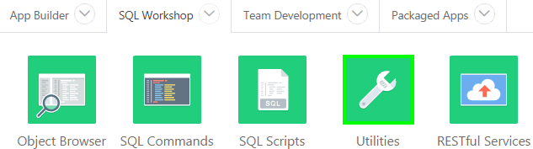
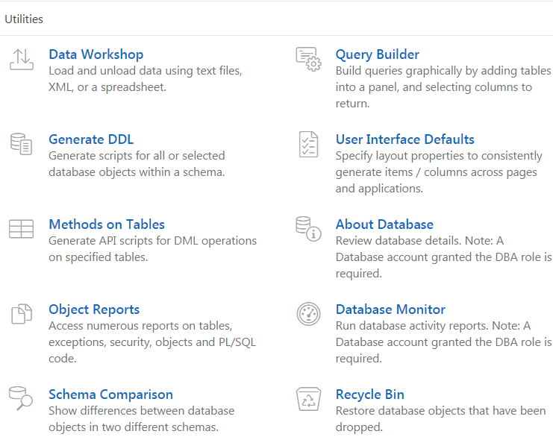
Using Oracle Application Express Utilities
Notes:
Oracle Application Express provides utilities to build SQL queries, load and unload data from an Oracle database, generate DDL, view object reports, manage User Interface Defaults, restore dropped database objects, compare schemas, monitor the database, and view database details. This lesson covers some of these utilities.
The slide shows navigating to the Utilities page. On your Workspace home page, click SQL Workshop. Then, click Utilities.

Slide 17

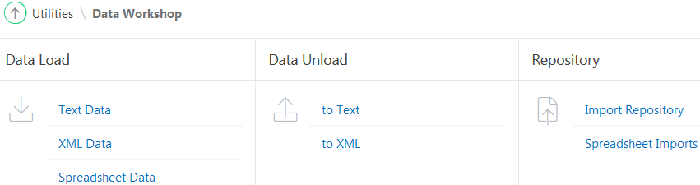
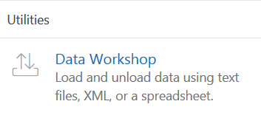
Loading and Unloading Data Using Data Workshop
The Data Load and Data Unload wizards enable you to easily load and unload delimited text data to and from the database
Notes:
The Data Load and Data Unload wizards in Oracle Application Express enable you to easily load and unload delimited text data to and from the database.
To access the Data Load/Unload page, perform the following steps:
On the Workspace home page, click the SQL Workshop icon.
Click Utilities.
Click Data Workshop. The Data workshop page appears.
Click the appropriate icon to load data, unload data, or view the repository.
The following are the limitations of the data load and data unload wizards:
The wizards load and unload table data only. They do not load or unload other kinds of schema objects.
You can load and unload to and from your own schema only. This is also true for users with administrator privileges.
You can load or unload only a single table at a time.
There are no data type limitations for unloading to text or XML files, or for loading from XML files. However, when loading from spreadsheets (through copy and paste) or from text files, only these data types are supported: NUMBER, DATE, VARCHAR2, CLOB, BINARY_FLOAT, and BINARY_DOUBLE
The following are the supported unload formats:
Text such as comma-delimited or tab-delimited data
XML documents

Slide 18
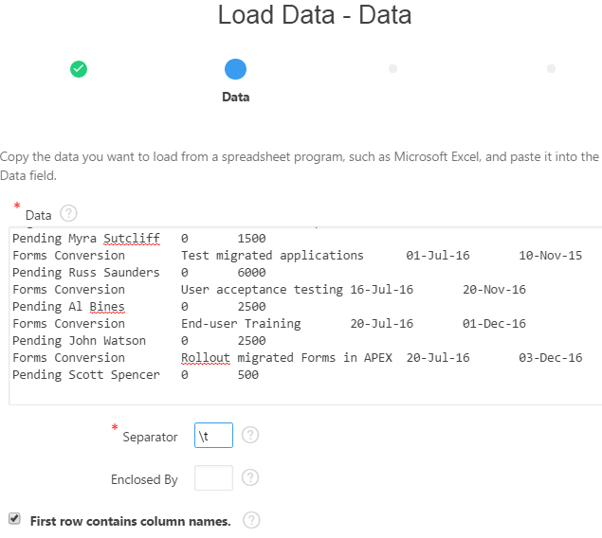
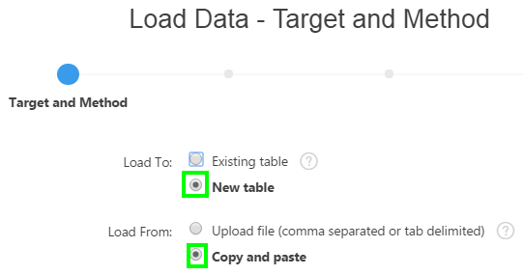
Loading Data Using Data Workshop: Example
Notes:
You can load data into the Oracle Application Express database in the following ways:
Copy and paste data from a spreadsheet.
Upload a spreadsheet file in a delimited format (such as comma-delimited (.csv) or tab-delimited).
Upload a text file containing comma-delimited or tab-delimited data.
Upload an XML document.
Loaded text data files and spreadsheets are stored in the Repository. The slide shows steps involved in loading a text file or spreadsheet data.
Click SQL Workshop > Utilities > Data Workshop
On the Data Load page, click Spreadsheet Data
Select either Existing Table or New Table for Load To. Then, select either Upload file or Copy and paste for Load From. Click Next. The slide example shows selecting New Table for Load To and Copy and paste for Load From
If you selected Upload File in the previous step, then browse through your folders and select the text file to upload. The slide example shows selecting Copy and paste. Navigate to the folder where you have the spreadsheet. Open the spreadsheet, copy the data including the column headings. Now, navigate to your browser and then paste it into the Data field of the load data wizard. Enter the column separator character. Use \t for tab separators. Click Next. Application Express engine parses the data and matches the column names in the first row of the spreadsheet data to the column names of the table into which you are loading the data.
Note: The example uses \t as the column separator character as the data is tab separated. If you do not use this separator for such data then all of the data will be imported into a single column.

Slide 19
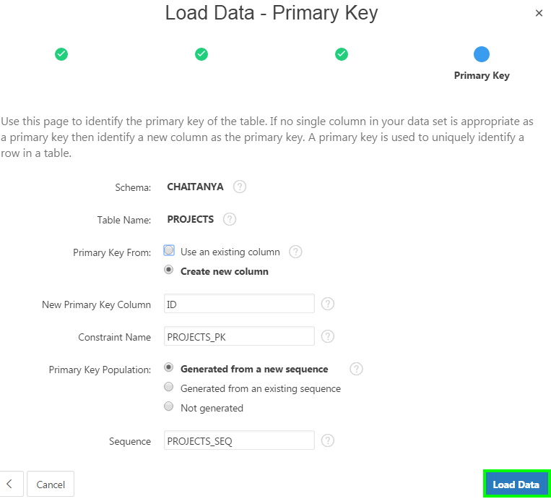
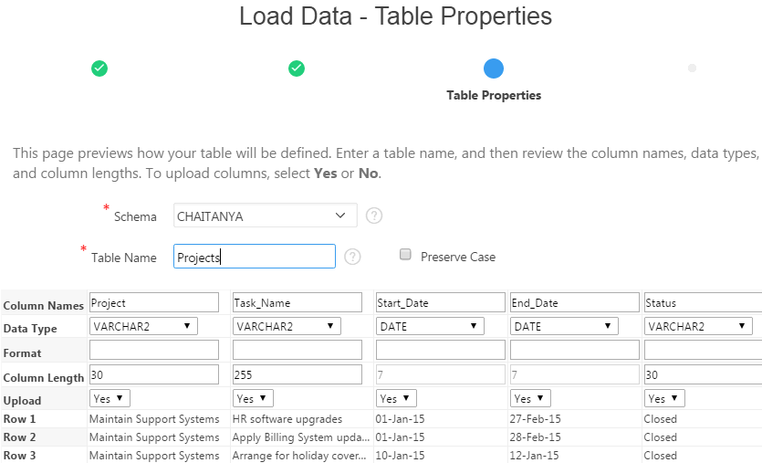
Loading Data Using Data Workshop: Example
Notes:
Specify a name for Table Name. Verify that the column names and data types are automatically picked up. Accept the remaining defaults and click Next.
Select Create new column for Primary Key From. Accept the remaining defaults and click Load Data.

Slide 20
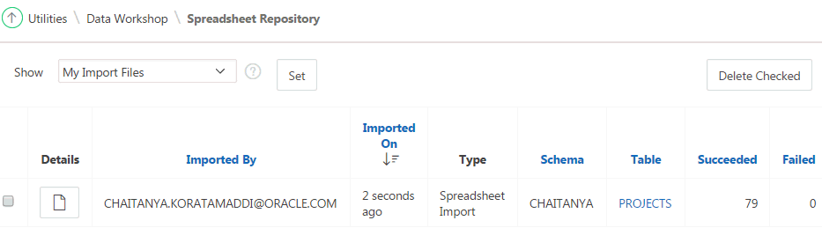
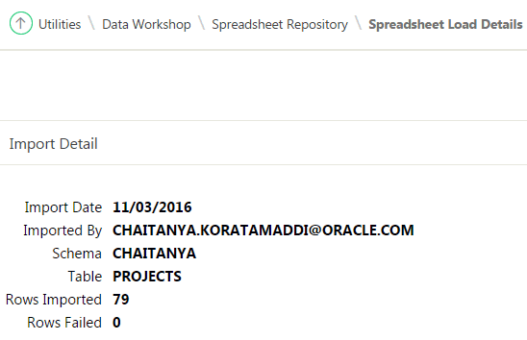
Loading Data Using Data Workshop: Example
Notes:
The file is now uploaded and you can view the same in the Spreadsheet Repository. Click Details to view if the import details and to make sure if all the rows are imported successfully.
Now, navigate to Object Browser and click the table that you just created. Click Data to view the data that you loaded into the table.

Slide 21
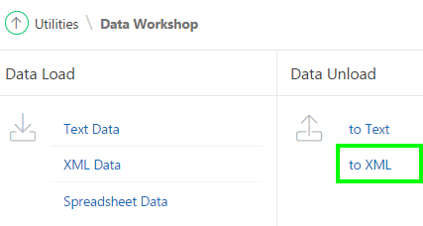
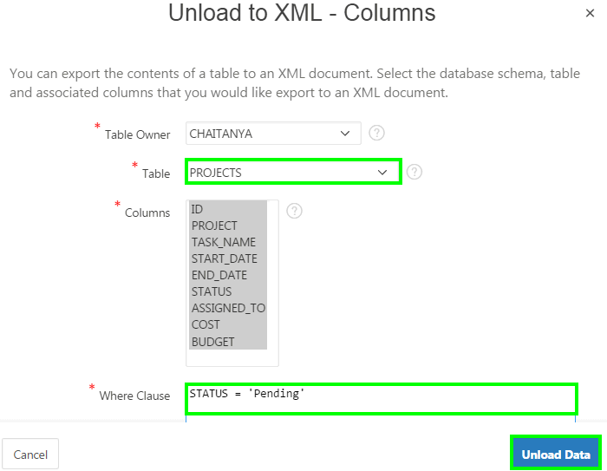
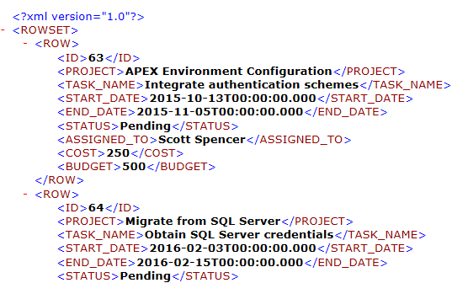

Unloading Data Using Data Workshop: Example
Notes:
You use the Unload to XML Wizard to export the contents of a table to an XML document adhering to the Canonical XML specification. The slide shows an
example of how to unload a table to an XML document. Perform the following steps:
Click SQL Workshop > Utilities
Click Data Workshop. Under Data Unload, click to XML. The Unload to XML Wizard appears.
Select the table to unload. Highlight the columns to include. Optionally enter a Where Clause to limit the records unloaded, and click Unload Data.
The File Download window appears. Click Save to download the file. A browser displays the XML data.

Slide 22
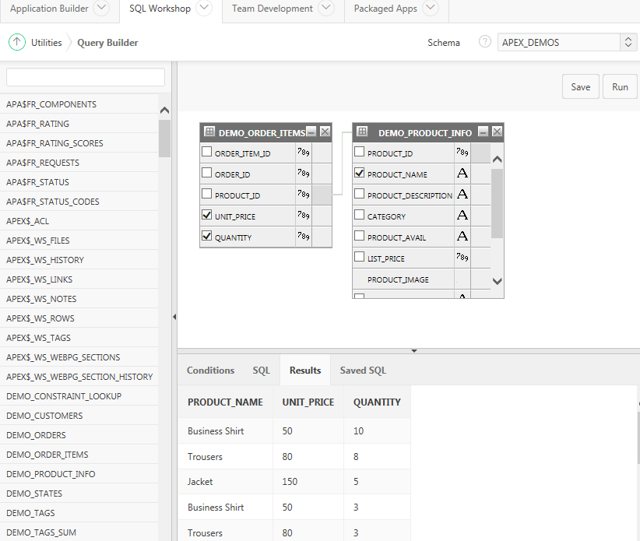
Building a Query Using Query Builder
Object selection pane
3
4
3
Design pane
2
1
Output pane
Notes:
Query Builder's graphical user interface enables database developers to build SQL queries without the need for manual SQL coding. Using Query Builder, you can search and filter database objects, select objects and columns, create relationships between objects, view formatted query results, and save queries with little or no SQL knowledge.
The Query Builder page is divided into three sections:
Object Selection pane displays on the left side of the page and contains a list objects from which you can build queries. Only objects in the current schema display.
Design pane displays to the right of the Object Selection pane and above the Conditions, SQL, Results, and Saved SQL tabs. When you select an object from the Object Selection pane, it appears in the Design pane.
Output pane displays below the Design pane. Once you select objects and columns, you can create conditions, view the generated SQL, or view query results.
To access Query Builder:
On the Workspace home page, click SQL Workshop.
Click Utilities.
Click Query Builder.
The slide shows steps to create and run a query which is a join between the two tables: DEMO_ORDERS and DEMO_PRODUCT_INFO.
In the object selection pane, select the objects from which you want to display data
Select the checkboxes for the columns you want to include in the query
Create a join by clicking the join column in the first table followed by the same join column in the second table
Click the Run button to view the results in the output pane

Slide 23
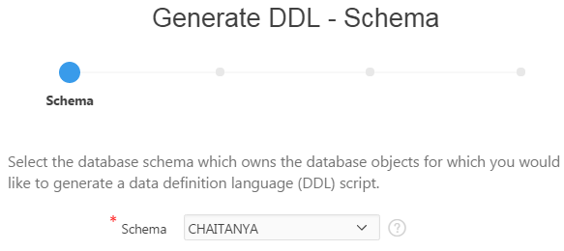
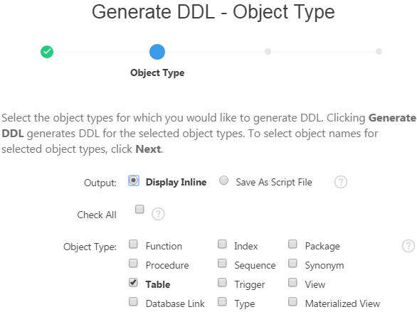
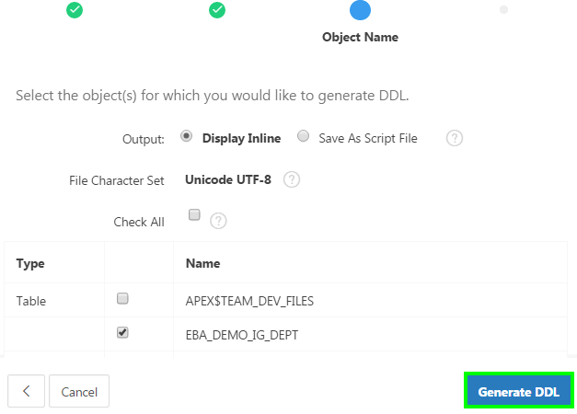
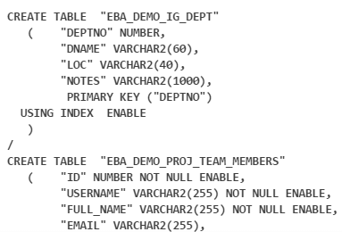
Generating DDL Statements
1
2
4
3
Notes:
With Oracle Application Express, you can generate data definition language (DDL) statements from the Oracle data dictionary. You can use these scripts
to create or re-create database schema objects. This is particularly useful when moving database objects from environment to another, for example from
development to test or production. The scripts can be generated to display inline or saved as a script file.
You can generate DDL statements for:
All the objects for a specific schema
Specific object types
Specific objects
To generate a DDL script, navigate to SQL Workshop > Utilities and then perform the following steps:
Select the database schema which owns the database objects for which you would like to generate a DDL script. Click Next.
Select the object types for which you would like to generate DDL. Clicking Generate DDL at this point generates DDL for the selected object types. If you want to select object names for selected object types, click Next.
Select the objects. Click Generate DDL.
View the generated script.

Slide 24
Summary
In this lesson, you learned how to:
  Navigate to SQL Workshop and review its components
  Browse through database objects using the Object Browser
  Create a lookup table
  Run SQL commands and SQL scripts
  Load and unload data using the Data Workshop utility
  Build a SQL query using Query Builder
  Generate DDL statements
Notes:
In this lesson, you learned how to interact with the database using the SQL Workshop components.

Slide 25


Slide 26
Hands-On Lab

