Slide 2

Unit 1: Getting Started with
Oracle Application Express

Slide 3
Lesson Objectives
After completing this lesson, you should be able to:
Describe Oracle Application Express
Explain the key features of Oracle Application Express
List and describe the components of Oracle Application Express
Describe Oracle Application Express architecture
Log in to Oracle Application Express
Install and run a packaged app
Notes:
In this lesson, you are introduced to Oracle Application Express.

Slide 4


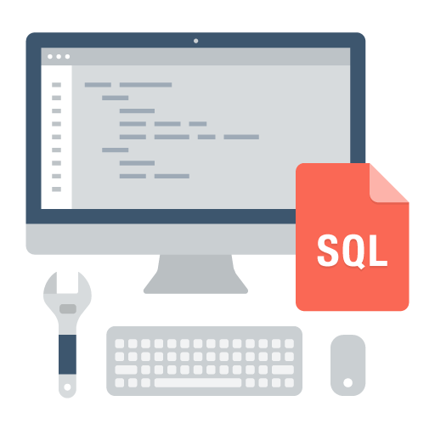
What is Oracle Application Express?
Database-centric web application development framework
Develop desktop and mobile web apps
Visualize and maintain
database data
Leverage SQL Skills and database capabilities
Notes:
Oracle Application Express (Oracle APEX) is a rapid Web application development tool for the Oracle Database.
Oracle Application Express enables you to design, develop and deploy beautiful, responsive, database-driven applications using only your web browser. You use Oracle APEX to build desktop and mobile applications for the Oracle Database.
Using Oracle Application Express you can quickly build reports, forms, charts, calendars, etc. on top of the data in your database.
Oracle Application Express enables organizations to capitalize on their existing investment in SQL and PL/SQL skills. Few programming skills are required, and anyone can quickly learn to develop applications. With Oracle Application Express, applications are built faster, with fewer developers.

Slide 5
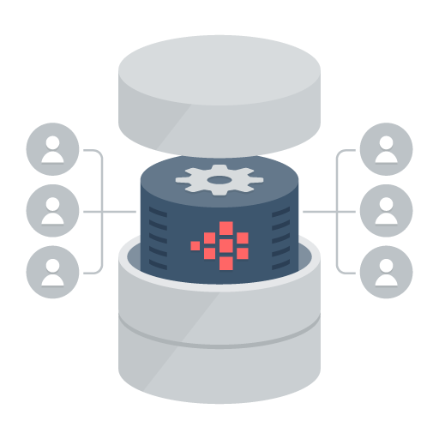
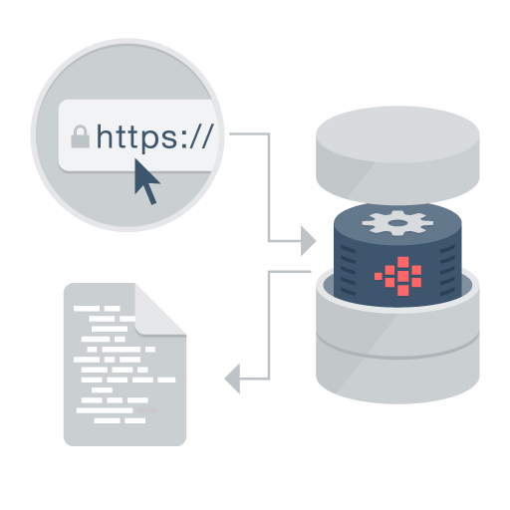

Oracle Application Express: Distinguishing Characteristics
Distinguishing Characteristics
App Development IDE is a web browser.
No client software needed
App definitions are stored in the database as meta data.
Declarative – No code generation
Page generation is efficient with only one request and one response.
Data processing done in the Database
Notes:
With Oracle Application Express, you simply use a web browser and the URL to access the development environment, or the URL and user credentials to run the application. You do not need any client software.
If you have the Oracle Database, you already have Application Express. Since 2004, Application Express has been a fully supported and no-cost feature of the Oracle Database. Your application developed in Oracle Application Express does not require complex build scripts to run in production. More importantly, your application automatically scales with your Oracle Database. You can seamlessly move applications to and from the Oracle Database Cloud Service, private (on premise) clouds and other public cloud services. Oracle Application Express installs with your Oracle Database and is comprised of data in tables and PL/SQL code. Whether you run the Oracle Application Express development environment or an application you built using Oracle Application Express, the process is the same. Your browser sends a URL request that is translated into the appropriate Oracle Application Express PL/SQL call. After the database processes the PL/SQL, the results are relayed back to your browser as HTML. This cycle happens each time you request or submit a page. The application session state is managed in the database tables within Oracle Application Express. It does not use a dedicated database connection. Instead, each request is made through a separate database session, consuming minimal CPU resources.

Slide 6




Oracle APEX Architecture
3 Tier Architecture
Data
Schemas
Oracle APEX
Engine
Oracle
Database
Browser
Mid Tier
Database Tier
ORDS = Oracle REST Data Services
Notes:
The Oracle Application Express architecture requires some form of Web server to proxy requests between a client Web browser and the Oracle Application Express engine. The Web server options include:
Oracle REST Data Services: Oracle REST Data Services (ORDS) is a Java based, free tool that is fully supported when used with Oracle WebLogic Server, Oracle Glassfish Server, and Tomcat.
Embedded PL/SQL Gateway: The Embedded PL/SQL Gateway (EPG) runs in the Oracle XML DB Protocol Server within the Oracle Database and includes the core features of mod_plsql.
Oracle HTTP Server: The Oracle HTTP Server (Apache) with mod_plsql plugin can be placed on the same physical machine as the database, or on a separate physical machine. Please note that mod_plsql is deprecated as of Oracle HTTP Server 12c (12.1.3).

Slide 7


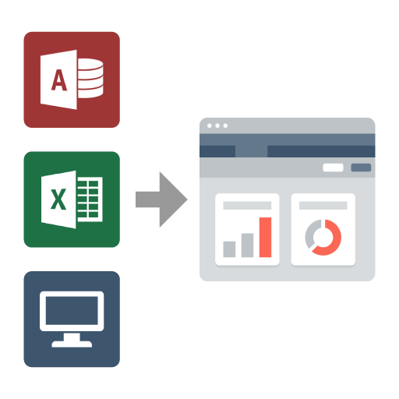
Oracle APEX - Use Cases
Use Cases
Developing opportunistic & self service web apps
Extending enterprise application solutions
Migrating file based and client server apps to the web
Notes:
Typical use cases of APEX are:
Rapidly build applications that are needed quickly to meet changing business requirements and maximize competitive advantage. For example, you quickly build self-service web applications to be used by all employees/partners in your organization
Extend enterprise application solutions in order to meet your specific business requirements
Migrate file based and client-server applications to the web. For example, you use APEX to convert a spreadsheet in to a multi-user, secure, robust database application.

Slide 8
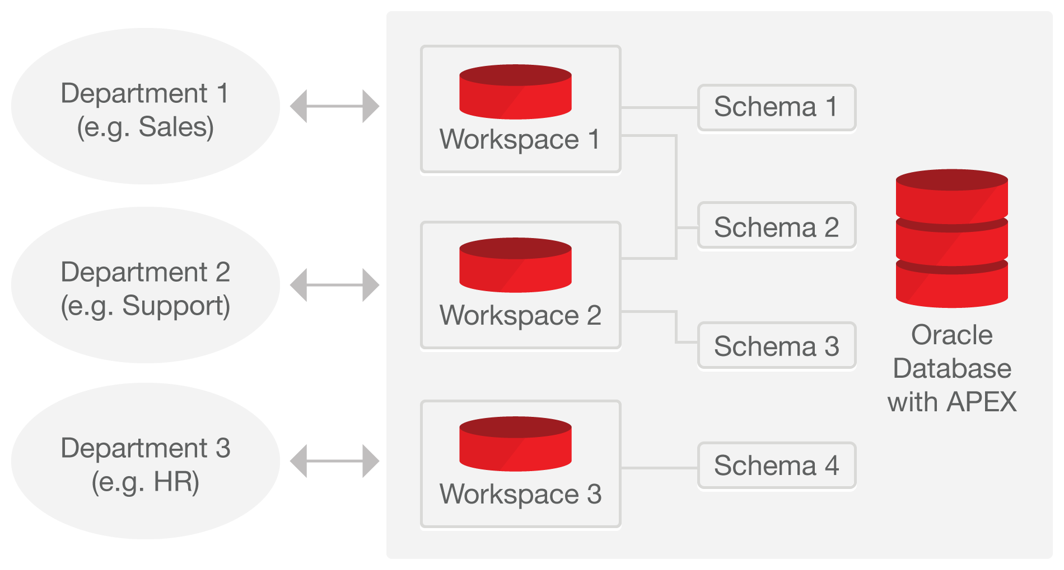
Oracle APEX - Concepts
Notes:
Workspace: A workspace is a logical work area which is associated with one or more Oracle database schemas. The schema(s) store the database objects that you build your applications on. A workspace enables multiple users to work within the same Oracle Application Express installation while keeping their objects, data and applications private. Each workspace has a unique ID and name.
Application: An application is an HTML interface that exists on top of database objects such as tables or procedures. Using Oracle Application Express, you create both database applications and Websheet applications. The main difference between these two types of applications is the intended audience. While database applications are primarily developed by application developers, Websheet applications are often created by end users with no development experience. In this course, you learn how to develop database applications.
User roles: Oracle Application Express users are divided in to four primary roles as:
End users do not have access to development or administrative capabilities. End users cannot sign into a workspace and create applications. End users can only run existing database or Websheet applications.
Developers are users who create and edit applications.
Workspace administrators are users who perform administrator tasks specific to a Workspace such as managing user accounts, monitoring workspace activity, and viewing log files.
Instance administrators are super users that manage an entire hosted instance using the Application Express Administration Services application. Instance administrators manage workspace provisioning, configure features and instance settings, and manage security.

Slide 9
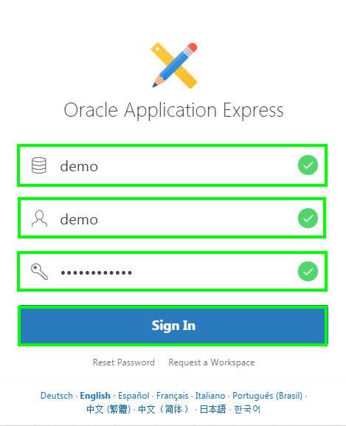
Logging In to a Workspace
Steps:
Enter the URL in your browser address bar.
Enter the workspace name.
Enter the username and password.
Click Sign In.
Notes:
To log in to Oracle Application Express, you need to specify the workspace name, the username and password created for that workspace. You can log in to Oracle Application Express either as a workspace administrator or as a developer.
Perform the following steps to log in to your Application Express Workspace:
You access the Oracle Application Express environment with the URL: http://<hostname>:<port>/apex
The login page appears. Enter the workspace name, username, and password.
Click Sign In. You may be prompted to change your workspace password the first time you log in.

Slide 10
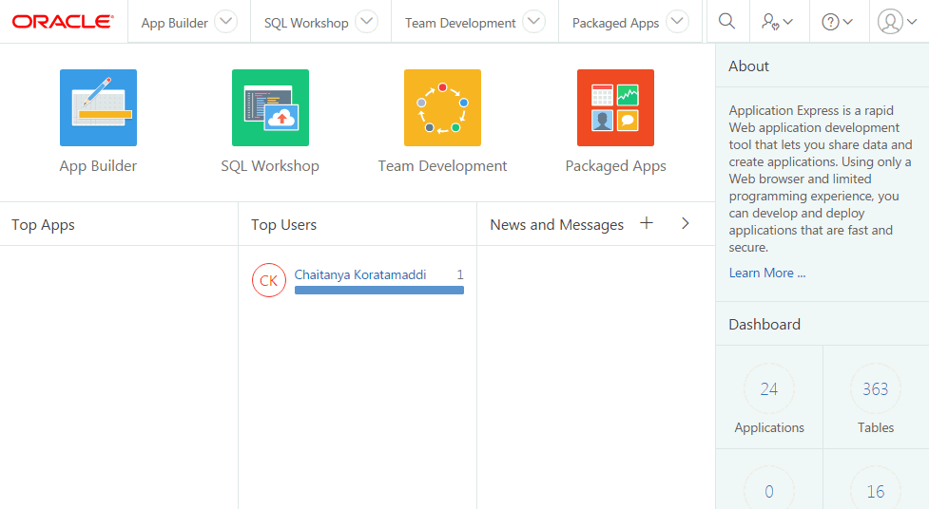
Oracle Application Express – Major Components
Comprehensive Development IDE, Web Application Development, and SQL Database Development
Notes:
When you sign in to Oracle Application Express development environment, the Workspace home page appears. The Oracle Application Express development environment consists of four components:
App Builder
SQL Workshop
Team Development
Packaged Apps

Slide 11
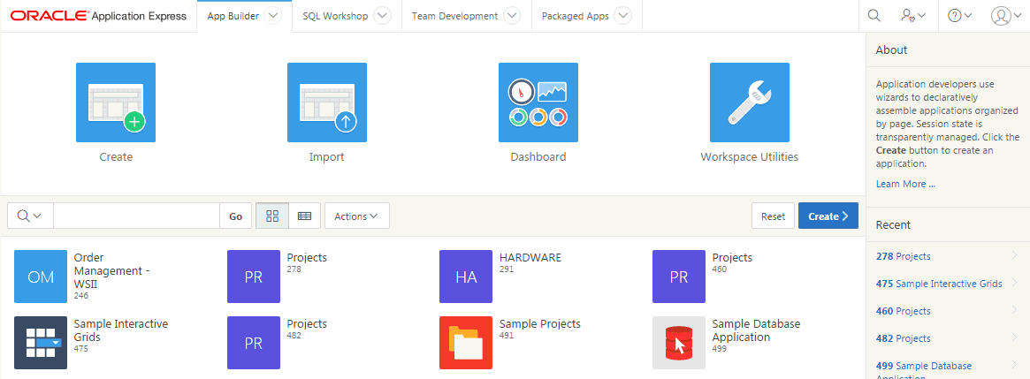
Oracle Application Express – App Builder
Notes:
Developers use App Builder to create the pages that make up an Oracle Application Express application. You spend the majority of your time in the App Builder defining, enhancing and maintaining applications.

Slide 12
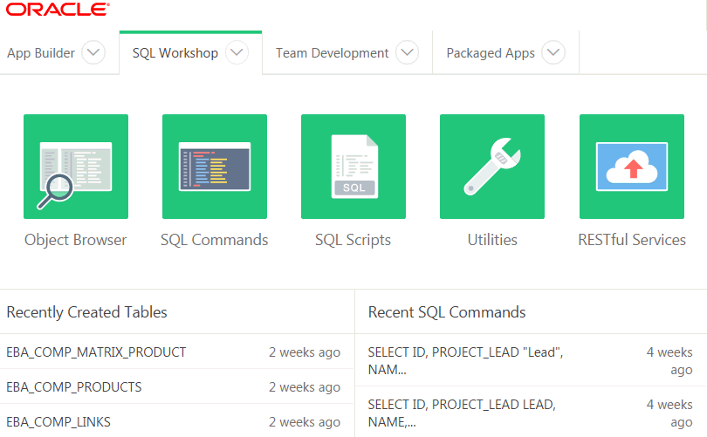
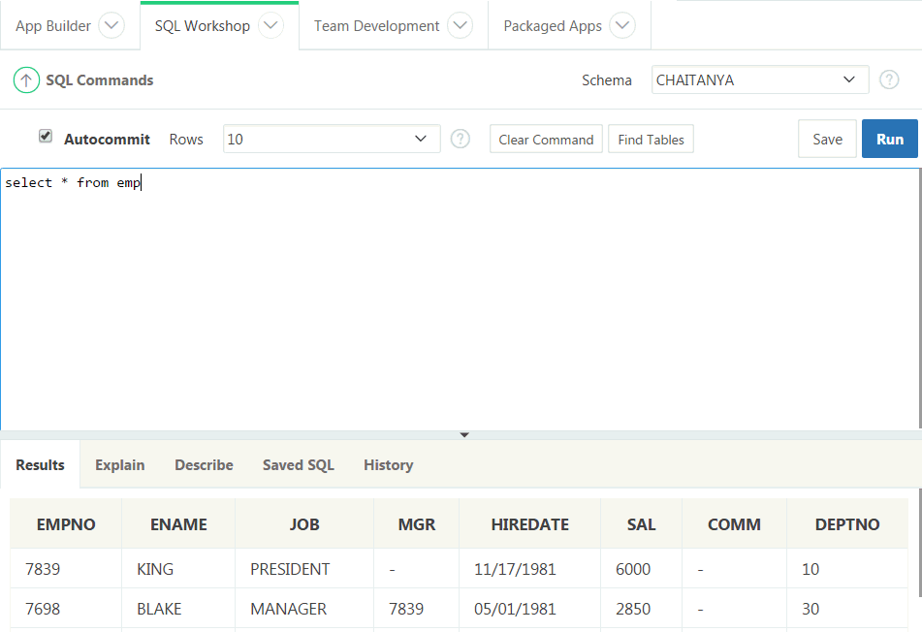
Oracle Application Express – SQL Workshop
Browser based maintenance of database objects and data
Designed to meet application developers’ needs, especially in hosted environments
Notes:
The SQL Workshop provides tools to view and manage database objects and data. SQL Workshop is sometimes the only means developers can maintain DB objects as they may not have direct access to the schema(s) via SQL*Net, especially if they are using a hosted service. The functionality available through SQL Workshop is a subset of SQL Developer and is designed specifically for developers to be able to maintain their DB objects.

Slide 13
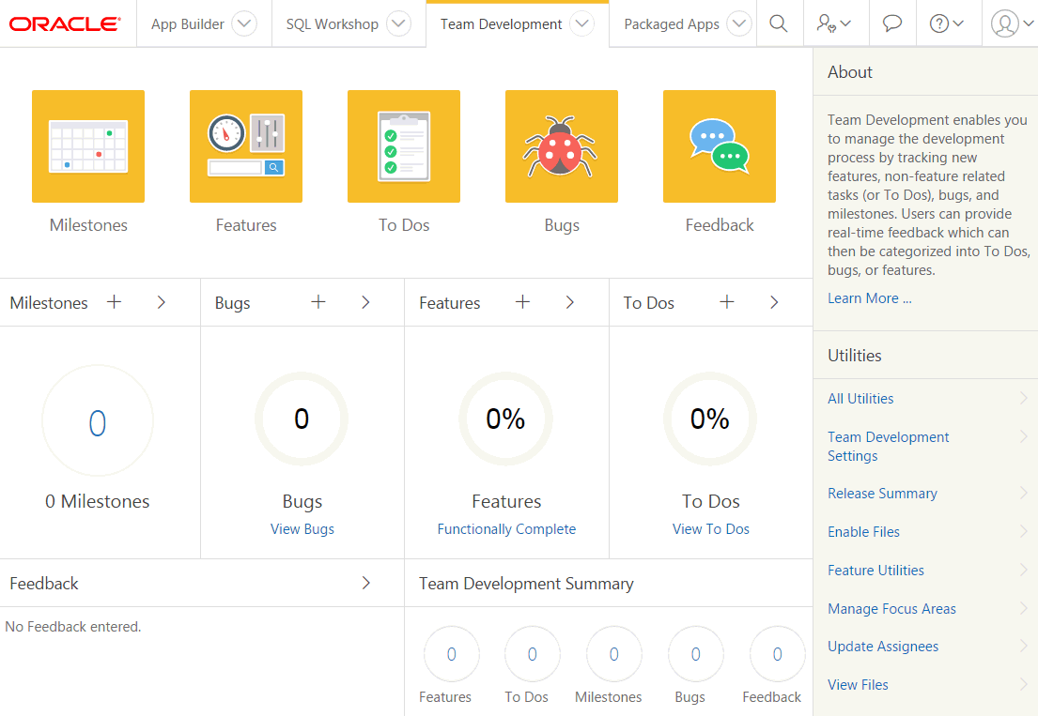
Oracle Application Express – Team Development
Collaborate with colleagues, track project details with associations to application pages. Life cycle development: design, develop, deploy, view customer feedback, enhance, re-deploy.
Notes:
Team Development provides the ability to manage the full lifecycle of your application development. Features, To-Dos, and Bugs can be assigned to specific applications and pages. Feedback allows developers to easily gather comments, enhancements, and bugs directly from their user community and includes important session state information to assist the developers with diagnosis.

Slide 14
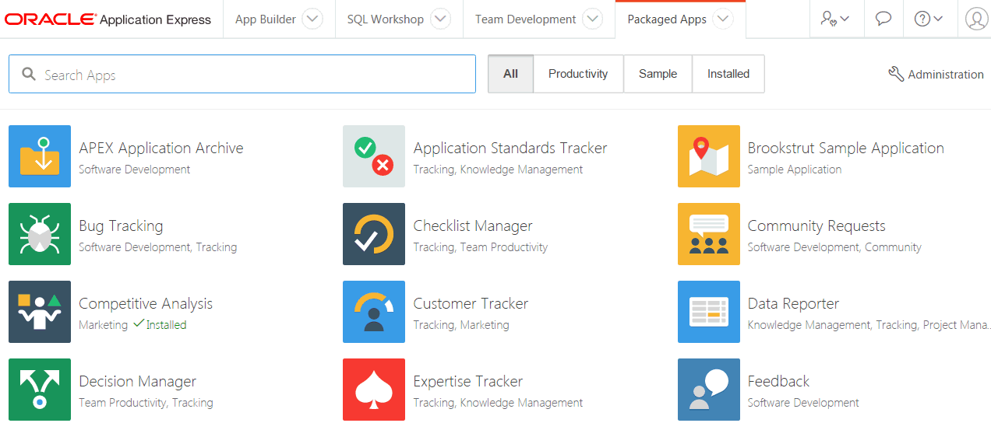
Oracle Application Express – Packaged Apps
Notes:
Packaged apps are a suite of business productivity applications, easily installed with only a few clicks. These solutions can be readily used as production applications to improve business processes and are fully supported by Oracle. Packaged Applications also include a collection of sample applications which demonstrate some of the major features of Oracle Application Express.

Slide 15
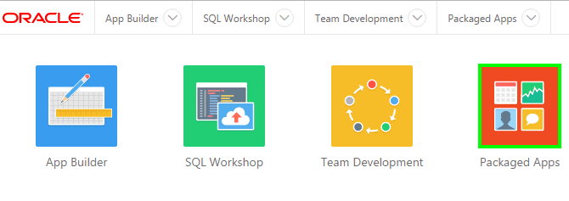
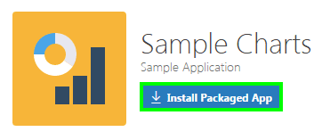
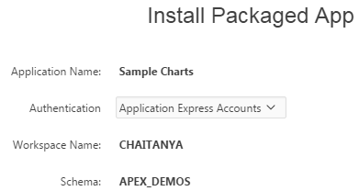
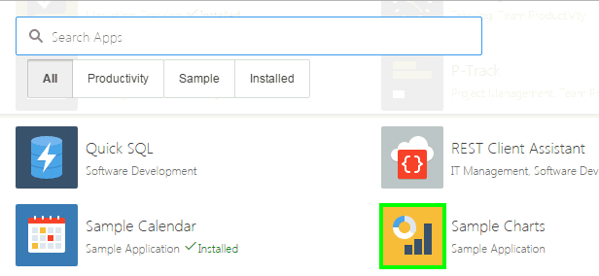
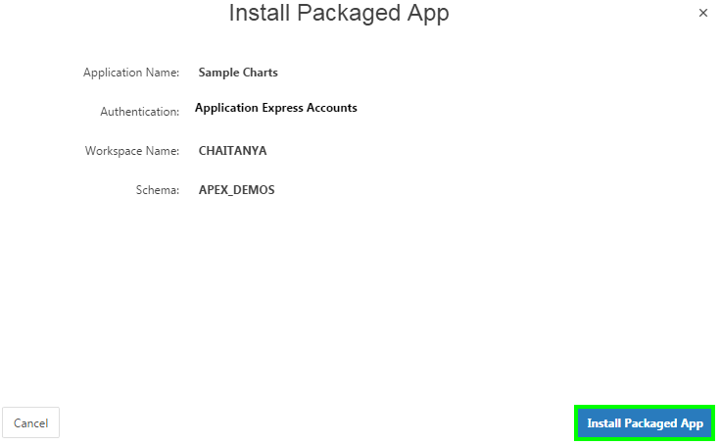
Installing a Packaged App
1
3
4
2
5
Notes:
The slide shows steps to install a packaged app in your Oracle Application Express Workspace.
Log in to your Oracle Application Express Workspace. On the Workspace home page, click Packaged Apps.
From the list of applications, select the packaged application that you want to install. For example, in the slide, you select Sample Charts application.
Click Install Packaged App to initiate the process of installing the application
Accept the defaults for authentication and click Next.
Now, click Install Packaged App. The application gets installed in your workspace.

Slide 16
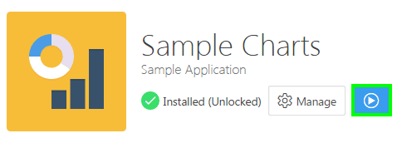
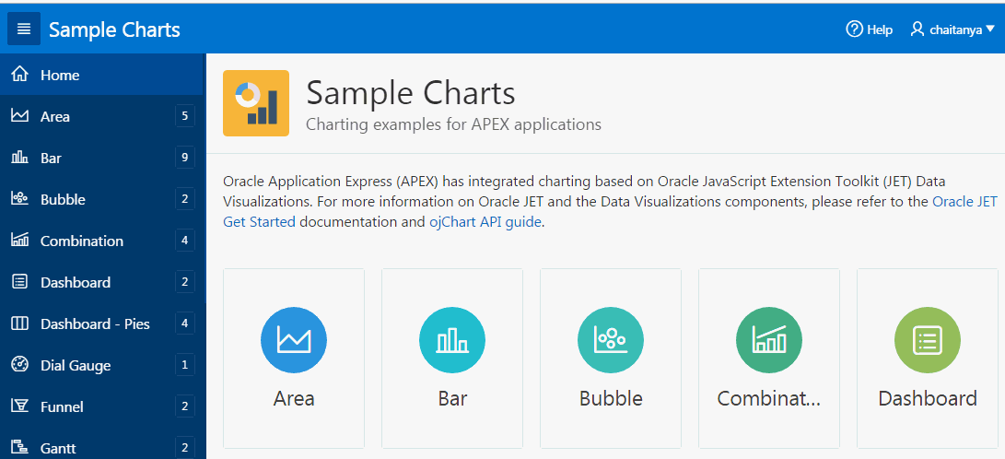
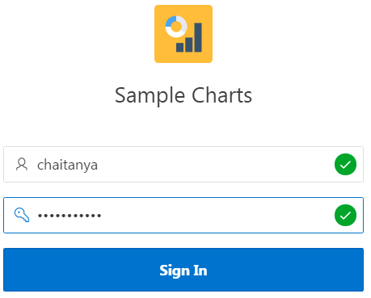
Running the Packaged App
1
2
Sample Charts Packaged Application
Notes:
After installing the packaged app as in the previous slide, you run the application.
Click Run Application.
Enter your Username and Password. Click Sign In. The application home page appears.

Slide 17
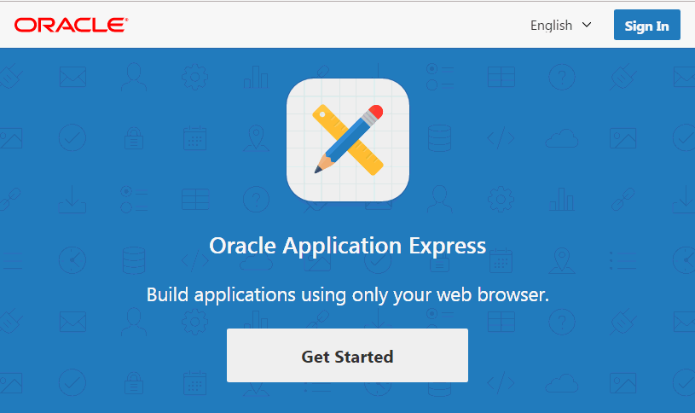
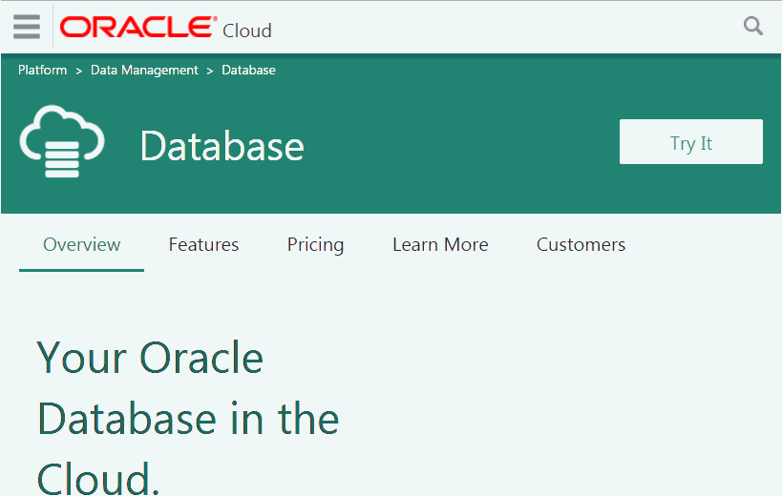
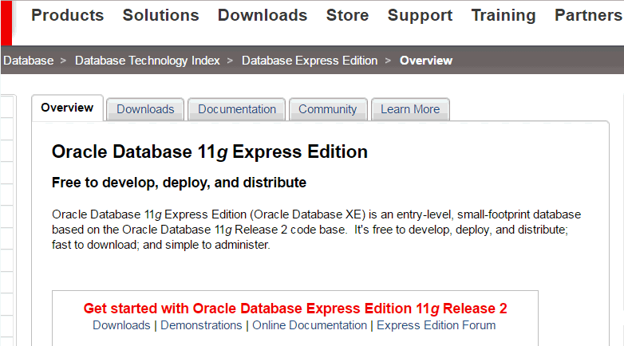
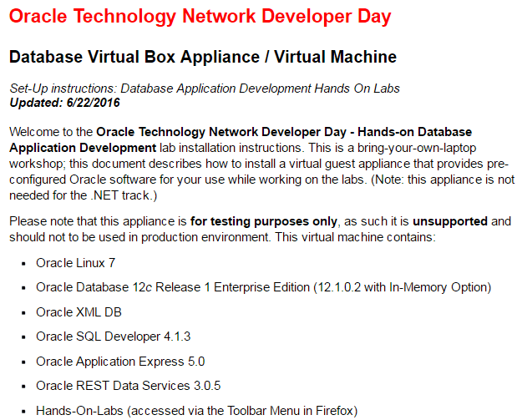
Getting Started
Oracle Database Cloud Service
apex.oracle.com
Oracle VM
Virtual Box
Oracle Database XE
Notes:
To get stared with using Oracle Application Express, the first step is to obtain an Oracle Application Express workspace. Select the most appropriate option from those listed below to obtain a workspace:
apex.oracle.com - Request a workspace on our free 'development only' service for evaluating the technology.
Oracle Database Cloud Service - Request service on the Oracle Database Cloud Service. Once provisioned you will be provided access to your cloud service which includes an Oracle Application Express Workspace.
Oracle Database 11g Express Edition - Download Oracle XE and install on your laptop or desktop machine and then download the latest Application Express release and follow these instructions.
Oracle VM Virtual Box - Download Oracle VM Virtual Box and then import the Database Application Development Appliance which includes Oracle Database 12c, Application Express and a number of labs pre-installed.
Note: The steps and screenshots in this student guide use the Workspace on apex.oracle.com.

Slide 18
Summary
In this lesson, you learned how to:
Log in to Oracle Application Express development environment
Navigate through the major components of Oracle Application Express
Install and run a packaged application

Slide 19


Slide 20
Hands-On Lab

