Slide 2

Oracle Application Express:
Developing Database Web Applications

Slide 3
Course Objectives
After completing this course, you should be able to:
  Create and run a database web application
  Manage your database application pages and page components
  Develop, use, and customize different types of reports in your application
  Create, use and modify forms in your application
  Build and use different types of charts in your application
  Customize the look and feel of your application
  Implement security in your application
  Migrate your application between environments
Notes:
In this course, you learn how to design, develop and deploy beautiful, responsive, database-driven web applications using Oracle Application Express.

Slide 4
Course Agenda
  Unit 1: Getting Started with Oracle Application Express
  Unit 2: Using SQL Workshop
  Unit 3: Creating a Database Application
  Unit 4: Managing Pages in Page Designer
  Unit 5: Developing Reports
  Unit 6: Managing and Customizing Interactive Reports
  Unit 7: Managing and Customizing Interactive Grids
  Unit 8: Creating and Using Forms

Slide 5
Course Agenda
  Unit 9: Creating Application Page Controls
  Unit 10: Adding Computations, Processes, and Validations
  Unit 11: Implementing Navigation in your Application
  Unit 12: Using Themes and Theme Styles
  Unit 13: Implementing Security in your Application
  Unit 14: Adding Additional Pages to your Application
  Unit 15: Creating and Using Dynamic Actions and Plug-ins
  Unit 16: Migrating Application Development Between Environments

Slide 6
What You Should Know Beforehand
  Basic knowledge of SQL
  Basic knowledge of PL/SQL, and HTML is beneficial
  Basic understanding of Web applications even as an end user

Slide 7
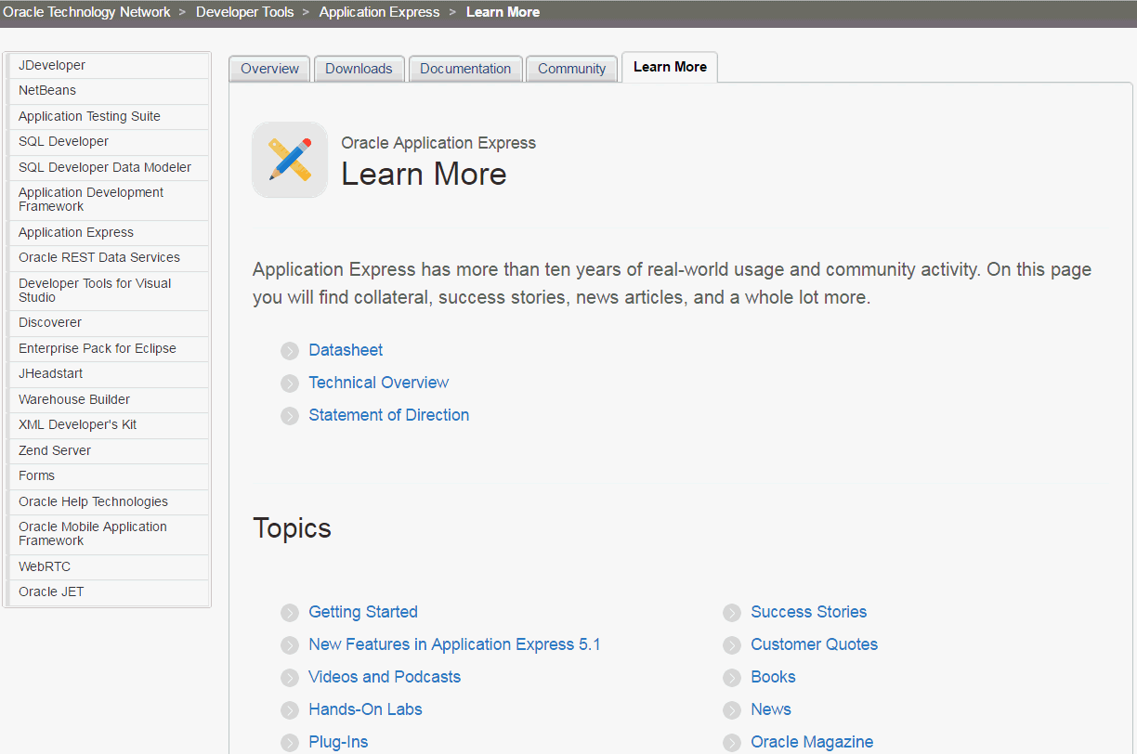
Learn More…
https://otn.oracle.com/apex

Slide 8


